Slide 1
Social Media as Digital Companionship: Scaffolding in the E-Learning Context
Long-Sheng Lin¹, Tsai-Fei Lin²
¹Department of Business Administration, Tainan University of Technology, Taiwan
²Institute of Human Resource Management, National Sun Yat-Sen University, Taiwan
Presented at 2018 ELFASIA, NTUB

Slide 2
Presentation outline
The prevalence of social media and its usage in the classroom
The research IN PROGRESS
PRELIMINARY RESULTS
LOOKING FORWARD

Slide 3
The prevalence of social media
Social media has become an essential part of personal life as users generate content, share photos, choose to "like", or interact in a game (tess, 2013).
According to data-analysis firm Statista, facebook penetration rate here in taiwan is 82%, higher than anywhere else in the world.
nearly 95% of Taiwanese had used Facebook, compared with just 26% for Instagram and about 33% for Google+ (MIC, 2017).
Nearly 97% of Taiwanese under 19 had used facebook.

Slide 4
Social media in the classroom ?
Extant research on the use of social media in the context of learning exhibits inconsistent or sometimes conflicting results.
social constructivism (McLoughlin & Lee, 2010) and situated learning theorists TEND to support social media use in the classroom (Hung & Yuen, 2010).

Slide 5
Social media in the classroom ?
However, several researchers questioned the ability of social media to foster debate and disagreement, which is a crucial component of learning (Friesen & Lowe, 2011).
Specifically, how social media usage by college students affects academic learning outcomes remains under-examined.

Slide 6
The research question
the current study aims to explore whether the complementarity effects of social media use in e-learning class setting exist .
adopting the scaffolding perspective to investigate the companionship effects.
Will social media usage enhances student participation or engagement?
Will social media usage leads to better learning achievement?

Slide 7
The research IN PROGRESS
We collected data from a class of 41 college students in a business related course. 37 students major in business & management related fields, 4 students non-business background.
The course (Human resource analytics, 2018 SPRING) introduce basic knowledge about using analytical tools and concepts to support managerial decision making of corporate human resources.
the course adopts a hybrid approach by combining distant learning (2/3 of the course hours) and "brick and mortar“ classroom teaching (1/3).

Slide 8
Social media setting
Dedicated private Facebook group for the course was set up and the students were invited to join the group.
The posts in the group were mainly course-related and discussions were centered on course activities.
Interaction data within the Facebook group was then collected and linked to student engagement and learning achievements.

Slide 9
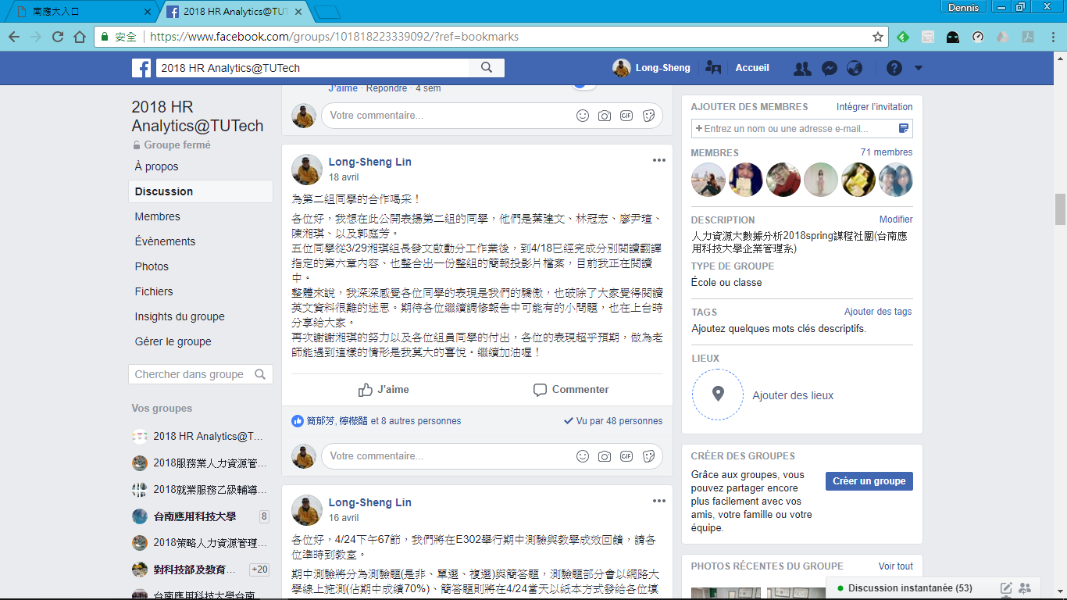
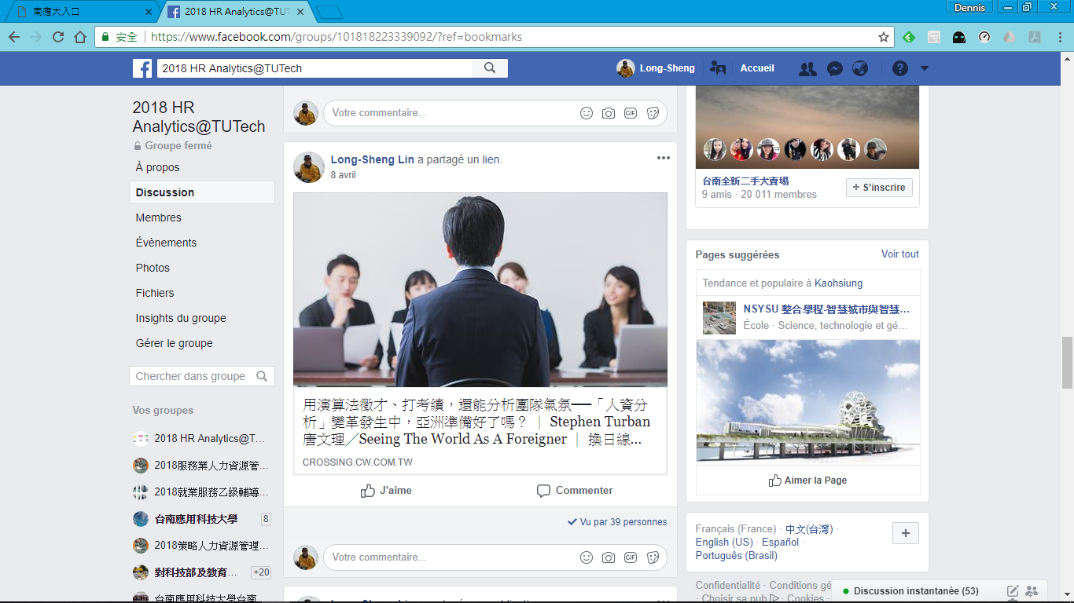

Slide 10
Data collection SO FAR
Student social media usage measured by the number of article vues and LIKES.
STUDENT PARTICIPATION MEASURED BY THE NUMBER OF POSTS IN THE DISTANT LEARNING CLASS BOARD.
STUDENT ENGAGEMENT MEASURED BY THE NUMBER OF ATTENDANCE IN THE DISTANT LEARNING CLASS.
LEARNING ACHIEVEMENT MEASURED BY THE MIDTERM EXAM GRADE.

Slide 11
PRELIMINARY RESULTS OF ANALYSIS
The initial results showed some supporting evidence of scaffolding effects, while further analysis might reveal more details.
THE CORRELATION BETWEEN SOCIAL MEDIA USAGE (MEAN 14.6, sd 7.4) AND PARTICIPATION (MEAN 2.6, sd 1.8) IS NON-SIGNIFICANT.
THE CORRELATION BETWEEN SOCIAL MEDIA USAGE AND LEARNING ACHIEVEMENT (MEAN 69.3, SD 17.1) IS ALSO NON-SIGNIFICANT.
THE CORRELATION coefficient BETWEEN SOCIAL MEDIA USAGE AND ENGAGEMENT (MEAN 23.8, SD 18.4) IS .38* AND SIGNIFICANT.

Slide 12
PRELIMINARY SYNTHESIS
SOCIAL MEDIA USE CAN BE POSITIVELY ASSOCIATED WITH STUDENT ENGAGEMENT, BUT NOT LINKED TO PARTICIPATION AND LEARNING ACHIEVEMENT.
The current study MIGHT contribute to the extant literature by offering some insights of how social media use can complement e-learning process and act as the digital companion for the college students.
The research results can offer theoretical and practical recommendations for RESEARCHERS, teachers and students.

Slide 13
Thanks for your attention.
Questions and Comments welcomed

