Slide 1
Learners’ engagement with Clickers: Attention and EEG alpha waves in blended learning with Students’ Response System (SRS)
Dr. Kevin Chan
Department of Applied Social Sciences
The Hong Kong Polytechnic University

Slide 2
Background
Students’ response system (SRS) & mobile EEG
Ubiquitousness of e-learning technology opens new arrays of possibilities in innovative teaching practice
Use of students’ response system (SRS) has been suggested to enhance engagement in learning, yet underlying attentional and cognitive processes remain unresolved
Recent advances in mobile electro-encephalogram (EEG) allow monitoring of students’ attention level in a naturalistic learning environment

Slide 3
Student Response system
Means of interactive learning
Student response system (SRS), also known as “Clickers”, is a medium allowing students in class to respond to teachers’ questions instantly with simple portal keypads or smart devices

Slide 4
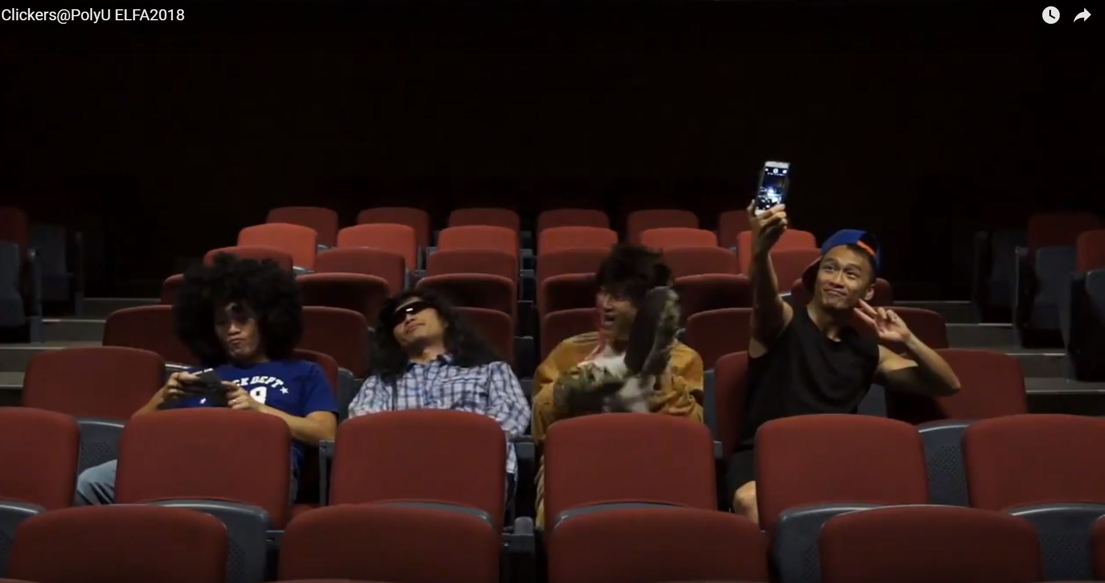
Notes:
https://www.youtube.com/watch?v=fLiHODfpO9w

Slide 5
Clickers usage at PolyU
Descriptive figures on clickers usage
SRS adoption at the participating institutions has experienced substantial growth
By 1st semester of the 2017-2018 academic year, the cumulative frequency of students engaging in clickers activities at the PolyU has reached a total of 30,000+ students.
Over 130 teachers have adopted SRS in their classes respectively
Over 2,500 sessions of SRS have been launched in more than 400 classes

Slide 6
Mobile EEG
Why do we need it?
EEG studies are typically conducted in a laboratory
The experimental environment is controlled and recording conditions are kept consistent across subjects
High precision but low on ecological validity
Mobile EEG: It’s small, lightweight & wirelessly
Over the years, the advancement of mobile EEG makes the system easier and faster to use
Mobile EEG allows monitoring of neural activities in a less costly and non-intrusive fashion

Slide 7
Methods
EEG experimental session
Participants (81 undergraduate students) were randomly assigned into one of the 2 experimental conditions:
2-SRS-polling-sessions condition
Vs
1-SRS-polling-session
Gender: 34 male ♂ & 47 female ♀
We excluded 7 cases in the analyses due to technical problems on sensor connectivity
A typical experimental session lasts for 15-20 minutes

Slide 8
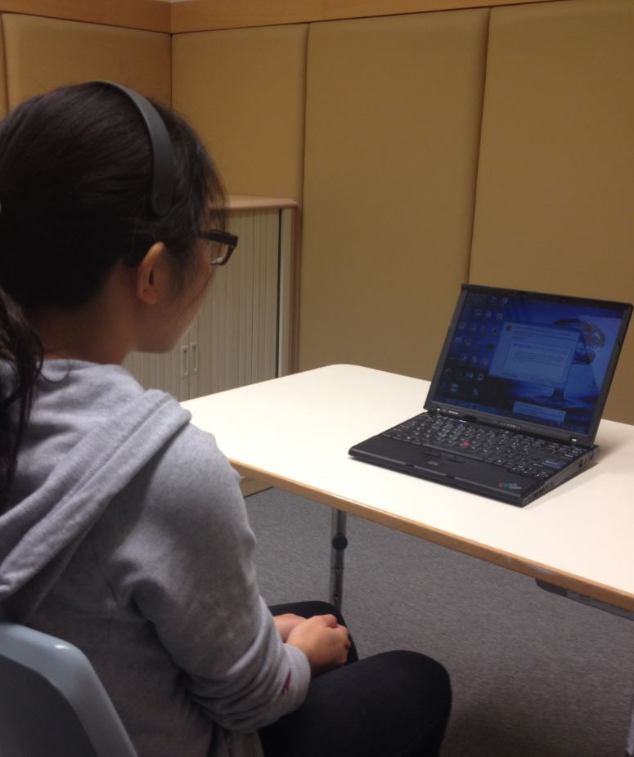
Experimental setting
All visual stimuli and video lecture were displayed on a laptop computer with a 13-inch screen
EEG signals were acquired through a headset with a single-point, dry electrode sensor
Data were transmitted through Bluetooth connection to a tablet device
Polling sessions were compiled with another tablet installed with the student response system

Slide 9
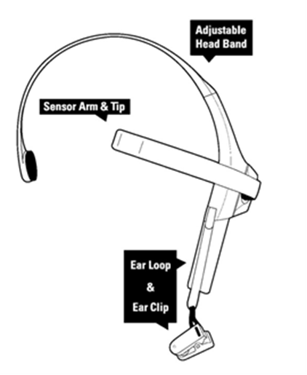
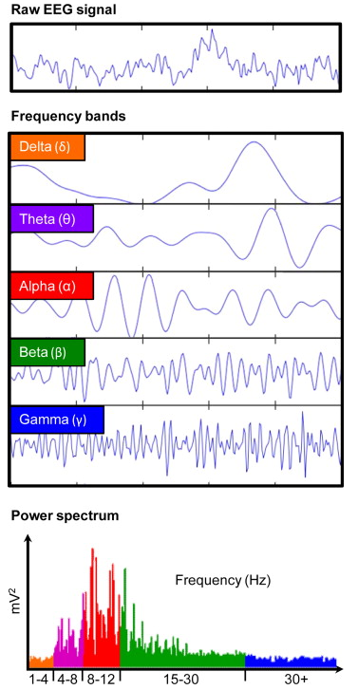
EEG data acquisition
Neurosky Mindwave Mobile headset
Acquisition of raw EEG data was performed using the Neurosky Mindwave Mobile headset
Signals were collected with a single-point dry-sensor electrode
Electrode for obtaining EEG signals was attached to the FP1 position on the forehead
Another electrode for reference and ground signals was placed with an ear clip at the left side of the headset

Slide 10
EEG data acquisition
Neurosky Mindwave Mobile headset
EEG signals were recorded through low-pass and high-pass filters within the range 1 to 50Hz
Signals were sampled at 512Hz per second frames
The EEG frequency bands collected were defined as:
Delta (1 Hz-4 Hz)
Theta (4 Hz-8 Hz)
Low Alpha (8 Hz-11 Hz)
High Alpha (11 Hz-14 Hz)
Low Beta (14 Hz-25 Hz)
High Beta (25 Hz-36 Hz)
Lower Gamma (36 Hz-40Hz)
Upper Gamma (40 Hz-44 Hz)

Slide 11
Hypothesized contrast of neural activities via EEG
H2
H3
 | 1 min | 5.5 mins | 1.5 mins | 5.5 mins |  | 1.5 mins
Group 1 | Resting trial | Video session 1 | Polling session 1 | Video session 2 |  | Polling session 2
 | 1 min | 11 mins |  |  | 3 mins
Group 2 | Resting trial | Video session |  |  | Polling session
H4
H6
H5
H1

Slide 12
Results
Statistical analysis
Data collected were analyzed with the Statistical Package for the Social Sciences (SPSS) version 22
To evaluate if the data are significantly different among various experimental sessions, paired sample t-test were performed examining within subject changes in various EEG spectrums

Slide 13
Differences among various experimental sessions
Pair sample t-test on resting trial and SRS session (H1)
There was a significant difference in both Low Alpha (M=14306.46, SD=10978.80) and High Alpha (M=11636.89, SD=6597.61) for the resting trial and the first video session (p<.05)
Paired Samples Statistics
 | Mean | N | Std. Deviation | Std. Error Mean
Resting trial—Low Alpha | 14306.46 | 81 | 10978.80 | 1219.87
SRS session—Low Alpha | 21417.76 | 81 | 13420.60 | 1491.18
Resting trial—High Alpha | 11636.89 | 81 | 6597.61 | 733.07
SRS session—High Alpha | 15913.1 | 81 | 7531.09 | 836.79
 | Paired Differences |  |  |  |  | t | df | Sig. (2-tailed)
 | Mean | Std. Deviation | Std. Error Mean | 95% Confidence Interval of the Difference
 |  |  |  | Lower | Upper
Low Alpha | -7111.29 | 14928.54 | 1658.73 | -10412.26 | -3810.32 | -4.29 | 80 | .000
High Alpha | -4276.21 | 7661.37 | 851.26 | -5970.28 | -2582.15 | -5.02 | 80 | .000

Slide 14
Differences among various experimental sessions
Pair sample t-test on the video session and SRS session (H2)
Paired Samples Statistics
 | Mean | N | Std. Deviation | Std. Error Mean
Video session—Low Alpha | 15851.29 | 82 | 6476.46 | 715.21
SRS session—Low Alpha | 21362.38 | 82 | 13346.92 | 1473.92
Video session—High Alpha | 12769.28 | 82 | 5058.57 | 558.63
SRS session—High Alpha | 15991.90 | 82 | 7518.39 | 830.27
Comparison of alpha obtained between lecture video viewing and SRS session (low alpha: t=-4.1, df=81, p<0.01; high alpha: t=-4.7, df=81, p<0.01) was also found statistically significant
 | Paired Differences
 | Mean | Std. Deviation | Std. Error Mean | 95% Confidence Interval of the Difference
 |  |  |  | Lower | Upper | t | df | Sig. (2-tailed)
Low Alpha | -5511.09 | 12161.70 | 1343.03 | -8183.30 | -2838.87 | -4.10 | 81.00 | 0.00
High Alpha | -3222.63 | 6524.50 | 720.51 | -4656.22 | -1789.04 | -4.47 | 81.00 | 0.00

Slide 15
Differences among various experimental sessions
Pair sample t-test on the 1st and 2nd SRS session (H3)
Comparison on high alpha waves collected during 1st and 2nd SRS session revealed a moderate decrease of high alpha activity from 1st to 2nd SRS session, while the difference was not statistical significant (t=1.85, df=36, p=0.07).
Paired Samples Statistics
 | Mean | N | Std. Deviation | Std. Error Mean
1st SRS Session—Low Alpha | 23834.00 | 37 | 13902.14 | 2285.50
2nd SRS Session—Low Alpha | 22085.95 | 37 | 12076.85 | 1985.42
1st SRS Session—High Alpha | 18143.93 | 37 | 8159.91 | 1341.48
2nd SRS Session—High Alpha | 15956.74 | 37 | 8056.15 | 1324.42
 | Paired Differences |  |  |  |  | t | df | Sig. (2-tailed)
 | Mean | Std. Deviation | Std. Error Mean | 95% Confidence Interval of the Difference
 |  |  |  | Lower | Upper
Low Alpha | 1748.05 | 12331.29 | 2027.25 | -2363.41 | 5859.51 | 0.86 | 36.00 | 0.39
High Alpha | 2187.19 | 7197.56 | 1183.27 | -212.60 | 4586.98 | 1.85 | 36.00 | 0.07

Slide 16
Discussions
Observed EEG patterns suggested potential association of cognitive processes in psychology of learning:
Our results confirms alpha and beta band activities associated with mental workload from high-resolution event-related potential (ERP) studies (Roy, 2016)
A creative brain needs time to think and consolidate: SRS breaks could facilitate mastery process by pausing the input process from lecture format and consolidate irrelevant information when asked to put knowledge obtained to work towards a solution.
Such cognitive process could be inferred from alpha band EEG & cognitive inhibition (Fink, 2009; Sawyer, 2011; Beaty, 2018)

Slide 17
Conclusions and recommendations
Results from this study provided evidence for empirical measurement of learners’ engagement during active learning with SRS
Students’ engagement and attention spiked when switching from passive lecture information encoding to active retrieval of prior knowledge
Repeated testing with multiple SRS sessions may be associated with sensitization of such modality change and testing effect
Optimal mix of SRS sessions and lecture modalities to maximize learning gains

Slide 18
References
Beaty, R. E., Kenett, Y. N., Christensen, A. P., Rosenberg, M. D., Benedek, M., Chen, Q., . . . Silvia, P. J. (2018). Robust prediction of individual creative ability from brain functional connectivity. Proceedings of the National Academy of Sciences, 115(5), 1087-1092. doi:10.1073/pnas.1713532115
Fink, A., Grabner, R. H., Benedek, M., Reishofer, G., Hauswirth, V., Fally, M., . . . Neubauer, A. C. (2009). The creative brain: Investigation of brain activity during creative problem solving by means of EEG and FMRI. Human Brain Mapping, 30(3), 734-748. doi:doi:10.1002/hbm.20538
Roy, R. N., Bonnet, S., Charbonnier, S., & Campagne, A. (2016). Efficient Workload Classification based on Ignored Auditory Probes: A Proof of Concept. Frontiers in Human Neuroscience, 10(519). doi:10.3389/fnhum.2016.00519
Sawyer, K. (2011). The Cognitive Neuroscience of Creativity: A Critical Review. Creativity Research Journal, 23(2), 137-154. doi:10.1080/10400419.2011.571191

Slide 19
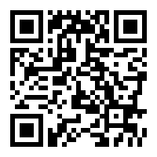
Want to know more?
Write here
Something About
WRITE SOMETHING HERE
http://www.apss.polyu.edu.hk/clickers/

