Slide 1

Impact of enhanced technology for team-based learning
Brian O’Dwyer
Embry-Riddle Aeronautical University Asia (Singapore Campus), Adjunct Faculty
CognaLearn, Executive Chairman and Commercial Founder
Duke-National University of Singapore Medical, Former Entrepreneur-in-Residence
eLearning Forum Asia 2018
National Taipei University of Business
Taipei, Taiwan
24 May 2018

Slide 2
Acknowledgements
The presenter would like to acknowledge the contribution of Laura Long in collecting, analyzing and presenting the data in this presentation.
The presenter would like to thank the faculty and students of the following institutions that graciously provided their time and feedback for this poster:
The presenter is the Commercial Founder of and has a financial interest in CognaLearn. CognaLearn is the company that developed InteDashBoard™ www.intedashboard.com, which is TBL software developed in collaboration with Duke-US Medical School; InteDashBoard™ is one of the technology tools described in this presentation.
A poster version of this presentation was presented at the 2018 Team-Based Learning Collaborative Conference 2018, San Diego, United States
Asia
Duke-NUS Medical School
Manipal International University
Singapore Institute of Technology
Europe
IE Business School
University of Sussex
North America
Augusta University
Boise State University
Columbus State University
Ithaca College
Southern Virginia University
University of Hawaii
University of Illinois at Chicago
University of South Alabama
South America
Universidade Federal do Maranhão
Australia
Deakin University
Macquarie University

Slide 3
Objectives
After this session participants should be able to:
Explain: who I am and why I am here
Define: team-based learning (“TBL”)
Describe: the impact of enhanced TBL technology

Slide 4

Landing objective

Slide 5
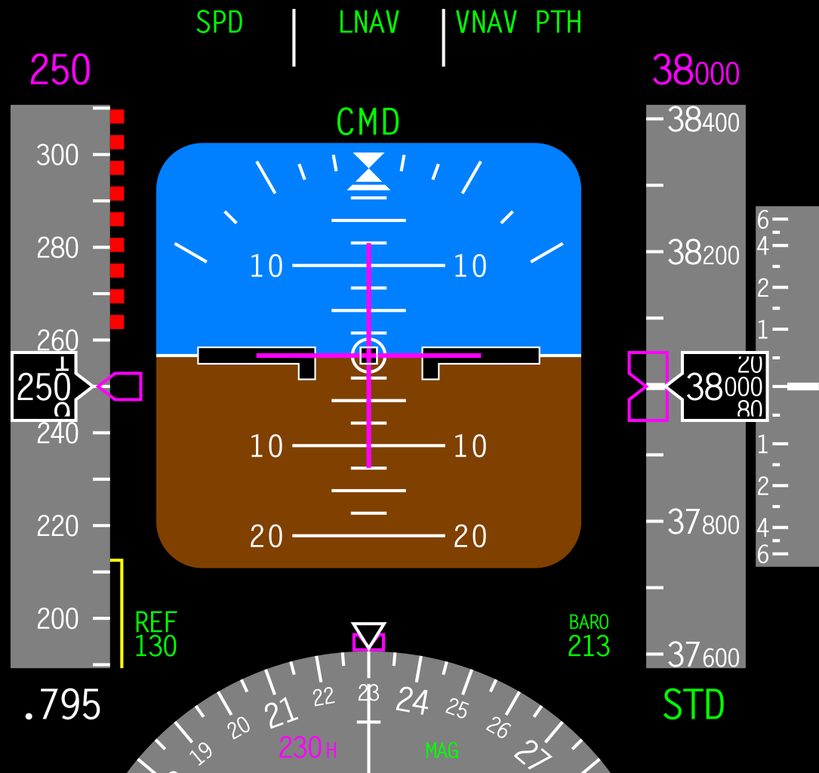
Too fast? Too slow?
Too high? Too low?

Slide 6



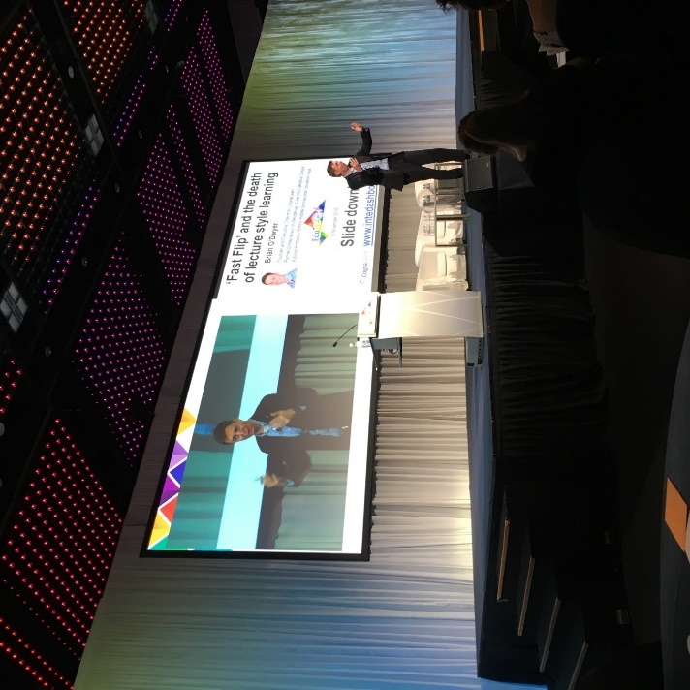
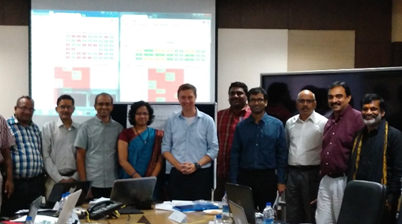
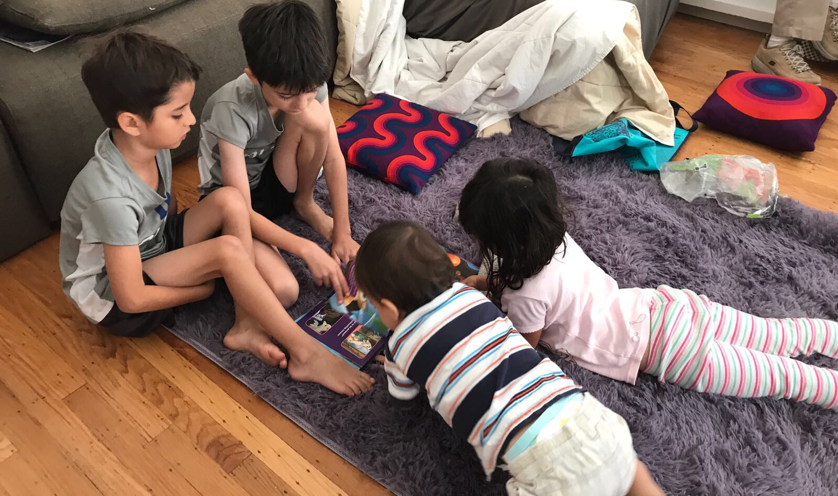
Team-based learning…
Educator
Entrepreneur
Speaker
Parent
Copyright Brian O’Dwyer and CognaLearn Pte Ltd and www.intedashboard.com where applicable.
Slides available from odwyerb@erau.edu and may be used with attribution

Slide 7







My path

Slide 8

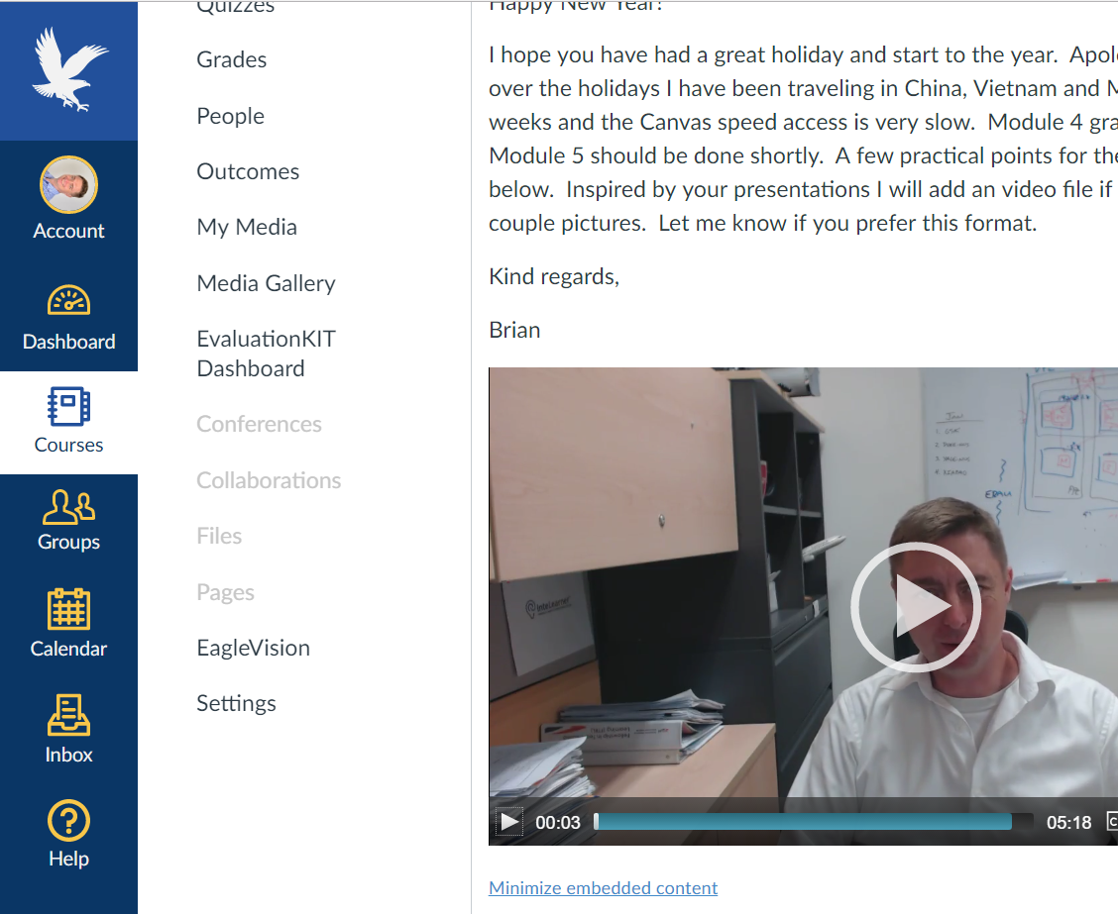

Problem 1: Employability gap
Learning 1.0
Learning 2.0
=
Laurentius de Voltolina, School of
Bologna 14th century.

Slide 9
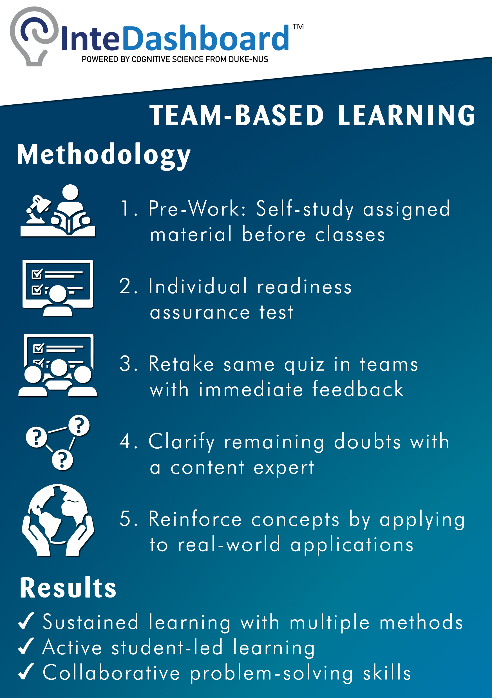
Solution 1: Team-based learning (“TBL”)
In class: theory
In class: apply
1. Pre-work
2. Quiz
3. Team quiz
4. Clarify
doubts
5. Team applications
Also 360° teammate evaluation

Slide 10














TBL
1970s by Professor Larry Michaelsen in Marketing
100s of universities globally
Many fields
Health sciences
Business
Computer science
Engineering
Social sciences
Law
Some K-12, government and corporate

Slide 11
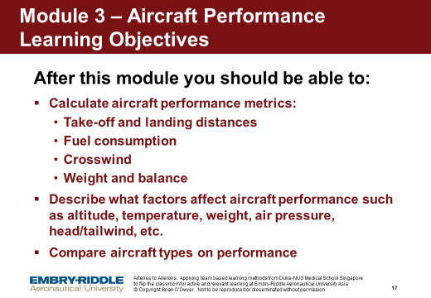
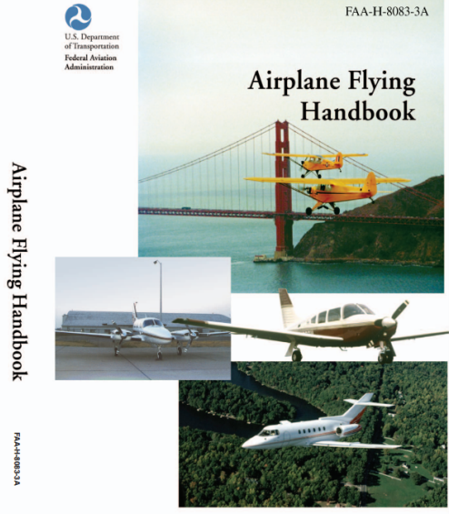
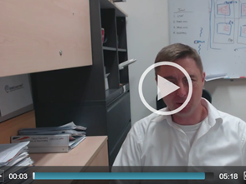
1. Pre-work

Slide 12

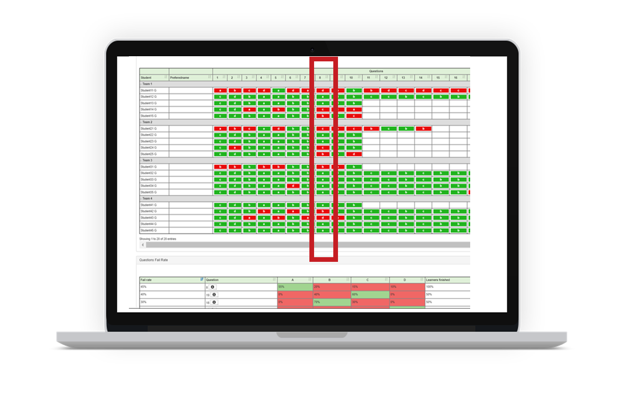

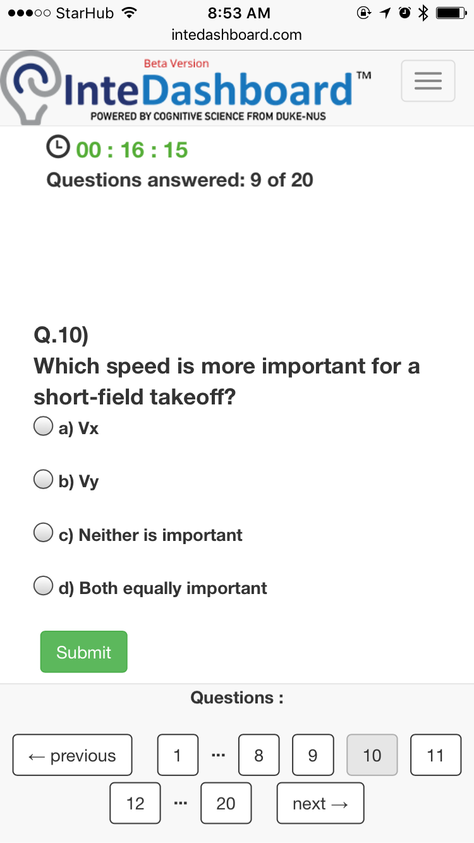
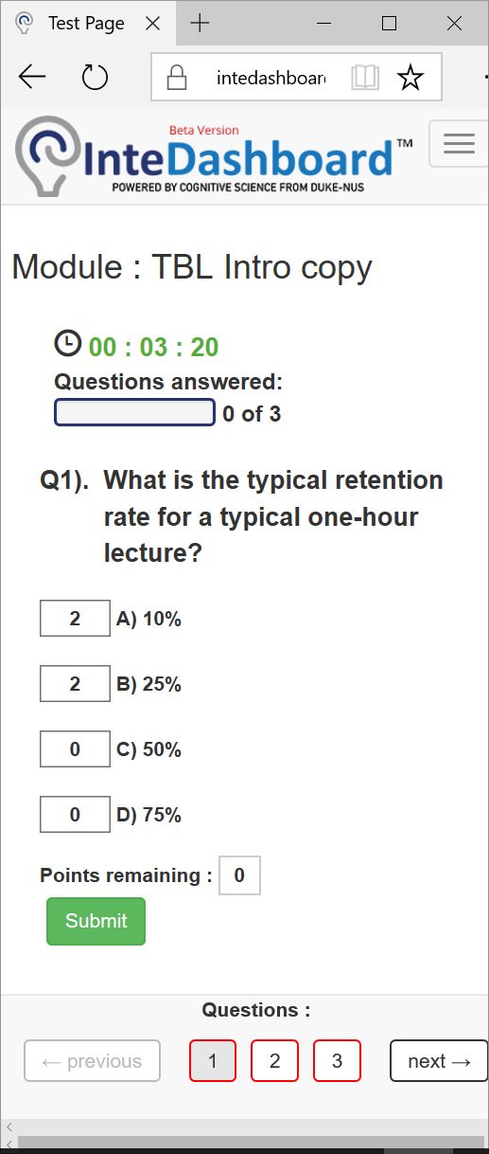
2. Individual Readiness Assurance Test (“IRAT”)

Slide 13
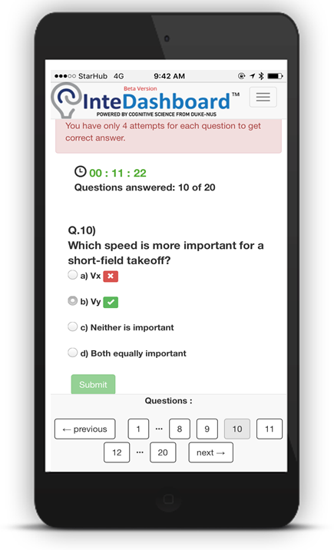
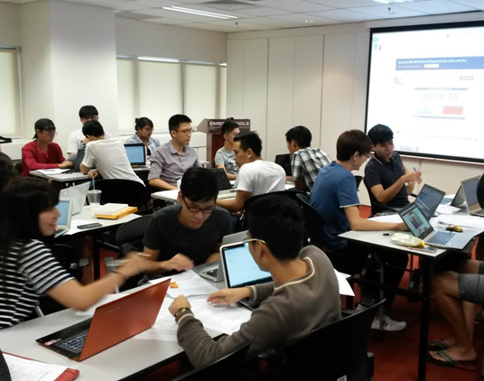
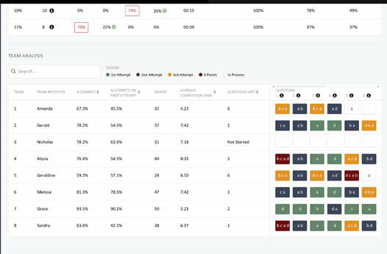
3. Team Readiness Assurance Test (“TRAT”) with immediate feedback

Slide 14

4. Clarifications

Slide 15
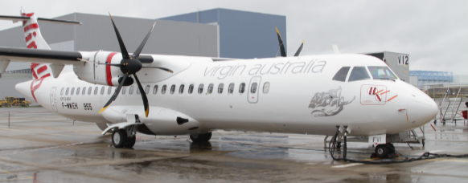
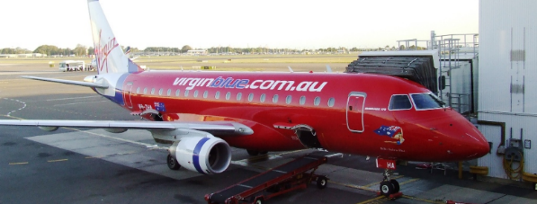
5. Applications
Significant problem
Same problem
Specific choice
Simultaneous report
Sydney
Canberra

Slide 16
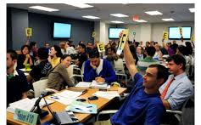
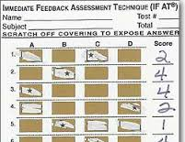




Problem 2: TBL administrative burden
Manual paper methods
Systems integration
Learning Management Systems

Slide 17
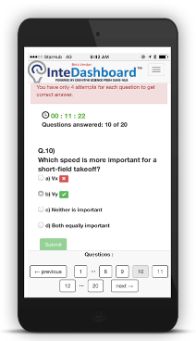
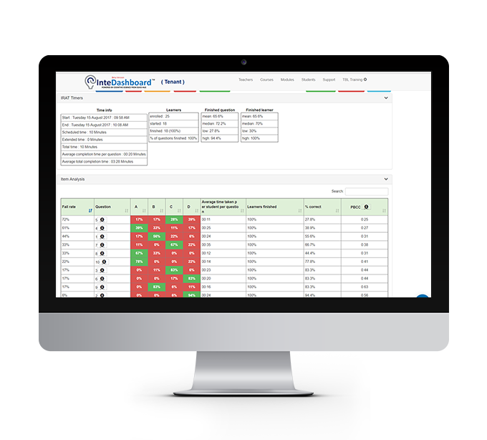
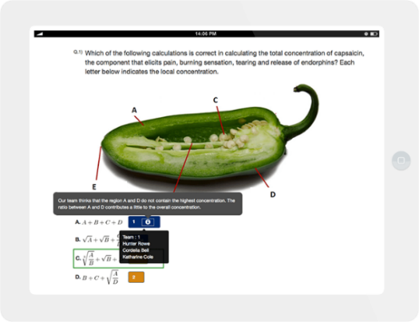

Solution 2: All-in-one TBL software
Individual and TEAM assessments
Real-time faculty dashboard
Learning Management System (“LMS”)

Slide 18
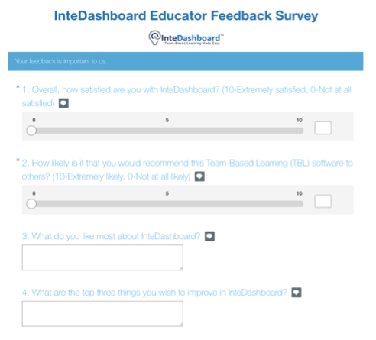
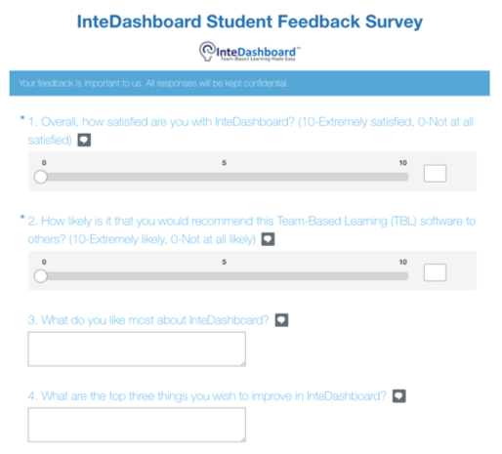
Method

Slide 19
Responses: 16 universities, 5 continents
Faculty
Student
N=30 (15% response rate)
N=304 (15% response rate)

Slide 20
Results: faculty satisfaction
Faculty Satisfaction Rating
93% Satisfaction Rate
Not satisfied
Satisfied

Slide 21
Results: student satisfaction
Student Satisfaction Rating
90%
5 and up
70% Satisfaction Rate
Not satisfied
Satisfied

Slide 22
Results: net promoter score (“NPS”)
Faculty willingness to recommend
Detractors : 20%
Passives : 30%
Promoters : 50%
NPS = Promoters
–
Detractors
50 - 20 = 30
Not satisfied
Satisfied

Slide 23

Results: NPS benchmarking
Net Promotor Score Comparison
25
25
30
50
61
Source: retrieved from https://npsbenchmarks.com in February 2018

Slide 24
Results: qualitative
Benefits
Concerns
  Real-time feedback, results collection, monitoring and analysis
  Has made TBL easier to implement: reduced manual work in grading and conducting peer evaluation
  One-stop online solution for TBL
  More peer evaluation types
  Features to support online remote TBL learning
  Infographics of student performance

Slide 25
Summary
Team-based learning (“TBL”): specific type of blended learning
Technology helped:
Provide real-time data
Automate manual tasks
Satisfaction:
93% faculty and 70% students
Brian O’Dwyer
odwyerb@erau.edu
Team-Based Learning Collaborative
www.teambasedlearning.org
TBL software
www.intedashboard.com

Slide 26
Appendix

Slide 27
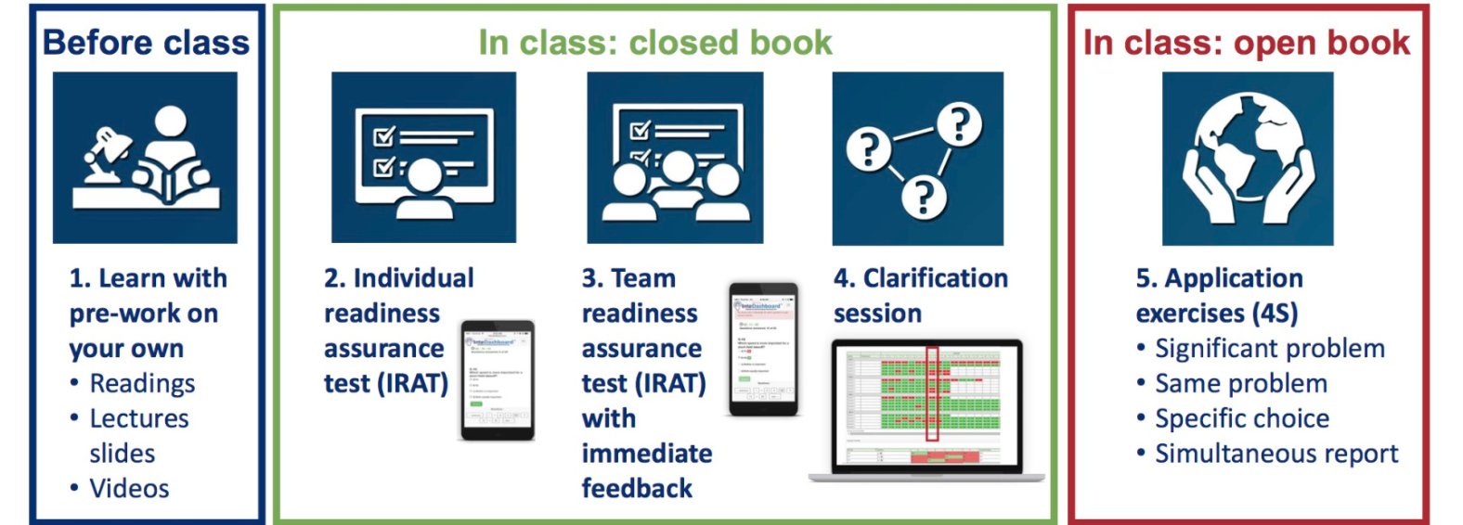
Team-Based Learning (“TBL”)
After class: Appeals and Peer evaluation

