Slide 1
Student Engagement And Learning With Mobile Learning Technologies In Higher Education Classes
Archimedes David Guerra
Hong Kong Baptist University

Slide 2
2016 Survey on English Usage of Hong Kong People
Cantonese-speaking citizens of Hong Kong of age 18 or above
503 respondents
https://www.hkupop.hku.hk/english/report/wall_street_english/index.htmla

Slide 3
2016 Survey on English Usage of Hong Kong People
Survey Item | % of respondents who rated the survey item 8, 9, or 10
How important do you think having a good command of English is to Hong Kong people? | 81.8*
Please rate your self-assessment on English listening. | 14.2**
Please rate your self-assessment on English grammar. | 12.5**
Please rate your self-assessment on English spelling. | 12.6**
Please rate your self-assessment on English vocabulary. | 8.6**
*Using a scale of 0-10, with 0 meaning not important at all, and 10 meaning very important
**Using a scale of 0-10, with 0 meaning very poor, and 10 meaning very good

Slide 4
Learning and Teaching Context
Students from HKBU undergraduate business courses from AY 2016-17 to AY 2017-18
Strategic Marketing
Case Analysis
Qualitative Marketing Research
Business and Marketing Research Methods
Entrepreneurship and Innovative Thinking
100% smartphone ownership
Free, fast internet connection on campus

Slide 5
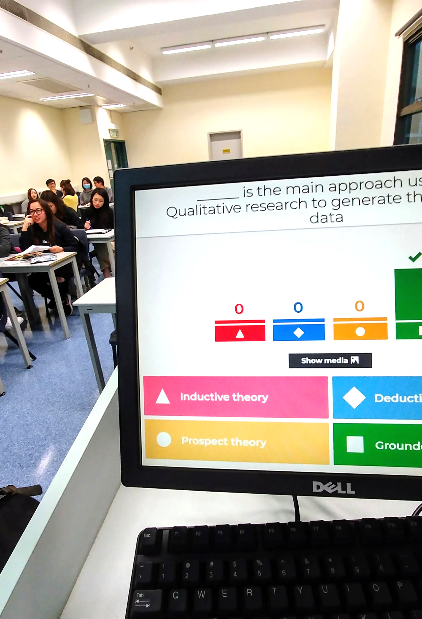
Intervention
Use mobile learning technologies to
Improve students’ engagement in learning
Provide more opportunities for st-st and t-st interactions
Provide more opportunities for student collaboration and peer feedback
Help students achieve course learning outcomes

Slide 6
Results (Spoiler)
YES, mobile learning technologies DO enable student engagement and the achievement of learning objectives

Slide 7
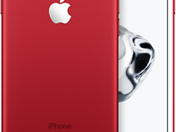
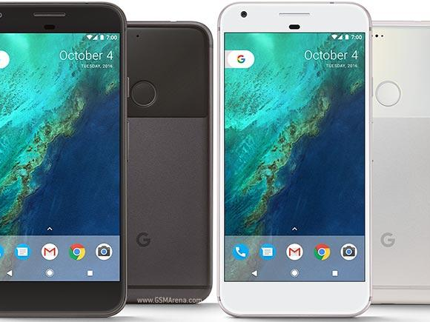
Mobile Technology in Teaching and Learning
The ability to choose what to learn and when to learn in the learner’s preferred format (Ng, 2015)
Increased student motivation, engagement, and academic performance (Nickerson, Rapanta, & Goby, 2016)
Avoid free rider problems in collaborative learning activities (Guerra, 2017)
Notes:
In the past decade, mobile technology has played an increasingly significant role in teaching and learning by giving students more control over what they learn and how they learn.
This phenomenon has been primarily driven by the affordability and consequent ubiquity of Internet-connected mobile devices such as smartphones and tablets (Jeng, Wu, Huang, Tan, & Yang, 2010). There is a saying among camera enthusiasts that “the best camera you have is the one you have with you.” The same can be said of smartphones. Your smartphone is the best computer, the best tool you have because it’s always with you.
Mobility is perhaps the most straightforward benefit of mobile technology to students—the ability to learn in any context and at any time, both inside and outside the classroom (McQuiggan, Kosturko, McQuiggan, & Sabourin, 2015).
In addition, since it’s becoming more common for mobile devices to have a persistent Internet connection, students gain ready, on-demand access to learning materials and information from various online sources (Nickerson, Rapanta, & Goby, 2016).
Finally, mobile applications or “apps” expand the functionality of mobile devices beyond Internet access and communication to those which are tailor-made to various teaching and learning situations. Mobile apps that are designed specifically for learning can supplement or enhance the capabilities of more traditional learning tools by providing more specialized methods of participation (Dennen & Hao, 2014). For example, some apps serve as classroom response systems, which have been found to help students learn better by encouraging them to participate in class activities and be better prepared for lessons (Jones, Crandall, Vogler, & Robinson, 2013).
Largely, the use of mobile technology for learning has been associated with increased student motivation, engagement, and academic performance (Nickerson et al., 2016).

Slide 8
Using Mobile Learning Technologies in Higher Education Classes

Slide 9
Using Technology for Student Engagement and Learning
Student Engagement
Learning
Technology
✕
Activity

Slide 10
Mobile Learning Technologies
Notes:
Google Classroom is the primary technological tool that I used in this project. I used it as the exclusive learning management system or LMS in my six marketing classes in semester 1.
Google Classroom served as the platform for most of the activities covered in this project, particularly those that involve Google Slides and Youtube, in addition to providing basic LMS functionality.
I used kahoot as an alternative personal response system or clicker, together with the quiz function of google classroom.

Slide 11
Kahoot
+
Classroom
✕
Poll/MC Questions
Notes:
Speaking of clickers, the first innovation that I want to discuss are poll or multiple-choice type questions using either kahoot or google classroom.
I use kahoot when I ask students to participate in teams, or when I need to identify the top performers, individually or by group, using kahoot’s scoring system.
I use Classroom’s multiple choice question function when I give students more time to answer a particular question, be it a couple of hours, a full day, or a week.

Slide 12
Classroom
✕
Reflective Questions
Notes:
A
The second innovation involves asking students to answer reflective or short-essay questions on google classroom.
These questions are usually open-ended, and require students to apply or reflect on important concepts that I have recently discussed.
B
Students have to answer these questions either in class, before the class ends, or after a few days before next week’s class.
After reading and evaluating the answers of students, I “return” their grade together with comments using classroom’s built-in grading functionality.

Slide 13
Classroom
✕
Youtube
✕
Reflective Questions
Notes:
The next innovation is a variation of the last one. Here, I ask students to watch a youtube video and then answer reflective or short-essay questions related to the video. I always give students until the following week’s class to perform the activity.
B
The videos that I ask them to watch are those that are related to a recent lesson and are never longer than 7 minutes.
These videos are either publicly available, rehosted on my Youtube account, or self-produced,

Slide 14
Classroom
✕
Student Comments/Feedback/Questions
Notes:
In the next innovation, I ask students to provide comments and feedback and ask questions after watching a group presentation. I post the Google Slides file of the presentation on Google Classroom, and ask students to post their comments, feedback, and questions in the comments section below. Students can open and browse through the slides as they watch or listen to the presentation.
After giving students some time to compose and post their thoughts, I ask the presenting group to respond.

Slide 15
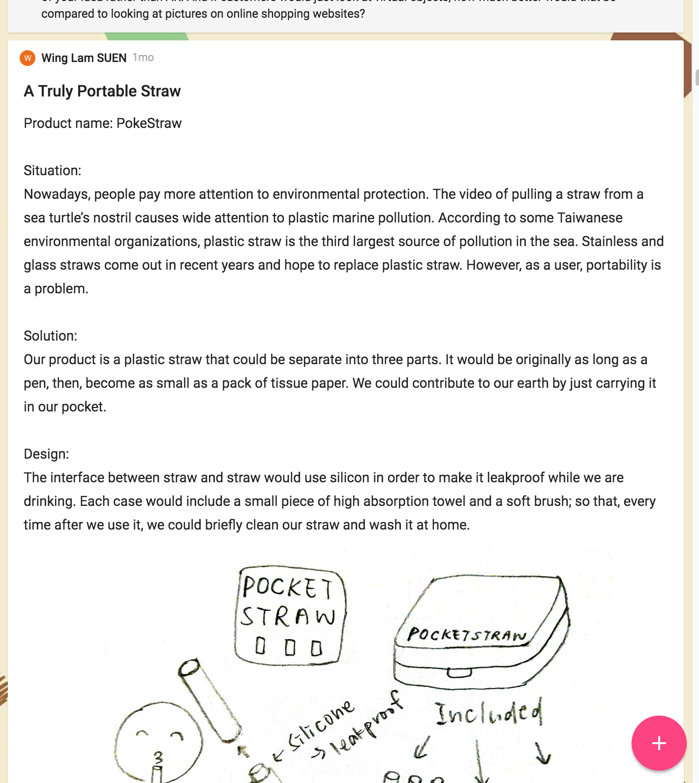
Padlet
Student Comments/Feedback/Questions
✕

Slide 16
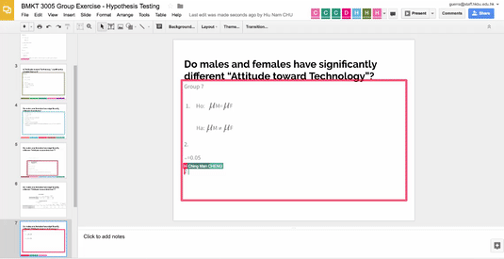
Google Slides
✕
Collaborative Activities
Notes:
The final innovation that I will discuss involves collaborative group activities using google slides.
b
In these activities, I ask students to answer a question or solve a problem in teams. Team members simultaneously work on the problem by editing a google slide file using internet connected devices such as laptops, tablets, and smartphones.
C
I ask students to work on activities like this to conclude a particular lesson, and usually ask them to complete their work before class ends.
In this slide, you are seeing around 40 students working simultaneously. They are divided into 7 groups, with each group working on a unique problem.

Slide 17
Evidence for Student Engagement and Learning

Slide 18
Participation Rates
Poll/Multiple Choice Questions using Kahoot and Google Classroom | 79%
Reflective Questions on Google Classroom | 85%
Reflective Questions for a Youtube Video on Google Classroom | 54%
Student Feedback, Questions, or Comments on Google Classroom | 64%
Student Feedback, Questions, or Comments on Padlet | 58%
Collaborative Learning Activities using Google Slides | 100%

Slide 19
Focus Groups
Final year undergraduate marketing students with experience in using mobile tech in learning activities
Group 1: 6 participants, 44 minutes
Group 2: 4 participants, 35 minutes
Questions about their experiences and opinions about mobile technology and learning activities
Notes:
Two studies were used to investigate the effectiveness of mobile technology in reducing free rider problems in collaborative learning.
First, as a pilot study, two focus groups were conducted to explore the experiences of students while using mobile devices in collaborative learning activities.
Ten final-year undergraduate students majoring in marketing in Hong Kong were invited to two focus groups. Focus Group 1 consisted of six participants and lasted for 44 minutes, while Focus Group 2 consisted of four participants and lasted for 35 minutes.
All participants had had 8 to 12 weeks of experience using Google Slides, Google Classroom, and their mobile devices to work on collaborative learning activities in two out of six of their classes that semester.
Using an open-ended interview guide, the participants were asked questions about their experiences and opinions about mobile technology and collaborative learning.

Slide 20
Main Themes from Focus Groups
Convenience (It is convenient for me to use my phone to type, even compared with using paper.)
Interactions (The apps are good because we can use them to interact with each other and the teacher online.)
Opportunity to contribute (Google Slides is effective because we can all edit the presentation at the same time during class.)
Preference for mobile technology (I prefer using my phone and sometimes my tablet when working on class activities.)
Effectiveness of learning (Using Google Classroom helps me learn better compared to Moodle; I am motivated to learn more because I want to perform better than other groups.)

Slide 21
Static Group Comparison Study
Two cohorts of Strategic Marketing
Cohort 1 (Sem 1, AY 2015-16, did not use mobile technologies)
Cohort 2 (Sem 1, AY 2016-17, extensively used mobile technologies)
Comparison of Course Feedback Questionnaires (CFQs) and Final Exam scores

Slide 22
CFQ Comparison
CFQ Item | Cohort 1 mean (n = 44) | Cohort 2 mean (n = 24) | t | Sig. | Effect size (Cohen’s d)
The teaching and learning activities provided me the opportunities to learn through active participation. | 4.11 | 4.50 | 2.50 | p < 0.05 | 0.67
The teaching and learning activities helped me learn what I was supposed to learn. | 4.18 | 4.54 | 2.43 | p < 0.05 | 0.64
I have achieved what I was supposed to learn in this course. | 4.18 | 4.38 | 1.17 | n.s. | 0.33
Notes:
Percentage of control group who would be below average person in experimental group
d = 0.67, 75%
d = 0.64, 74%
d = 0.33, 63%

Slide 23
CFQ Comparison
Student comments from the 2015-16 CFQs:
lecturer introduced some new method of presentation
Class activities help me to understand the theories very much. We have well interaction between students and also teacher.
Good interaction in class

Slide 24
CFQ Comparison
Student comments from the 2016-17 CFQs:
High interactive during the lesson, it able students to exchange mind and discuss instantly
use classroom (presumably Google Classroom)
Kahoot game is very interesting for me. And the Google classroom is a good apps for student to study.
interactive class activities

Slide 25
CFQ Comparison
Student comments from the 2016-17 CFQs:
Good use of Google classroom and Kahoot
Kahoot! game can encourage case reading.
Use technology to facilitate the lesson.
I love Kahoot game.
Class activities (Kahoot) are interesting and helping me to have better understanding on the courses

Slide 26
Final Exam Comparison
 | Cohort 1 mean (n = 84) | Cohort 2 mean (n = 64) | t | Sig. | Effect size (Cohen’s d)
Final Exam score | 69.51 | 73.07 | 1.46 | n.s. | 0.24
Notes:
Percentage of control group who would be below average person in experimental group
d = 0.24, 59%

Slide 27
Next steps
Increased role of mobile learning technologies in higher education classes
Resources for personnel and student training
Future research about challenges to a more widespread adoption of mobile learning
Use data for continuous improvement

Slide 28
The concept of mobile learning encourages learners to take control of what they need to learn, access the learning materials and related information independently and fosters learner autonomy.
Darmi & Albion (2017)

Slide 29
Questions

