Slide 1
Automatic Generation of Transcripts of Student English Presentations using YouTube
Simon WANG Peggy LAI Louisa WONG
Language Centre
Hong Kong Baptist University
{simonwang, peggylai, louisawong}@hkbu.edu.hk

Slide 2
Overview of our talk
The transient nature of spoken English and its implications for teaching (Peggy)
How transcripts may help (Peggy)
Automatic generation of transcripts using YouTube (Louisa)
Preliminary findings (Louisa)
Conclusion and reflections (Simon)

Slide 3
The transient nature of spoken English
Problems of teaching, evaluating and learning English speaking:
1. Unlike written words, talks and speeches are transient (Wang, Kuhl, Chen, Dong, 2009)
2. Oblivious to what was said / obliterate to what was presented (Coulthard, 2016)
3. Evaluation based on impression and notes taken during the talk
4. Issues of inconsistency in marking (Douglas & Selinker,1992; Douglas,1993)
Notes:
~ Corpus-based approach in speaking skill development is less common despite its wide usage in teaching writing (Flowerdew, 2002; Jabbour, 2001)
~ written text is interactive and it allows analysis to take place (Coulthard, 2016)
~ According to Douglas and Selinker (1992, 1993), raters of oral performance, despite working from the same scoring rubrics, may well arrive at similar ratings for qualitatively different performances. Such discrepancies are due to the lack of transcripts; method: record the speaking of learners and then ask them to review their own recordings and comment on their communicative performance
~ It is important to analyze speech data ( I.e. what test-takers actually said) in oral tests and to analyze the test as a speech event in order to address issues of validity (Van Lier, 1989).
~ Lack of transcripts leads to similar ratings for qualitatively different spoken English performances (Douglas & Selinker,1992; Douglas,1993)
~ For example, in our course, UEII, there is a Lack of moderation for grading

Slide 4
Existing solution
The talks and speeches are taped and transcribed
Examine the transcript (teaching)
Build corpus (research) (e.g. https://warwick.ac.uk/fac/soc/al/research/collections/base/)
The problem
Manually transcribing the talks is too laborious ~ Labor-intensive and time-consuming (Reppen, 2010)
Notes:
Overview of BASE Plus
BASE Plus is a larger collection of British Academic Spoken English data held at the Centre for Applied Linguistics. It comprises the following:
Text and tagged transcripts of the lecture and seminar holdings (i.e. the BASE collection)
Video and audio recordings of lectures and seminars recorded in a variety of university departments;
Video recordings of academic conference presentations;
Interviews with academic staff on aspects of their academic work and field (audio recordings, transcripts, interview notes)
Proposed solutions:
Cos: Computer-based training can be effective in improving second language learners’ perceptions and productions of segmental speech contrasts. (Wang, Munro, 22004)

Slide 5
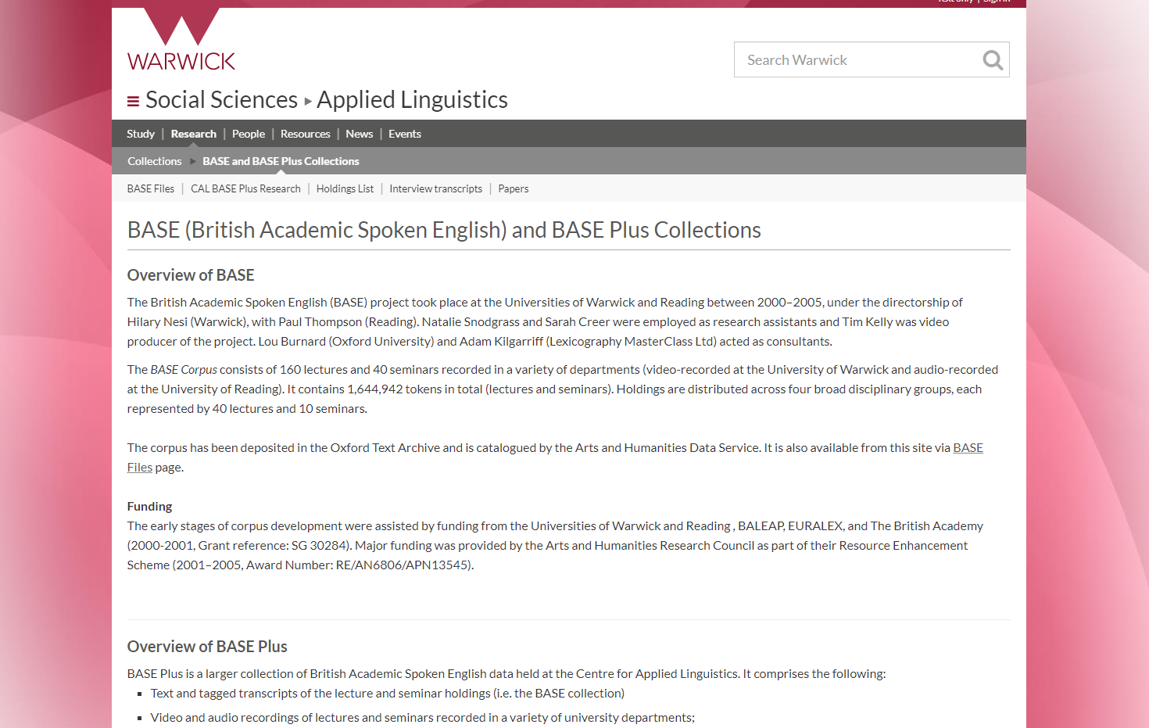

Slide 6
BASE Plus: A Spoken English Corpus
Text and tagged transcripts of the lecture and seminar holdings (i.e. the BASE collection)
Video and audio recordings of lectures and seminars recorded in a variety of university departments;
Video recordings of academic conference presentations;
Interviews with academic staff on aspects of their academic work and field (audio recordings, transcripts, interview notes);
Notes:
Slide about existing corpora
BASE Plus is a larger collection of British Academic Spoken English data held at the Centre for Applied Linguistics. It comprises the following:

Slide 7
Proposed solution
Automatic generation of transcripts using YouTube

Slide 8
How transcripts may help
Identify discourse features
Detect pronunciation errors
Recognize grammatical errors
Notes:
Find some pictures

Slide 9
Identify discourse features
The language in use (vocabulary, grammatical forms, fixed expressions etc.,)
The study of specific discourse marker, e.g. “then” (Haselow, 2011) in spoken texts
The study of specific connectives in written learner corpus and expert corpus (e.g. the study on “besides”) (Yeung, 2009)
Translations of "oh" in the 2.5 million-word English-Spanish parallel corpus PACTRES (Ramon, 2015).
Notes:
When they are speaking spontaneously people do not usually have time to combine their clauses in the varied ways that they might use in writing (when they might have many subordinate clauses introduced by a range of conjunctionss such as however, therefore or since). The most frequent conjunction in spoken English is the all-purpose and. So and but are also frequent, but less so since they have more specific meanings (so suggests that what follows is the result of what has just been said, and but suggests a contrast).
~The YouTube-based practices of transcribing student presentations could be pedagogically useful in a wide variety of contexts of teaching English as a foreign language and may also help teacher researchers to build learner corpora of spoken English that are not as common as the learner corpora of written English.

Slide 10
CAPT tools powered by ASR
Automatic Speech Recognition (ASR) technologies have been used for Computer Assisted Pronunciation Training (CAPT) (Golonka, Bowles, Frank, Richardson, & Freynik, 2014; Levis, 2007)
CAPT systems can help students improve their pronunciation e.g. programs that acoustically analyse student and sample speeches and provide visual feedback (e.g. Hardison, 2004)
Low correlation between software scores and human scores (e.g. Kim, 2006)
Most CAPT systems are proprietary (not freely available), e.g. Speaking English 60 Junior (Ahn & Lee, 2016);
Notes:
prosody refers collectively to variations in pitch, tempo, and rhythm

Slide 11
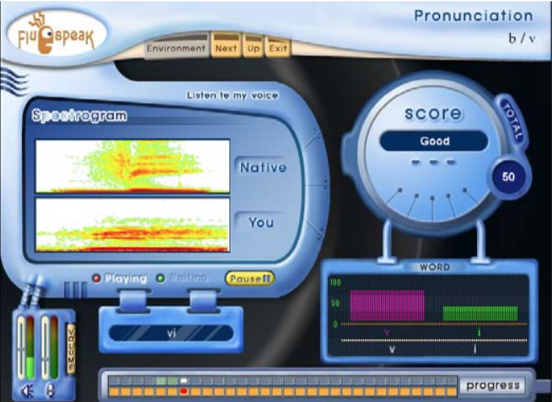
Fluspeak, a CAPT tool studied by Kim (2006)

Slide 12
Detect pronunciation errors in transcripts
A rather simple approach: compare the transcript generated by YouTube with the original transcripts (written or not)
Not all the mistakes are due to mispronunciation
Imperfect algorithm
Poor audio quality
Usage and collocation errors
Some pronunciation errors may not be detected
Redefine intelligibility?

Slide 13
Grammatical Errors in Spoken & Written English
Common Types of Grammatical Errors in Spoken and Written English made by L2 Learners (Ting, Mahadhir & Chang, 2010; Chan, 2010)
Morphological Level | Lexical Level | Syntactic Level
Verb Form Tense | Preposition Article Tense Subject Verb Agreement Pronoun (Mistakes "He" for "She" and vice versa) | Negation Question Fragments Part of Speech
Notes:
Chan (2010) studies the errors in written English of Hong Kong students + refer to other studies on grammatical accuracy of written learner corpus (references of Chan 2010; cited by )

Slide 14
Research questions
To what extent could YouTube auto-captioning function be useful for generating transcripts of L2 spoken English?
How could the transcription assist the teaching of spoken English?
How useful do the students find the transcription process?

Slide 15
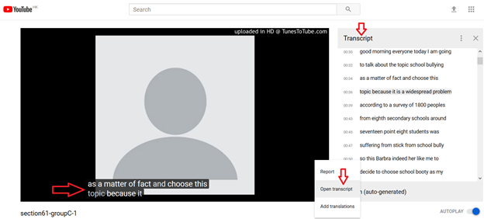
Auto-captioning Feature of YouTube
Natural Language Processing technologies developed by Google
Upload a video with English spoken texts
After a few minutes English transcripts will be automatically generated
The service has been around for more than 10 years
But the accuracy was not very good initially
Notes:
Methodology:
~150 students gave 8-minute oral presentations on argumentative research papers
~The audio recordings (total running time about 1200 minutes) of their presentations were uploaded to YouTube using the audio-to-video conversion services provided by https://www.tunestotube.com/
~An impressive 96.5% overall accuracy rate of transcribing

Slide 16
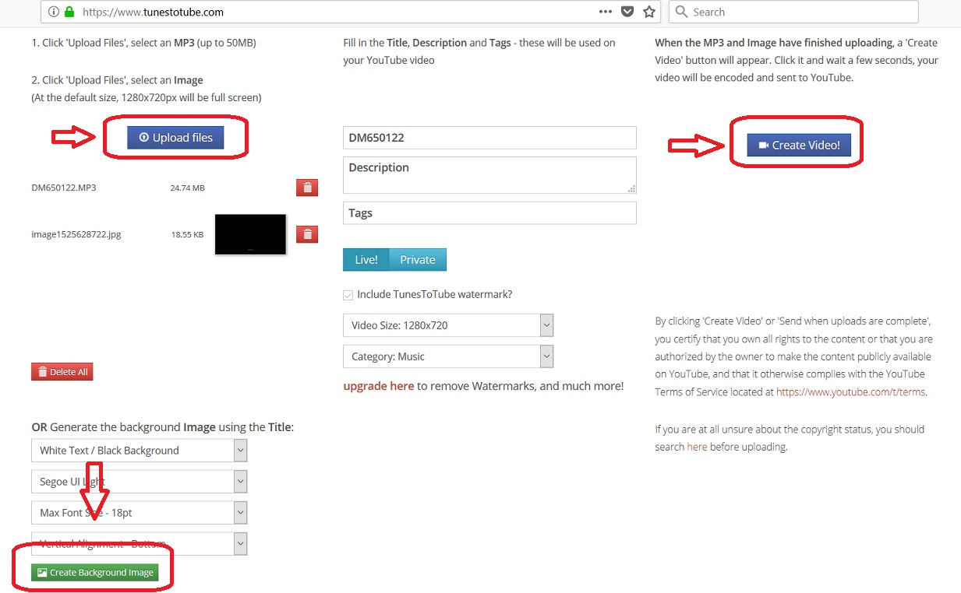
Methodology
1. The course/ academic oral presentation
2. Record students’ talks using a digital recorder
3. MP3 files are uploaded to YouTube via http://tunestotube.com

Slide 17
Methodology
4. A transcript is then generated by YouTube. Students open the transcript and download it.

Slide 18
Methodology
Transcripts are copied and pasted to a Google docs
Students edit the transcripts and fill out a Google Form
Notes:
https://docs.google.com/forms/d/1lbtEBuyE3mcC7Uv4jXFTZFX2r6fzQGmVOtHEg392kto/edit

Slide 19
Preliminary Findings – Some Data for the Research Questions
To what extent could YouTube auto-captioning function be useful for generating transcripts of L2 spoken English?
How could the transcription assist the teaching of spoken English?
How useful do the students find the transcription process?
Notes:
https://www.youtube.com/watch?v=JPmLNxsACE8&feature=youtu.be we could use this for a short demo and screenshot
One interesting issue to discuss: in some cases, students may have mispronounced a word but YouTube was able to detect the right word – should we consider this as a case of YouTube failure or perhaps the very notion of intelligibility has to be redefined in the age of natural language processing .

Slide 20
Speech Rate and Accuracy
Accuracy (total word count – no. of mistakes)/ total word count) |  | Speech Rate (No. of words per minute)
Mean | 94.98% | 123.83
Standard Deviation | 3.51% | 17.32
Minimum | 83.13% | 91
Maximum | 99.52% | 150
Total No. of Scripts | 73 | 73

Slide 21
Percentage of errors due to mispronunciation
 | Total errors | Errors due to mispronunciation | Errors due to YouTube | Mispronunciation recognition rate
Mean | 44.68 | 15.17 | 29.52 | 39.28%
Standard Deviation | 25.13 | 14.22 | 23.51 | 29.71%
Minimum | 5 | 1 | 0 | 3.13%
Maximum | 107 | 78 | 102 | 100.00%
Total No. of Scripts | 60 | 60 | 60 | 60

Slide 22
Usefulness of Transcripts in Improving Speaking Rated by Participants

Slide 23
Students’ evaluation of the tool
Themes in students’ responses | Frequencies (Total: 78 respondents)
Help with pronunciation errors | 34 (43.59%)
Help with grammatical errors | 4 (5.13%)
You-Tube System Errors | 24 (30.77%)
Encourage Self-Reflection | 8 (10.26%)

Slide 24
Pronunciation Errors

Slide 25
Case studies of student transcripts – Grammatical Errors & Discourse Markers

Slide 26
Conclusions
YouTube can be used to automatically generate transcripts of speeches of advanced EFL students with an impressive level of accuracy (about 95%)
The tool may be used to teach speaking focusing discourse features, mispronunciation and grammatical errors.
The majority of students found the tool useful in helping them improve their English speaking but some found it too time-consuming.

Slide 27
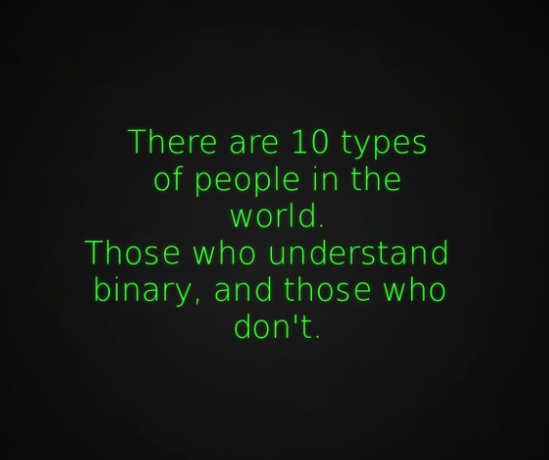
Final thoughts
The sharp contrast between the advancement in NLP/AI technologies and their limited applications in English Language Teaching
The challenge: Not the technologies; but the people
The strategy: Not to reinvent the wheel; but to leverage the existing technologies

Slide 28
References
Chan, A. Y. (2010). Toward a taxonomy of written errors: Investigation into the written errors of Hong Kong Cantonese ESL learners. Tesol Quarterly, 44(2), 295-319.
Coulthard, M. (2016). Advances in written text analysis. New York: Routledge.
Douglas, D., & Selinker, L. (1992). Analyzing oral proficiency test performance in general and specific purpose contexts. System, 20(3), 317-328.
Douglas, D., & Selinker, L. (1993). Performance on a general versus a field-specific test of speaking proficiency by international teaching assistants. A new decade of language testing research, 235-256.
Ramón, N. (2015). The English Discourse Particle ‘oh’ in Spanish Translations: Evidence from a Parallel Corpus. Procedia - Social and Behavioral Sciences, 173, 337-342. doi:10.1016/j.sbspro.2015.02.075
Ting, S. H., Mahadhir, M., & Chang, S. L. (2010). Grammatical errors in spoken English of university students in oral communication course. GEMA Online® Journal of Language Studies, 10(1).
Wang, X., & Munro, M. J. (2004). Computer-based training for learning English vowel contrasts. System, 32(4), 539-552. doi:10.1016/j.system.2004.09.011 (on compute-based learning is effective)
Wang, Y., et al., (2009) Sustained and transient language control in the bilingual brain, NeuroImage , doi:10.1016/j. Neuroimage.2008.12.055
Wetherell, M., Taylor, S., & Yates, S. J. (2014). Discourse as data: A guide for analysis. Los Angeles: Sage.

Slide 30
Automatic Generation of Transcripts of Student English Presentations using YouTube
Simon WANG Peggy LAI Louisa WONG
Language Centre
Hong Kong Baptist University
{simonwang, peggylai, louisawong}@hkbu.edu.hk

