Slide 1
Supakarn Chamni, Ph.D. Taksina Chuanasa, Ph.D. Sornkanok Vimolmangkang, Ph.D.
Use of Social Media to Motivate Academic Inquiry and Discussion for Developing of Critical Thinking
Faculty of Pharmaceutical Sciences
Chulalongkorn University, Thailand
E-Learning Forum Asia 2018, Taiwan, May 23-25, 2018

Slide 2
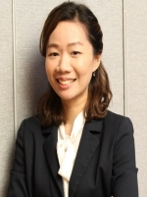
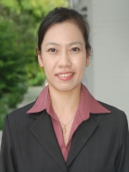
Research team and participant
Asst. Prof.
Supakarn
Chamni
Asst. Prof.
Taksina Chuanasa
Asst. Prof.
Sornkanok Vimolmangkang
Graduate Program
The Department of Pharmacognosy and
Pharmaceutical botany
Faculty of Pharmaceutical Sciences Chulalongkorn University, Bangkok, Thailand

Slide 3
Critical thinking
Thinking critically can be defined as rationally deciding what to do or believe (Blair, 1983; Ennis, 1981; Hitchcock; 1983, Norris, 1985)
CRITICAL THINKING
Complex of many consideration
Educational ideal
Look for reason behind conclusion
Having critical spirit
Sensitive to content
To think critically, one must have knowledge
Norris S. P. (1985) Synthesis of research on critical thinking. Educational leadership, 42, 40-45.

Slide 4
Skill for thinking critically
Critical
thinking
Reasoning
Analyzing
Evaluating
Judging
Reflecting
Conceptualizing
Understanding

Slide 5
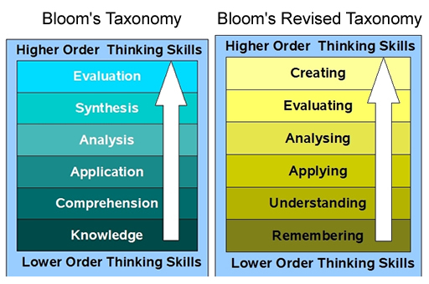
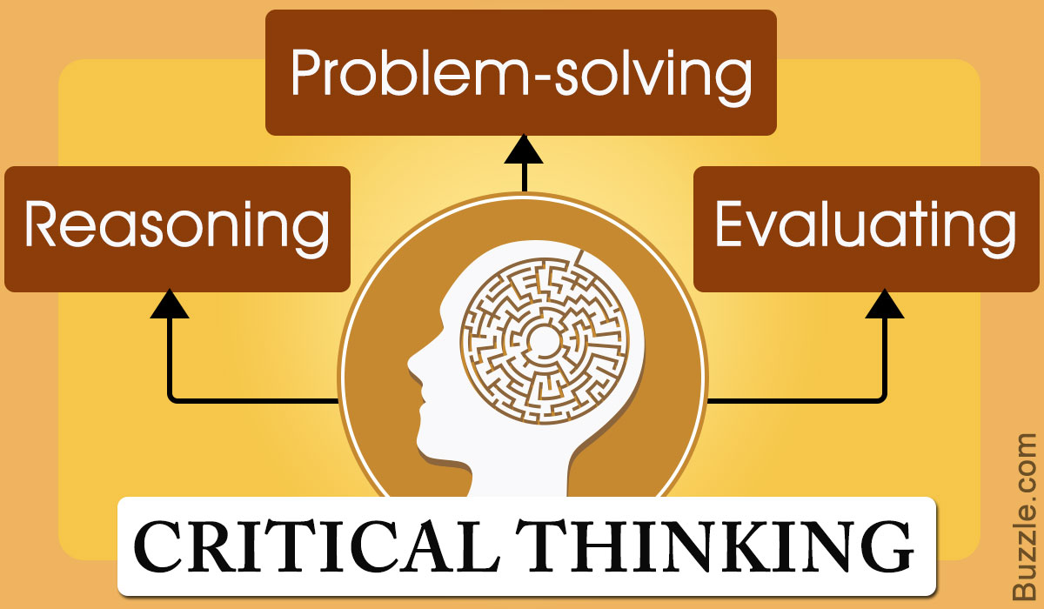
Enhancing thinking skill
Critical thinking is a domain-general thinking skill
Thinking critically promotes creativity and new knowledge
Pithers, R. T. and Soden, R. (2000) Critical thinking in education: a review, Educational Research, 42:3, 237-249
http://www.vanderkaap.org/histoforum/images/bloom.jpg verkregen 21-4-2013

Slide 6
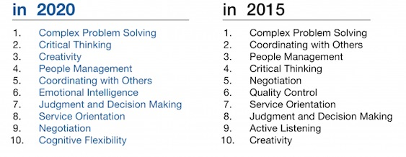
Cognitive skills need for future
The top three skills are thinking skills related to critical thinking and creativity
"The Future of Jobs” World Economic Forum, January 2016

Slide 7
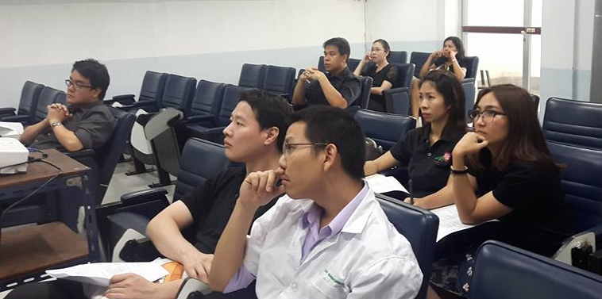
Research problem
Seminar course in graduate program
Graduate students in seminar course were lacking of ability to asking question that lead to discussion and conclusion
Students did not show their critical thinking skill
Face-to-face discussion failed to motivate peer discussion

Slide 8
Research problem
What is the reason of no participation during question and discussion?
How to motivate student to think critically?
Personal character
Lacking of knowledge
?
Stupid comment
?
No motivation
Difficult question
?
?
Peer pressure
Not interested
Don’t understand content

Slide 9
Research about online discussion
and critical thinking
Jeong, 2003; Online discussion promoted more discussion and critical thinking, and arguments led to the well drawn conclusions
Derwin, 2009; there were no significant differences between face-to-face and online learners for the critical thinking skill development
Jeong, A. C. (2003) The Sequential Analysis of Group Interaction and Critical Thinking in Online , American Journal of Distance Education,17:1, 25-43
Derwin, E. (2009) Critical Thinking in Online Vs. Face-to-Face Higher Education. Media Psychology Review. Vol. 2(1)

Slide 10
Research about online discussion and critical thinking
Guiller, 2008; critical thinking was found in the online condition and students preferred this mode of discussion
Cheong, 2008; online discussion showed positive attitudes, however guides on designing good questions was recommended to foster critical thinking skills in this environment
Guiller, J., Durndell, A. and Ross, A. (2008) Peer interaction and critical thinking: Face-to-face or online discussion?, 18, 187-200.
Cheong, C-M. and Cheong W-S. (2008) Online discussion and critical thinking skills: A case study in a Singapore secondary school. Australasian Journal of Educational Technology, 24, 556-573.

Slide 11
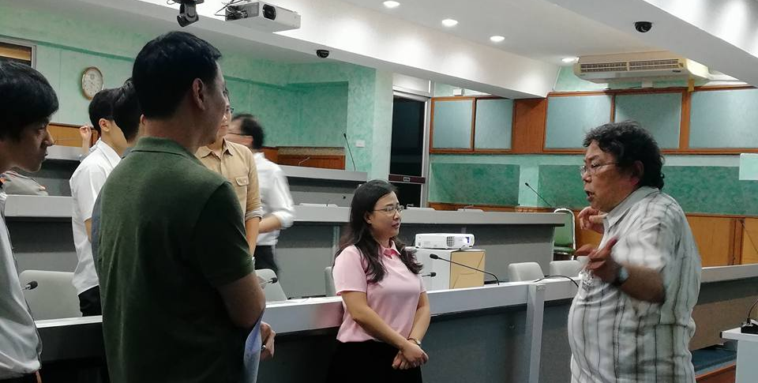
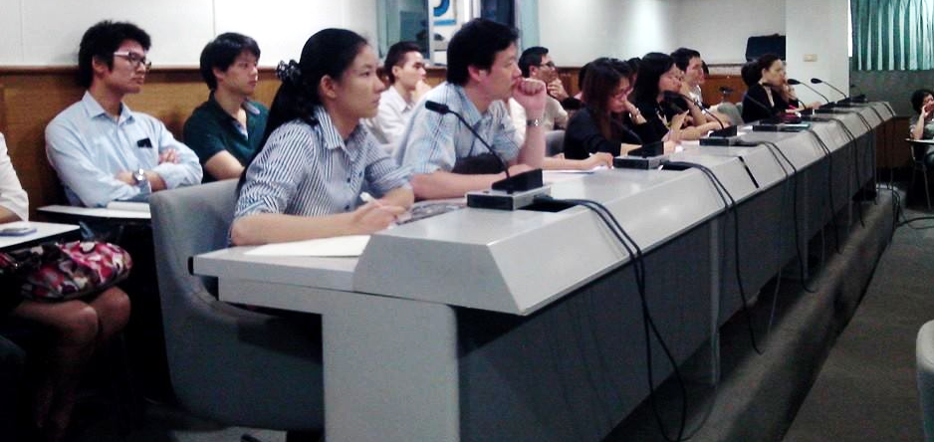
Research methodology
Objective
1. To motivate students to practice their critical thinking skill by using online discussion forum
2. To guide students how to enhance their critical thinking skill by asking open-ended questions
Participants
20 Graduate students of Department of Pharmacognosy and Pharmaceutical botany
Duration
Consecutive 2 semesters

Slide 12
Online discussion platform
Every students have Facebook account
High chance of daily use
Convenience and accustom
Free of charge
Acceptable feature to be integrated

Slide 13
Hypothesis
Using suitable online discussion platform would reduce personal barrier such as peer pressure and background knowledge which inhibits critical thinking development in participants
Using suitable online discussion platform would encourage participants to think critically by ask question, discussion, analyzes content and get to point of conclusion
Online discussion would provide freedom and comfortable zone of individual thinking
Online discussion
Critical thinking
Creativity and new knowledge

Slide 14
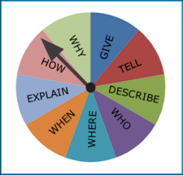
Research methodology
Semester 1
face-to-face discussion
all participant must ask at least 3 questions in class
questionnaire
Semester 2
open-ended question practice
face-to-face in combination with online discussion
all participant must ask at least 3 questions in class
questionnaire
Data collection
Number of question
Type of question

Slide 15
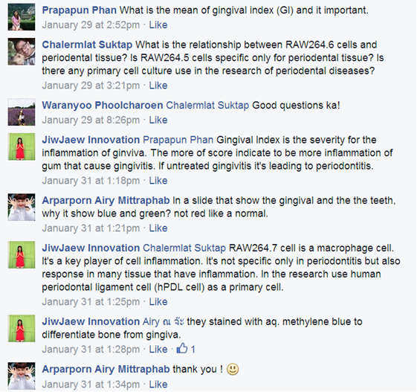
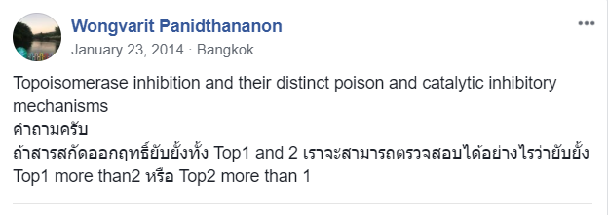
https://www.facebook.com/groups/534849106594941/

Slide 16
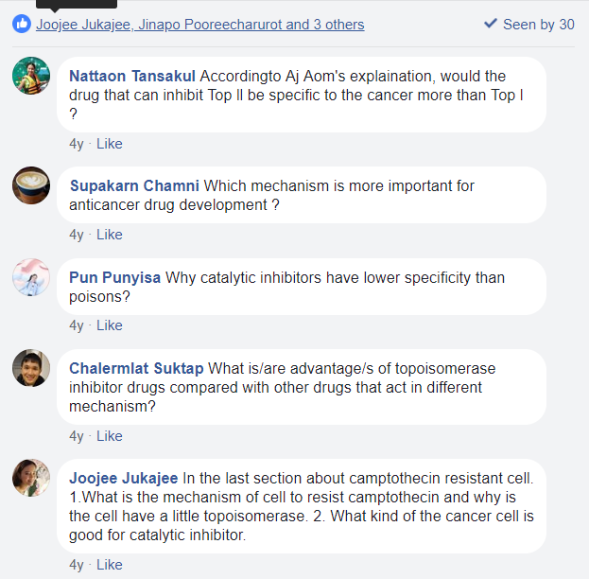
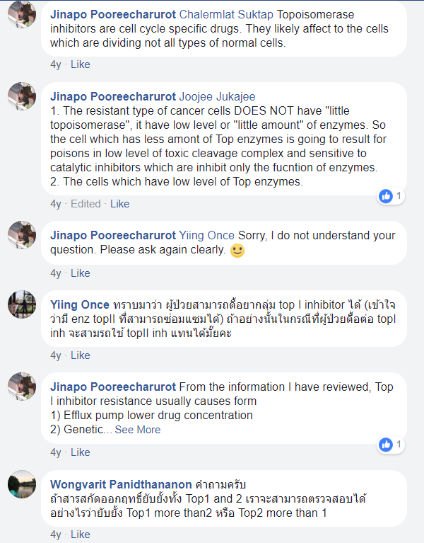
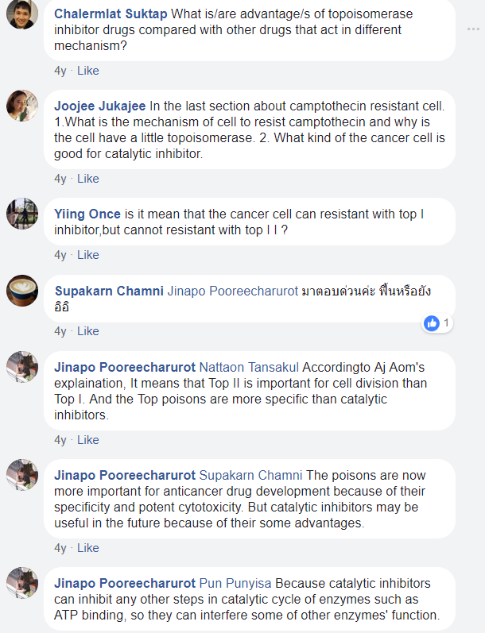
https://www.facebook.com/groups/534849106594941/

Slide 17
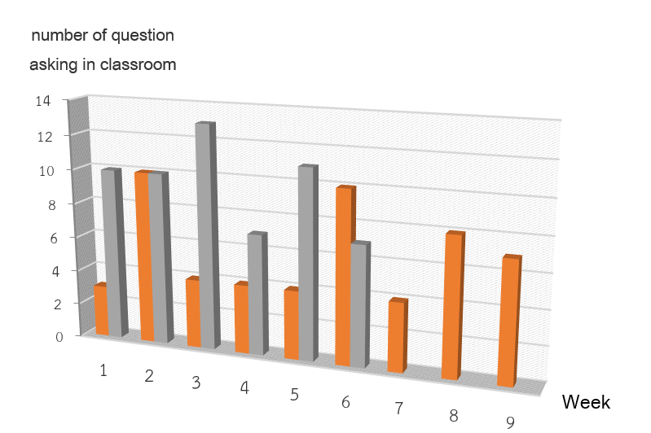
Result and discussion
Semester 1: face-to-face 9 seminars
Semester 2: face-to-face and Facebook 6 seminar

Slide 18
Result and discussion
Condition | Face-to-face | Face-to-face and Facebook
Participant | 20 persons | 19 persons
Seminar | 9 | 6
Average number of question each week in classroom | 6 | 10
Number of discussion in classroom | 0 | 1
Number of online discussion | 0 | 2
Close ended question | 33 | 45
Open ended question | 22 | 13

Slide 19
Result and discussion
In classroom question
Type of in classroom question
Open ended
question
16.88%
Close ended
question
25.71%
Average
Question per
person
6.13%
Average
Question per
week
23.40%

Slide 20
Surveys
Condition | Face-to-face | Face-to-face and Facebook
Why do you not ask question? | Worry about friendship Worry that friend can not answer their question | Don’t understand seminar content
Why do you ask question? | Interesting in seminar content | Interesting in seminar content
What is the best way to encourage you to ask question? | Rule and points | Practice with friends
What type of question should be ask in seminar? | Opinion and knowledge sharing | Explain for more understanding

Slide 21
Conclusion
Use of Social Media such as Facebook can change participant learning behavior
Online discussion can motivate question and discussion activity in classroom
Online discussion allows participant to have freedom of thought and enhance critical thinking
Online discussion reduces classroom pressure
Asking question helps for enhancing critical thinking
Provide enough time for asking question by using online discussion is the key to improving critical thinking skill
Teacher is the key facilitator to create active learning environment

Slide 22
Acknowledgements

