Slide 1
Development of a Mobile Application for Lead(II) Ions Detection and Active Learning in Chemistry Eric H. C. CHOW, Wanzhu LI, Kangning REN, and Han SUN
Eric Chow
Apps Resource Centre
eLFA2018 Taipei
May 24, 2018

Slide 2
Design and build educational mobile apps for publicly-funded universities in Hong Kong
Engage and mentor students to develop coding and design skills through apps making (school projects, community projects)
About ARC

Slide 3
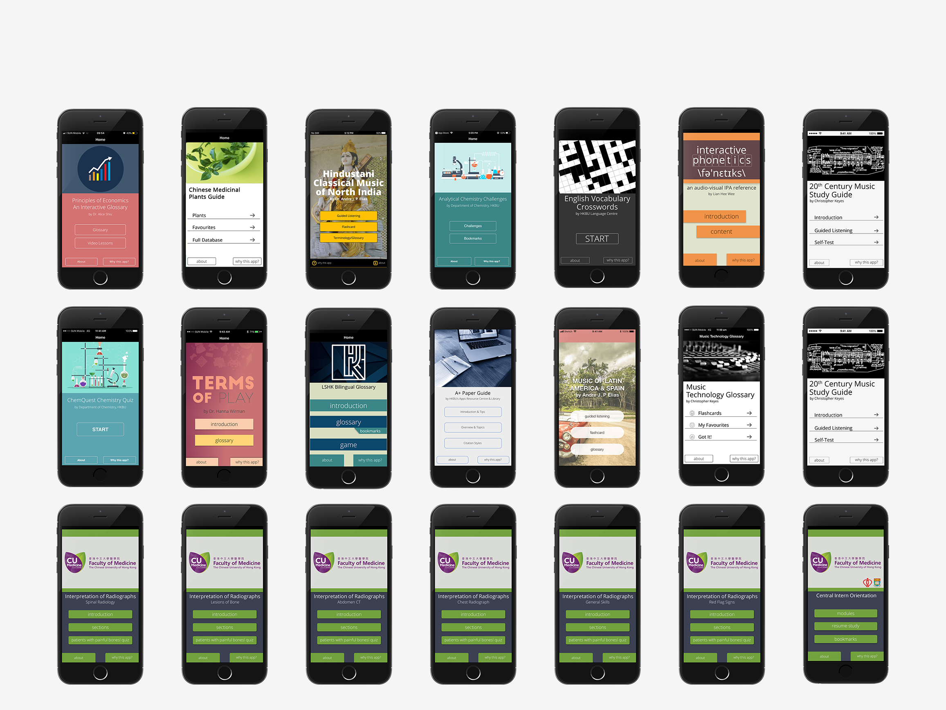
PORTFOLIO OF APPS
Total downloads: Over 127,000 (as of Feb 2018)

Slide 4
Active Learning: students participate when they are doing something besides passively listening (Bonwell, 1991)
Evidence of benefits of active learning are well documented: de Caprariis (2012), Freeman (2014), Kontra (2015).
Active Learning
Notes:
Higher knowledge retention
Improved learning outcome

Slide 5
Lead(II) ion toxic has adverse effects on the environment and human health
A method of using specific DNA complex to detect concentration of lead ions via luminescence signal has been developed (patent pending).
Lead(II) Ions Detection
Notes:
(kidney disease and high blood pressure in adults, delayed physical & mental development in infants and children)

Slide 6
Apparatus Design

Slide 7
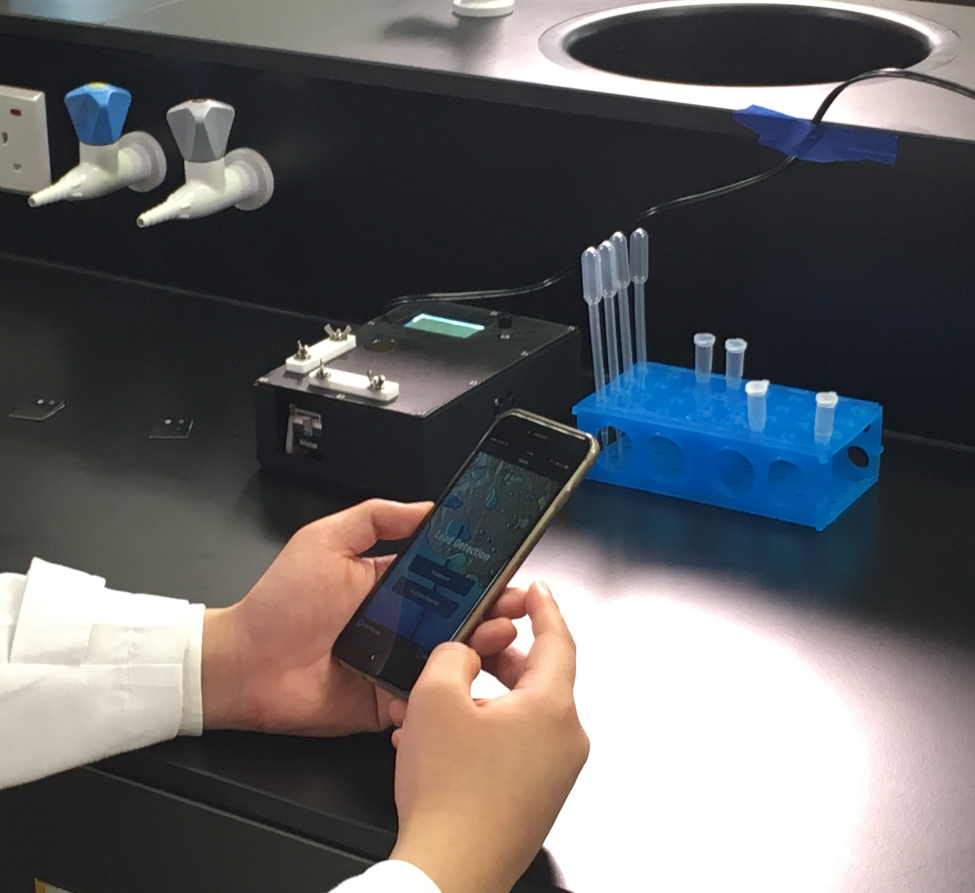
Apparatus Design
The “Lead Detecting Device for Water” invented by Dr Ren Kangning and Dr Edmond Ma is a 10-minute on-site lead detection method that uses a portable, DNA-based paper device. The device is very simple and designed for on-site lead testing of drinking water without the need of special training or skills. The ease of use, quick and accurate detection and low cost are the key advantages of this device.
Notes:
The “Lead Detecting Device for Water” invented by Dr Ren Kangning and Dr Edmond Ma is a 10-minute on-site lead detection method that uses a portable, DNA-based paper device. The device is very simple and designed for on-site lead testing of drinking water without the need of special training or skills. The ease of use, quick and accurate detection and low cost are the key advantages of this device.

Slide 8
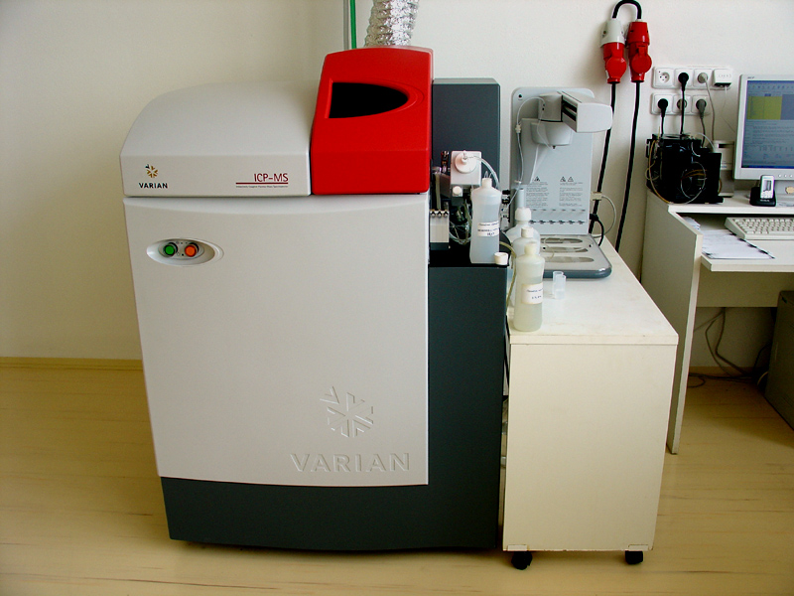
Why an App?
Inductively coupled plasma mass spectrometry
A low cost method for Lead (II) Ion detection

Slide 9
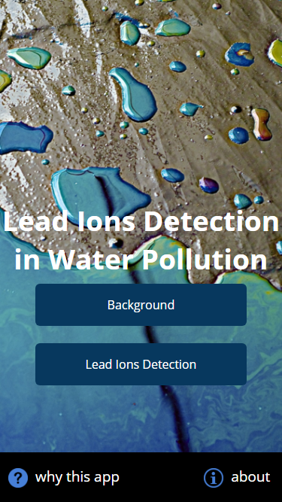
Why an App?
Inductively coupled plasma mass spectrometry
A low cost method for Lead (II) Ion detection

Slide 10
2. Enable students to actively learn and perform Lead(II) Ion detection in lab and in real-world environment through the mobile app
Why an App?

Slide 11
App Design

Slide 12
Sample to be measured
Reference
(lead-free water)

Slide 13
Use of OpenCV to compute sum of all pixel value (R-G-B channels)

Slide 14
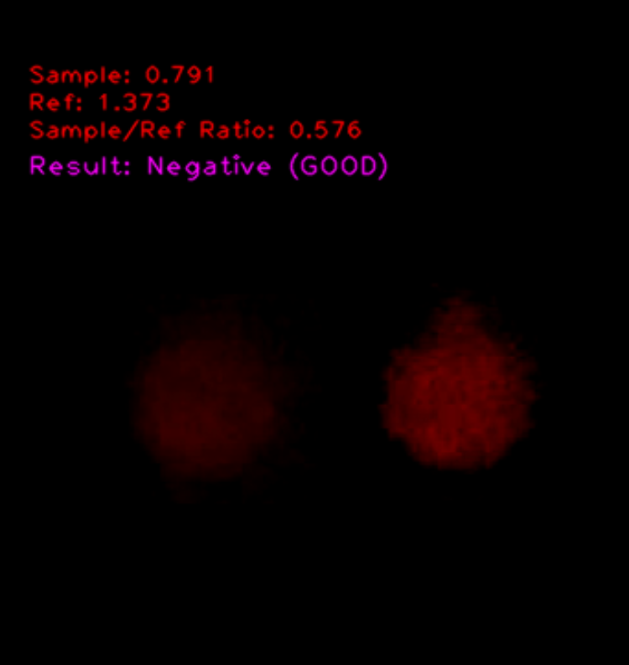
App Design

Slide 15
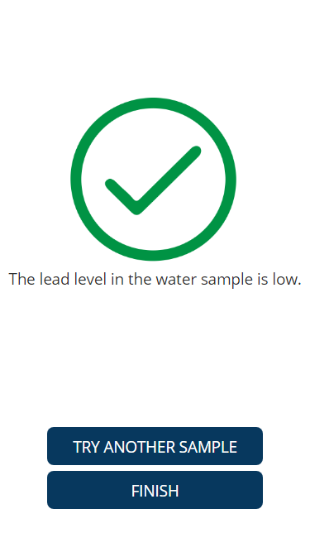
App Design

Slide 16
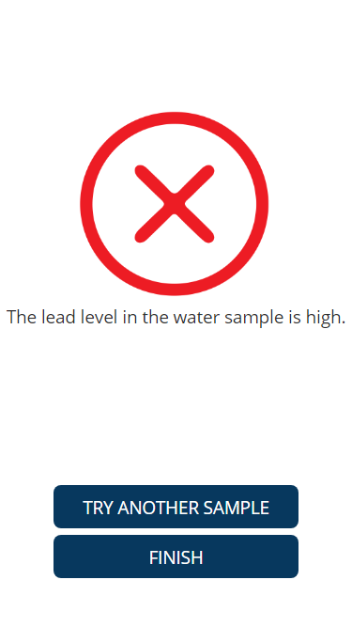
App Design

Slide 17
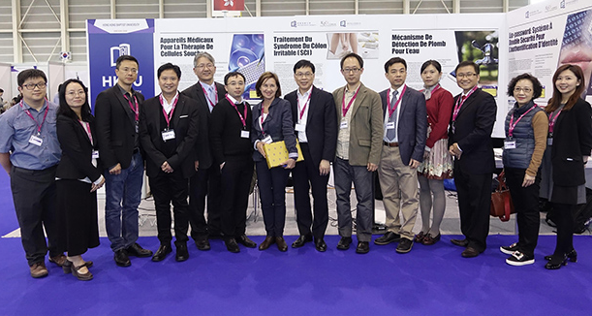
International Recognition
Gold medal award (Food and Environment category)

Slide 18
Actively construct knowledge in bioanalytical chemistry
Experience first-hand lead(II) ion detection for tackling bioanalytical chemistry and real-life problem
Mobile Learning Activity Design

Slide 19
The mobile activity is designed around (inter)active construction of knowledge by learners using collaboration and cooperation. Learners have control of the learning process and time and opportunity to reflect and develop personal meaning.
(Parsons, 2017)
Mobile Learning Activity Design

Slide 20
The mobile activity is wholly designed around a cycle of experience, observation, conceptualization, and experimentation, transformed through reflection into new knowledge.
(Parsons, 2017)
Mobile Learning Activity Design

Slide 21
Apple & Google Play stores – FREE
HKBU: Bioanalytical chemistry lab class (undergraduate level)
Deployment

Slide 22
Further Use Case
NGO workers can measure pollution level of water samples in a portable, low cost way

Slide 23
Bonwell, C. C., & Eison, J. A. (1991). Active Learning: Creating Excitement in the Classroom. 1991 ASHE-ERIC Higher Education Reports. ERIC Clearinghouse on Higher Education, The George Washington University, One Dupont Circle, Suite 630, Washington, DC 20036-1183.
de Caprariis, P., Barman, C., and Magee, P., 2012. Monitoring the benefits of active learning exercises in introductory survey courses in science: an attempt to improve the education of prospective public school teachers. Journal of the Scholarship of Teaching and Learning, Vol. 1, No. 2, pp. 13-23.
Freeman, S., Eddy, S.L., McDonough, M., Smith, M.K., Okoroafor, N., Jordt, H. and Wenderoth, M.P., 2014. Active learning increases student performance in science, engineering, and mathematics. Proceedings of the National Academy of Sciences, Vol. 111, No. 23, pp. 8410-8415.
Kontra, C., Lyons, D.J., Fischer, S.M. and Beilock, S.L., 2015. Physical experience enhances science learning. Psychological Science, Vol. 26, No. 6, pp. 737-749.
Land, S.M. and Zimmerman, H.T., 2015. Socio-technical dimensions of an outdoor mobile learning environment: a three-phase design-based research investigation. Educational Technology Research and Development, Vol. 63, No. 2, pp.229-255.
Low, L. and O’Connell, M., 2006, September. Learner-centric design of digital mobile learning. In Proceedings of the OLT Conference, pp. 71-82.
Parsons, D. and MacCallum, K., 2017. A Learning Theory Rubric for Evaluating Mobile Learning Activities. International Journal of Online Pedagogy and Course Design (IJOPCD), 7(4), pp.24-38.
Sharples, M., Taylor, J. and Vavoula, G., 2005, October. Towards a theory of mobile learning. In Proceedings of mLearn, Vol. 1, No. 1, pp. 1-9.
Sun, H., Li, W., Dong, Z. Z., Hu, C., Leung, C. H., Ma, D. L., & Ren, K. (2018). A suspending-droplet mode paper-based microfluidic platform for low-cost, rapid, and convenient detection of lead (II) ions in liquid solution. Biosensors and Bioelectronics, 99, 361-367.
Zydney, J.M. and Warner, Z., 2016. Mobile apps for science learning: Review of research. Computers & Education, Vol. 94, pp.1-17.

Slide 24
Thank you!
Contact: Eric Chow
choweric@hkbu.edu.hk

