Slide 1
The Development of 360–Video Interactive Chemical Lab Safety Training
Ran Wei
Learning Technology Consultant

Slide 2
The University of Nottingham Ningbo China (UNNC)
The first Sino-Foreign university established in 2004
With more than 7800 students and around 750 members of staff

Slide 3
Content
Project Brief
Background
Development
01.
02.
Findings
03.
04.
05.
Challenge & Future plan

Slide 4
Project Brief
UNNC Small Teaching and Learning Grant winner to pilot safety training in VR format
Collaboration - a project worked together with Faculty of Science and Engineering (FoSE) and student group
Faculty raised the request to enhance safety training
Learning technologies team brought the technical solution
Student helpers produced the training materials
An activity Cocktail in Chemical Lab was organized to collect student feedback
Student participants joined the session to gain the opportunity of safety training, chemical experiments and credits
Learning Technology
Faculty
Students

Slide 5
Project Background – Learning Technology Perspective
VR for Learning
VR Library Tour
VR UX Centre
VR future project
Teach with VR
360-degree Safety Training for Chemical Lab
Teach VR
Student VR activity
Phase 2016/17
Phase 2017/18
VR for Education
Phase 2018/19

Slide 6
Project Background – Faculty Perspective
Improve student awareness of lab safety
Turn long, dry, full-text training materials to enriched multimedia materials
Standardize the lab use procedure
Draw student attention to chemical experiments
Provide more opportunities for students to access the chemistry lab

Slide 7
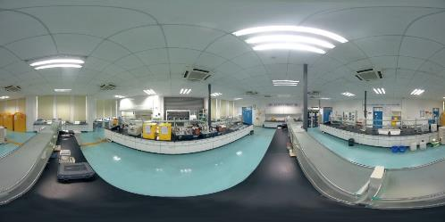
Development of 360-degree Interactive Video
Design the narrations and scenes
Recruit PhD students as the actors
Take the panoramic videos
Audio recordings
Post production
Make the interactive hotspots
Panoramic photo of chemical lab

Slide 8
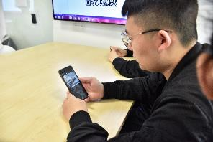
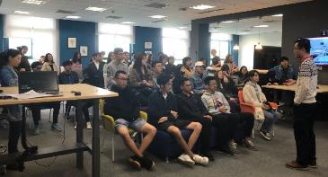
Cocktail in Chemical Lab
An activity to collect students results and feedback
A safety training session using the 360 interactive video and tutor to demonstrate
questionnaire to collect student result and feedback
Students who attended the training session and finished the questionnaire could enter the final experiment session
Cocktail in Chemical Lab safety training session

Slide 9
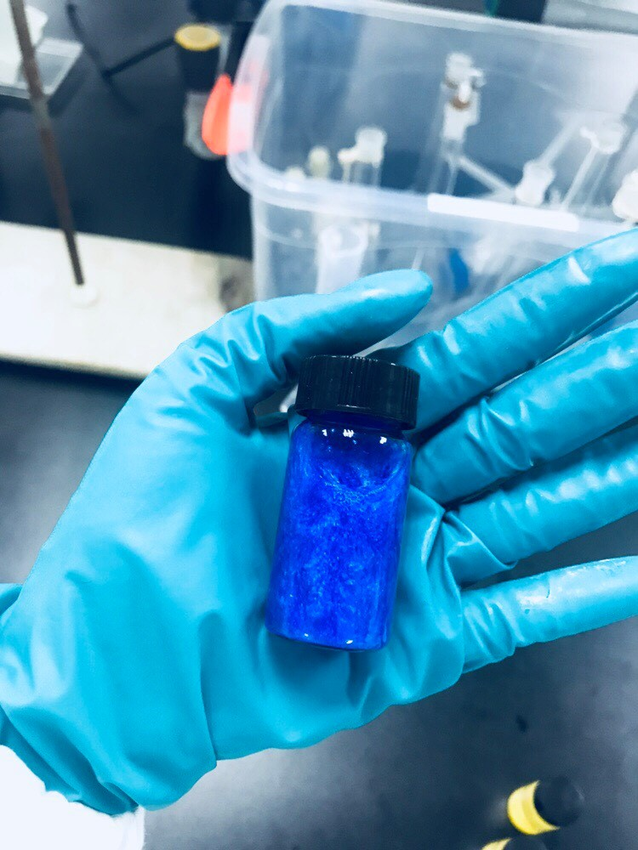
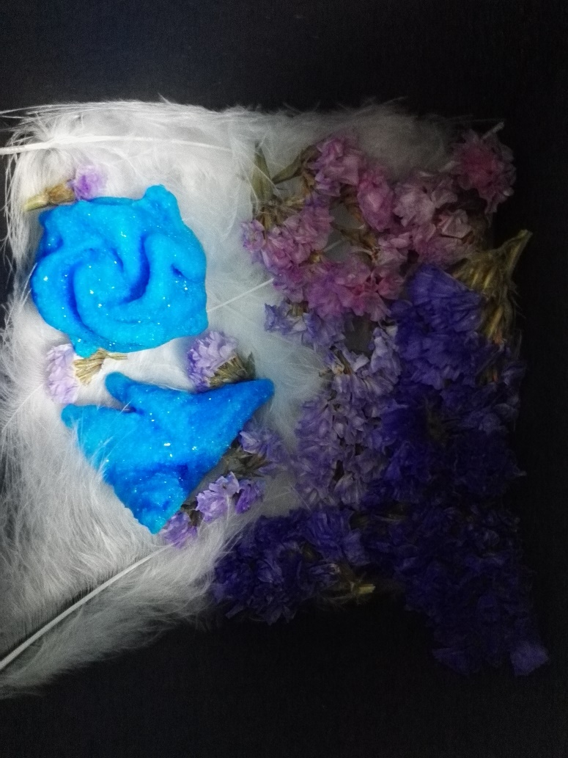
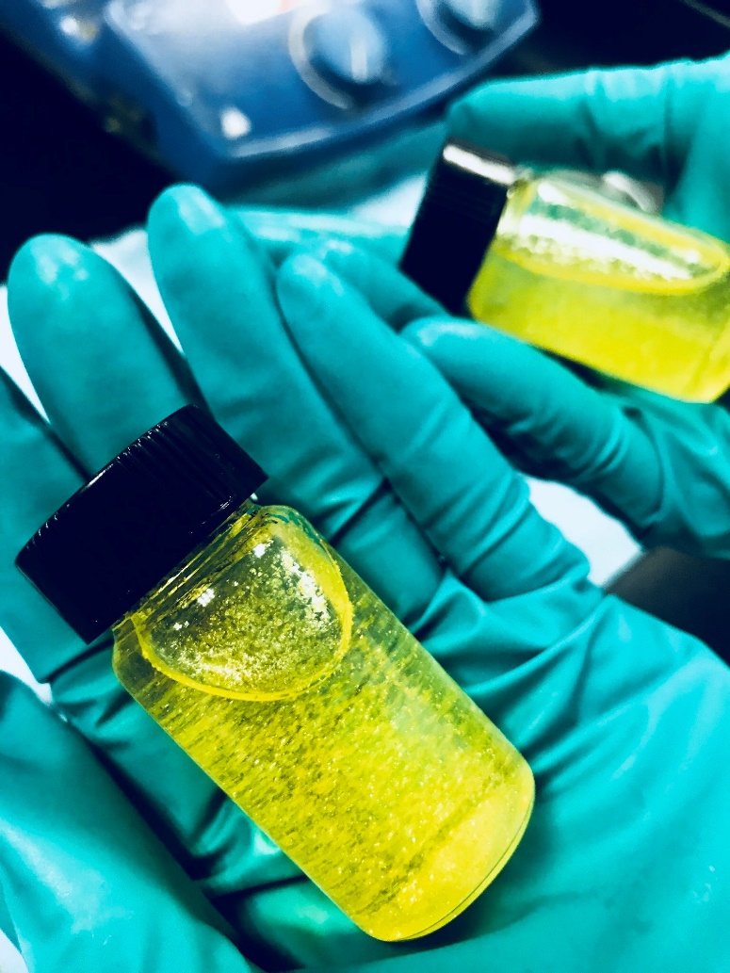
Cocktail in Chemical Lab
Blue Crystal Rain
Crystallization
Golden Rain

Slide 10
Findings
Students :
64 entries registered
49 attended the training session and finished the questionnaire
Students were from 12 different majors, 7 out of which don’t have chemical experiments
Learning outcome:
Good in multiple choice
Poor in correct procedure

Slide 11
Feedback
More than 80% of the students found it helpful and interesting
About 10% found it neutral and 10% found it not so helpful
Several students made suggestions on what other training materials we could develop in the same format

Slide 12
Challenge
Raw materials are huge
Not enough good software and hardware for video production
Not compatible with all mobile phones
User behavior change
Proper assessment
Production
Assessment
Compatibility
Target scenario
User behavior change

Slide 13
Future Development
More materials on chemical lab safety training and basic operation skill training to further the current pilot project in more formats
Safety training for other driplines and professional service department
360 videos for fieldtrip and language learning

Slide 14
Thank You
Sherry.wei@nottingham.edu.cn

