Slide 1
Preparing Future-Ready Graduates through Personalised, Self-determined Technology-Integrated Learning
Eddie Yeou
Nanyang Polytechnic, Singapore

Slide 2
Outline
1. Future Ready Graduates
2. Conceptual Framework
Elearning 2.0
Self-determined Learning
3. Blended eLearning 2.0 Environments
4. Findings & Discussions
5. Implications

Slide 3
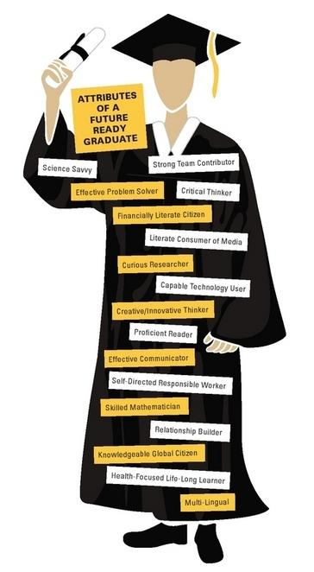
Future-ready Graduates
Future-employment-ready?
Work/Practice-ready?
21st Century-ready?
Everything/Anything-ready?
VUCA (volatile, uncertain, complex, ambiguous) world
Technology/media-suffused world
21st Century Skills such as professional communication.
Source: p21.org

Slide 4
BM0022 Effective Business Writing
Module Learning Outcome: Learners equipped with career-focused communication skills
Topics:
The 5Cs of effective business writing
Business messages (Bad news, persuasive messages etc.)
Agenda and minutes of meeting
Resume and cover letter
Formal business report
Source: p21.org

Slide 5
Research Design
Explore the effectiveness of using eLearning 2.0 and self-determined learning for 21st Century skills – professional communication skills
What does elearning and elearning look like for future-ready graduates?
Quasi-experimental design
12-week intervention
Pre and post questionnaires
Pre and post proficiency tests
10 classes, 241 participants, 5 instructors

Slide 6
Conceptual Framework
Heutagogy
(Self-determined Learning)
eLearning 2.0
Open, flexible eLearning conception that places learners in a social, personalised, adaptive learning process (Haj-Bolouri, Flensburg, & Thapa, 2016)
Holistic, learner-centred approach – learner negotiation, flexible curriculum, co-development (Blaschke & Hase, 2016)
Personalised, Blended
eLearning 2.0 Environments
Converged blended technology-integrated learning environment

Slide 7
Blended eLearning 2.0 Environments
Transformed | Traditional
Goal setting Curriculum delivery and learning activities negotiation Blended eLearning 2.0 environments: Guided experiential learning via Instructor-led tutorials with writing drills and exercises Peer learning through self-directed tutorials with embedded collaborative e-activities Self-directed learning via integrated e-learning activities Self-directed learning via web-based elearning packages: Online writing strategies, strategies for writing professional documents Social learning on Facebook writing group Authentic learning via online case studies and real-world situations Competency-based learning approach to curating additional elearning content Co-teaching opportunities where learner teams presented writing solutions and taught writing strategies Performance-based learning through group project work and assessed using performance tasks Formative and summative assessments with assessment negotiation Reflective learning through summative reflection on skill building and growth | Structured lesson plans Blended learning environments: Guided experiential learning via Instructor-led tutorials with writing drills and exercises Self-directed learning via elearning replacement of topics Self-directed learning via instructor-supervised elearning completion during tutorials Self-directed learning via web-based elearning packages: Online writing strategies, strategies for writing professional documents Authentic learning via offline case studies and real-world situations Formative and summative assessments Reflective learning through summative reflection

Slide 8
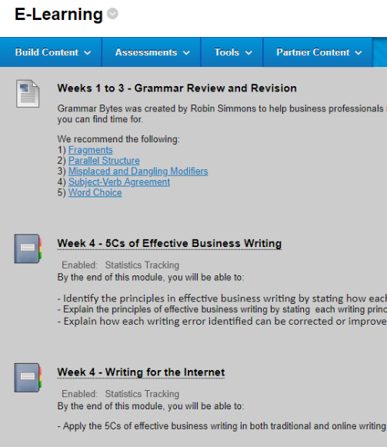
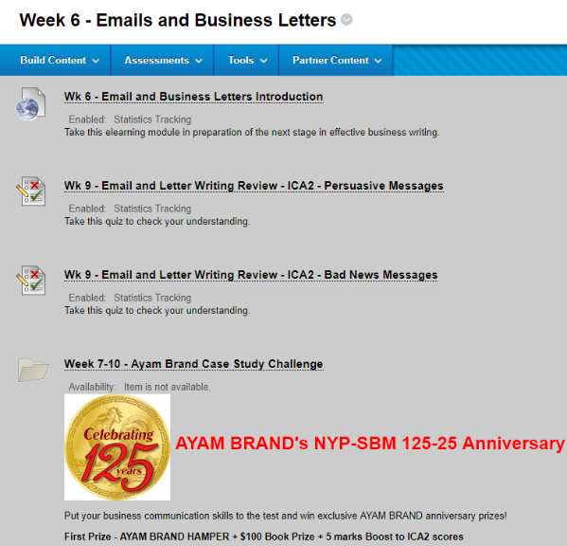
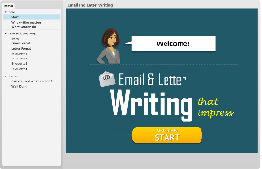
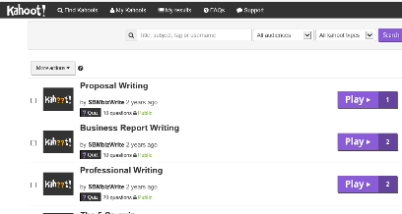
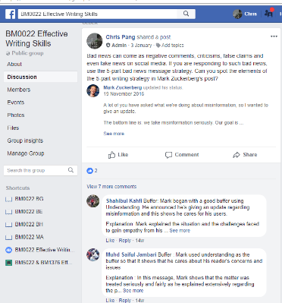
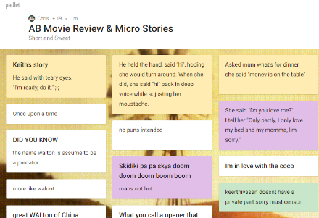
Blended eLearning 2.0 Environments
E-Lesson Plan – Learners can negotiate what, how, how much to cover.
Technology-integrated activities with authentic professional communication challenges
eLearning packages, Web 2.0 activities, co-teaching activities

Slide 9
Findings – Social Media Habits
 | Experimental n=114 | Control n=127
Age (median) | 18 yrs old 95 (83.3%) | 18 yrs old 101 (79.5%)
No. of years using social media | ≥5 years 91 (79.8%) | ≥5 years 94 (74%)
No. of times accessing social media per day | ≥6 times 96 (84.2%) | ≥6 times 103 (81.1%)
No. of hours spent on social media per day | ≥1 hour 108 (94.7%) | ≥1 hour 114 (89.8%)
Learners started on social media in pre-teens.
High social media consumption per day

Slide 10
Findings – Learning Preferences
 | Experimental n=114 | Control n=127
Learning format preferences Social Media/Online In-class Group-based/Peer-based | 3.48 3.36 2.96 | 3.47 3.45 3.04
Learners preferred social media/online learning.
Learners may favour the freedom more though!

Slide 11
Findings – Self-determined Characteristics
 | N | Mean | Std. Deviation | T
Experimental | 104 | 3.37 | .63 | 2.49*
Control | 120 | 3.16 | .62
*p<.05
Learners:
More likely to take charge of own learning.
More willing to suggest topics, negotiate delivery & learning activities, & experience greater control of learning
Increased perceived writing proficiency gains

Slide 12
Findings – Proactivity
 |  | Proactivity
Learner Negotiation | Correlation Coefficient | .483**
 | Sig. (2-tailed) | .000
 | N | 104
Learner’s Sense of Control | Correlation Coefficient | .414**
 | Sig. (2-tailed) | .000
 | N | 104
Higher learner negotiation and sense of control translated to higher learner proactivity
More likely to seek additional coaching, pursue learning beyond the classroom

Slide 13
Findings – Digital Literacy
 |  | Digital Literacy (Technology-embedded Activities)
Learner Interest | Correlation Coefficient | .562**
 | Sig. (2-tailed) | .000
 | N | 104
Learner’s Extra Learning | Correlation Coefficient | .542**
 | Sig. (2-tailed) | .000
 | N | 104
Technology-embedded activities were corelated with learner interest and extra learning.
Learners more likely to enjoy learning, and learn beyond the topic.

Slide 14
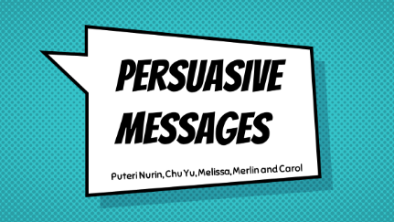
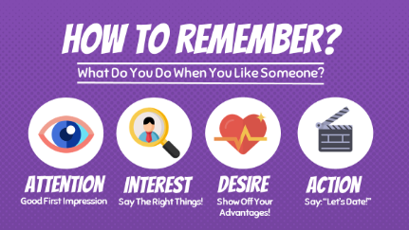
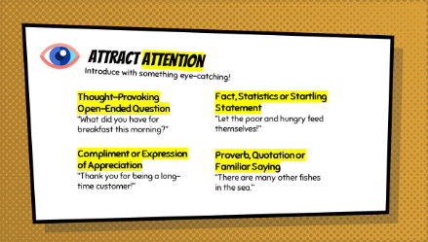
Findings – Learners’ Co-Developed Content
Learners co-developed high quality, relevant, participatory content!

Slide 15
Implications
eLearning 1.0’s transmissive mode increasingly challenged
Shift towards a multiplicity of skills
Skills building comes first for future-ready graduates using heutagogy (personalised, self-determined learning).
Perhaps, future-ready educators are urgently needed!
Blended eLearning 2.0 environments may well be a viable future for preparing future-ready graduates.

Slide 16
For enquiries, explorations, collaborations & future possibilities:
Eddie Yeou
School of Business Management
Nanyang Polytechnic
Eddie_Yeou@nyp.edu.sg

