Slide 1
Enhancing Student In-Class Engagement with the Echo360 Active Learning Platform (ALP)
Daniel DAI
Learning Technology Consultant
The University of Nottingham Ningbo China (UNNC)
Notes:
Good afternoon everyone. Thank you for your attention. I am Daniel, learning tech cons, from UNNC, UNNC for short. In this semester, we are running a pilot at UNNC to enhance student in-class engagement by using ALP. I’d like to share our experience during this pilot to you. Hopefully it would be helpful to the similar practices in you institutions.

Slide 2
About UNNC
Established in 2004
The first Sino-foreign university in China
Run by The University of Nottingham with co-operation from Zhejiang Wanli Education Group
More than 7,800 students
Vast majority recruited from Mainland China via Gaokao system
Notes:
First of all, let me introduce our UNNC very briefly.
UNNC is established in 2004, first….
UNNC is a joint venture, which is run by UNUK and Zhejiang Wanli Edu Group.
There are more than 7800 students at UNNC. Most of majority….

Slide 3
Before (Students)
Might not understand contents
Don’t ask question
Few interaction with academics and peers
Listen and think
Notes:
Now let me explain why we’d like to run this pilot at UNNC.
On the left, students are attending a lecture. Some… some don’t understand.
Domestic UG, don’t ask question.
There is few interactions.
They listen and think in lectures.

Slide 4
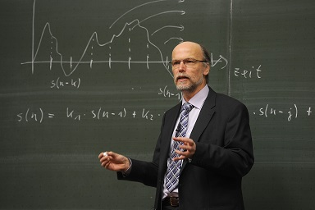
Before (Academics)
Hard to tell who understand
To which extend students understand
No real-time barometer in class
Assignment, exam etc -- too late
A lecturer
Notes:
On the other hand,

Slide 5
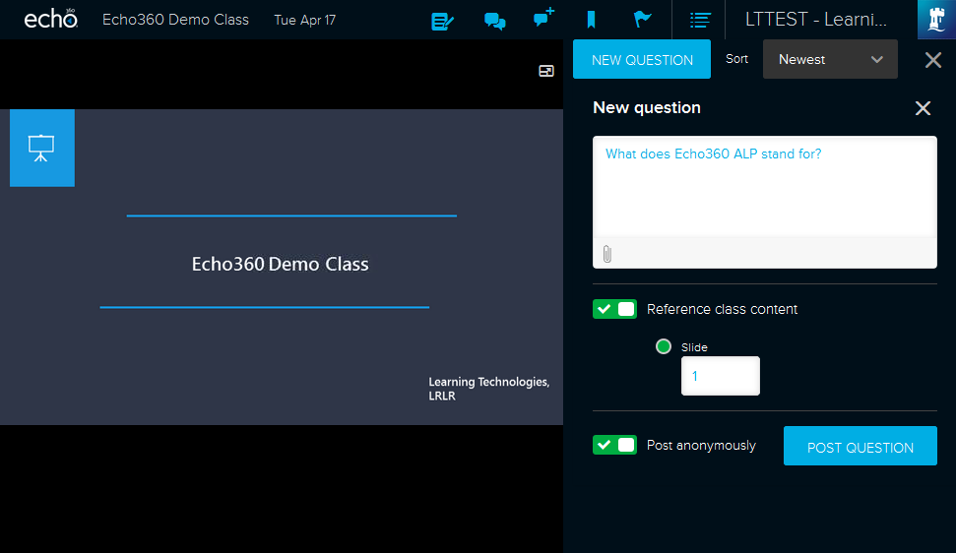
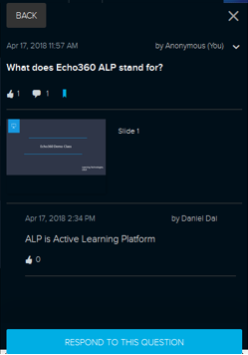
After (Students)
Notes
Bookmarks
Confuse Flag
Post questions
Answer questions & discuss
Raise confuse flag
Take notes and bookmarks
Listen, think, share and collaborate
Notes:
Let’s then take a look at changes brought by this pilot and Echo360 ALP.
On the left, this is a student view of Echo360 ALP. This is lecture’s slides uploaded by the lecturer before class.

Slide 6
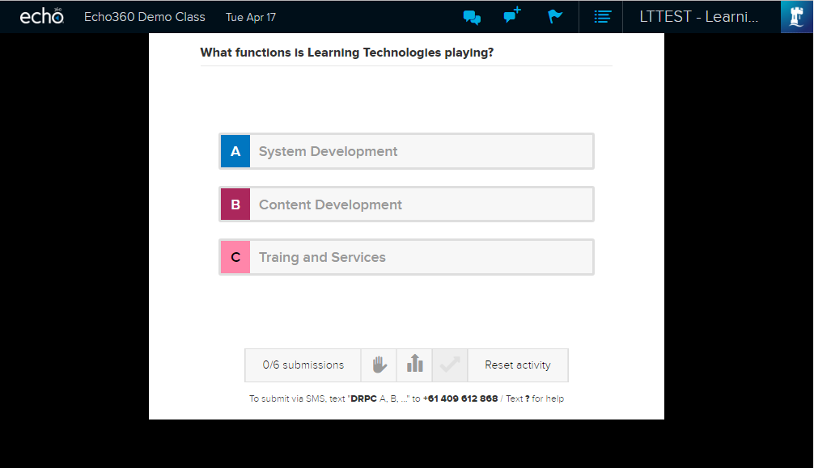
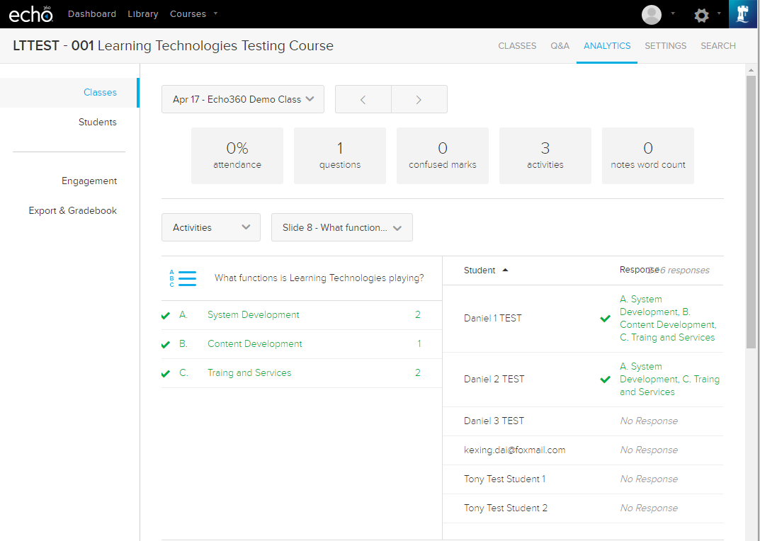
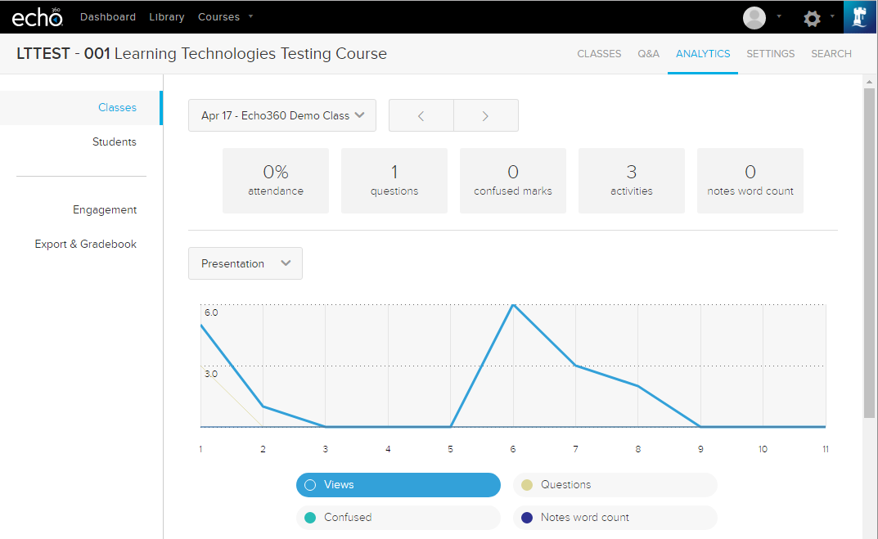
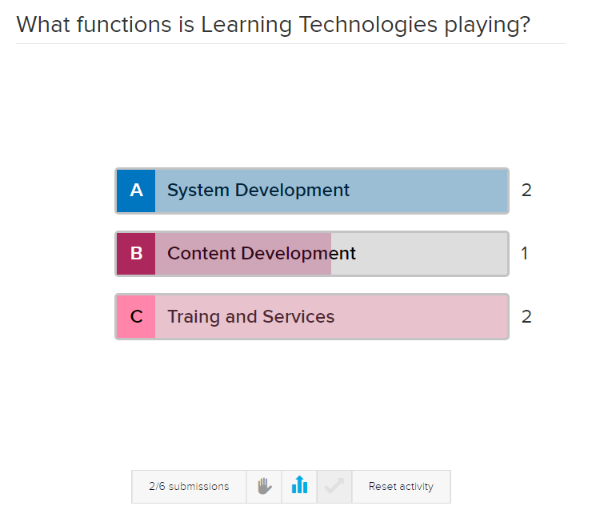
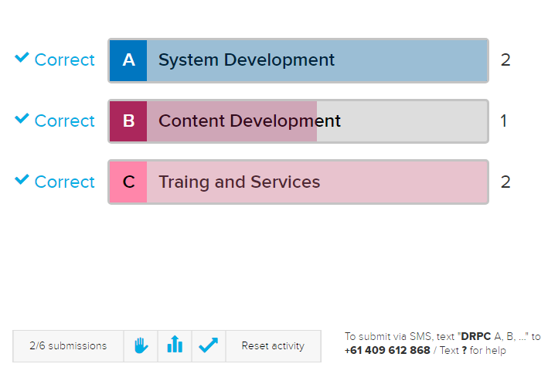
After (Academics)
Post quiz in class
Show real-time submissions
Publish solution
Multi-dimensional data analytics
A lecturer, facilitator and leader

Slide 7
Deliverables
Pilot License
2-month trial license
Research
Presentation on eLFA 2018
Recruitment
6 academics, 146 students
Survey
Effectiveness & efficacy
Doing now
Consultation
1-to-1 consultation
Class
Observe and support classes
Notes:
Then, I’d like to show you the major deliverables of this pilot.
License
We are not decision and policy maker in T&L. Have to recruit.

Slide 8
Key figures (Mar – May 2018)
6
Academics
Participating
28
Presentation
Uploaded to Echo360
75
Interactive activities
MCQ,, short-text question etc
146
Students
Participating
612
Presentation views
From students in-class
391
Activity participations
From students in-class

Slide 9
Challenges
Behaviour & Mind Change
Awareness and training are insufficient
Need individual mentoring and coaching
Culture & Environment
Recruitment of only self-motivated academics is insufficient
Need learning community and systematic incentives
Digital Infrastructure
Need more reliable and fast access to digital tools and learning content.
Notes:
Hard to change behavior and mind. Even for academics who are interested. Change pace.
We need to raise their awareness of that digital tools can be useful for more effective T&L.
The culture is that not every academic is willing to embrace change. Only self-motivated academics are. So systematic incentive mechanism shall be built.

Slide 10
Thanks for Watching! Questions?
Daniel DAI
daniel.dai@nottingham.edu.cn

