Slide 1
Lessen Learned From A Large Class-size Flipped Classroom: Student Mindset And Misconception
John YUEN Associate Professor, School of Nursing Co-Chair, Advisory Committee of eLearning Leader, MOOCs & SPOCs Community of Practice
The Hong Kong Polytechnic University

Slide 2
Fact sheet
Flipped classroom
Class size: 600-700
Year 1 studying in 1 of the 7 healthcare programs in FHSS
Foundation course to all healthcare professionals
Diversified background of students

Slide 3
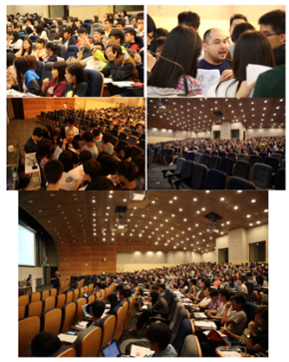

Slide 5
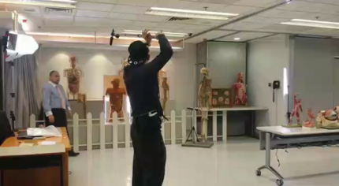
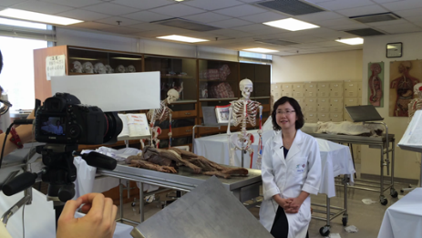
ANA101x Human Anatomy 1st launch: August 25, 2015 3rd launch just completed on March 31, 2018
Interdisciplinary
From the perspective of six healthcare disciplines
Using a real-life severe stroke case scenario
Module 1 – Stroke Case Presentation using Micro Movie
Module 2 – Generic Anatomy lectures by Animations with Voice Over
Module 3 – Healthcare-discipline Specific Role Plays and Round-up Lectures

Slide 6
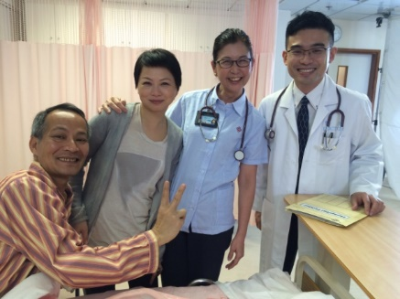
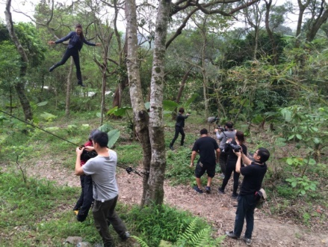
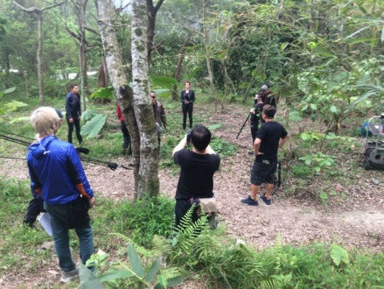
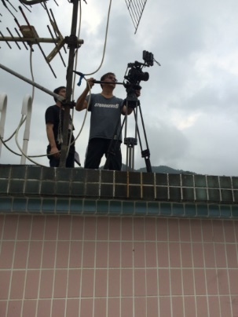
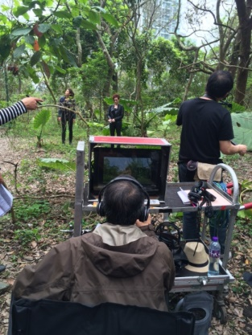
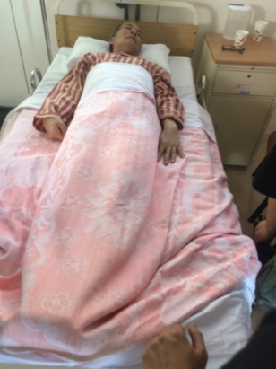
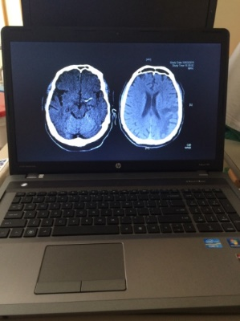
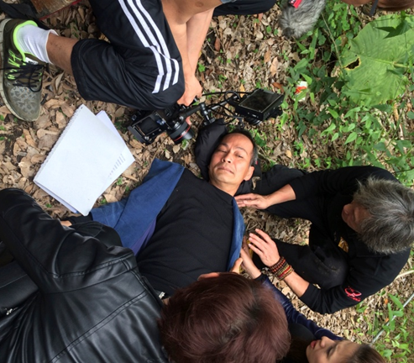
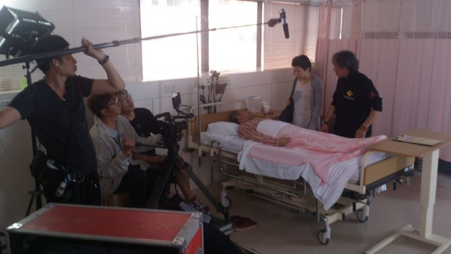
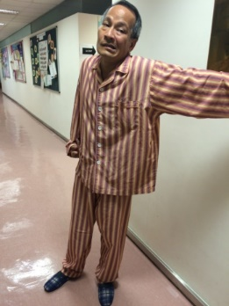
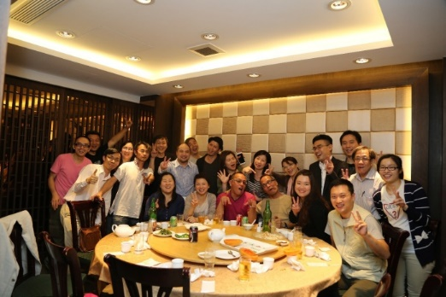
Snapshots during the micro-movie filming

Slide 7
Teaching team involves 12 local and overseas professors
Some figures:
81,489 enrollments from 183 countries;
1,065 verified learners;
702 verified certificates issued
Stimulated vigorous discussion on the topic and arose learning interest
Attracted discussions from stroke survivors and their family, in addition to health professionals

Slide 8
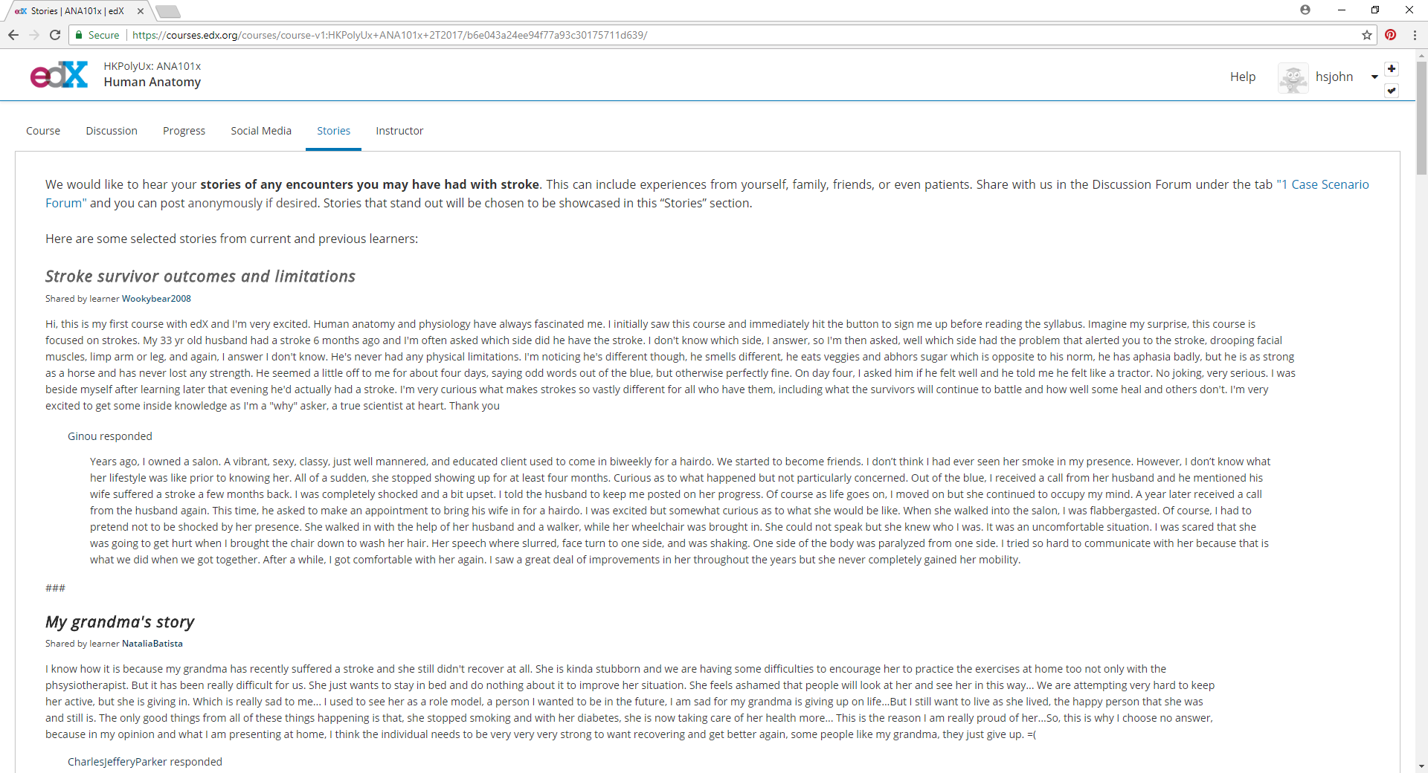

Slide 9
Encouraging comment from global learners

Slide 10
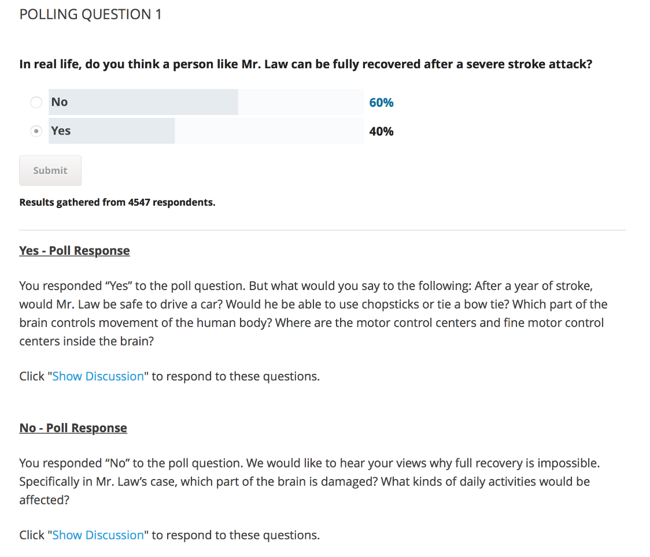
ANA101x Human Anatomy
Polling Questions
On a weekly basis
Motivated students to vote and discuss the specific topic
Established a harmonious global learning environment by using the ‘Poll Response’ discussion forums

Slide 11
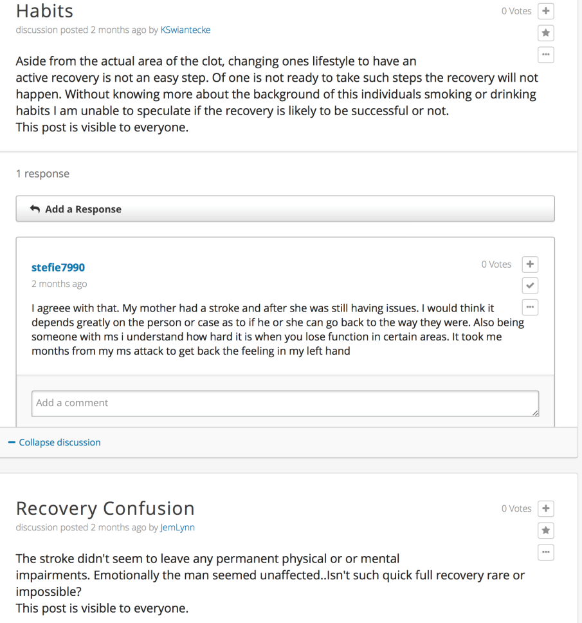
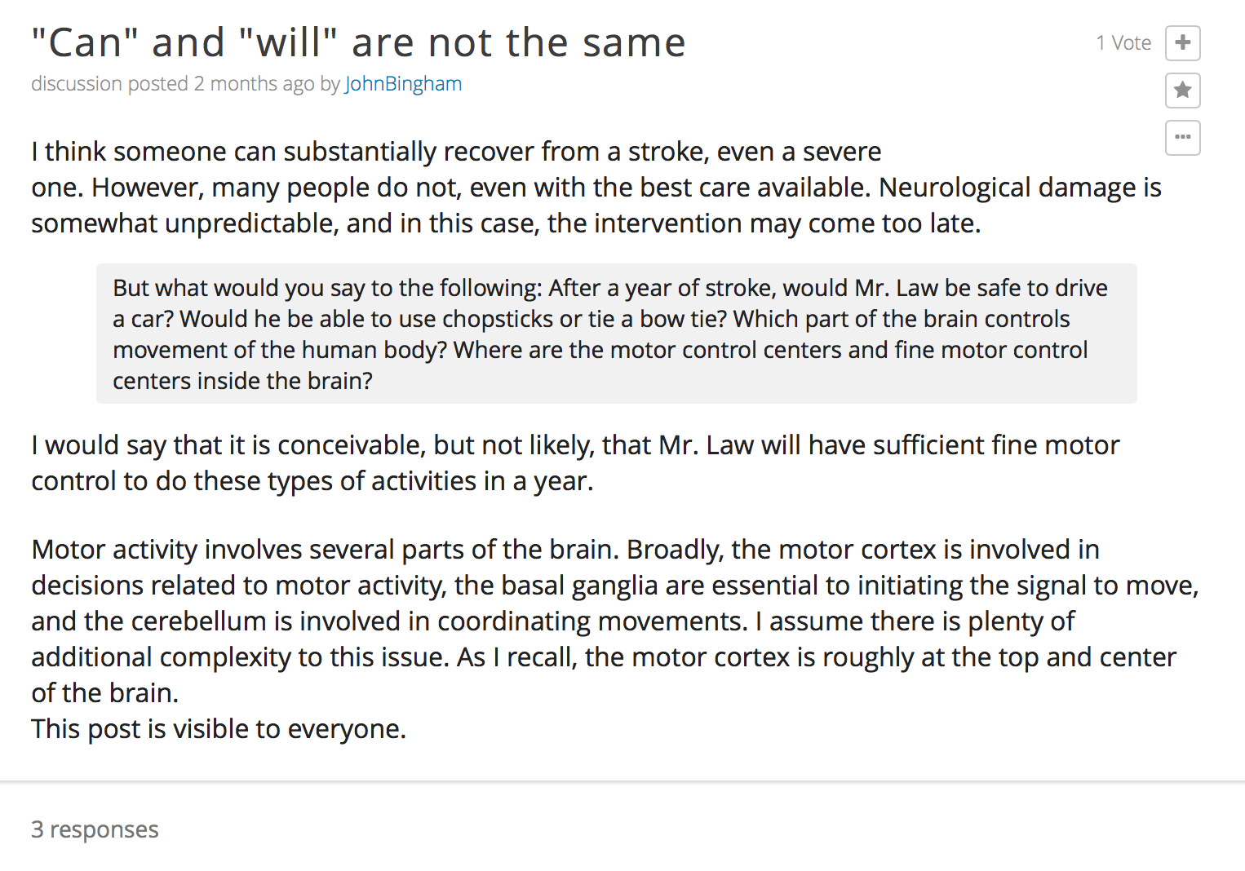
ANA101x Human Anatomy
Polling Questions
Lively discussions

Slide 12
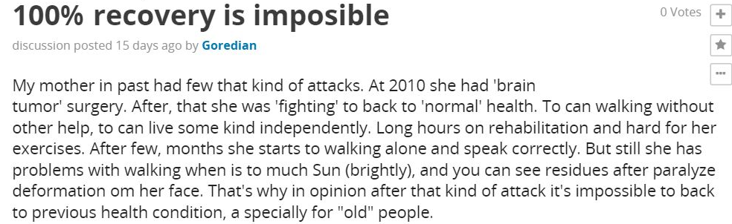
ANA101x Human Anatomy
Polling Questions
Self-driven learning
Received good comments

Slide 18
Our findings…

Slide 20
Then, we focus on the 2017/18 cohort
For understanding their views and feelings about the flipped classroom

Slide 21
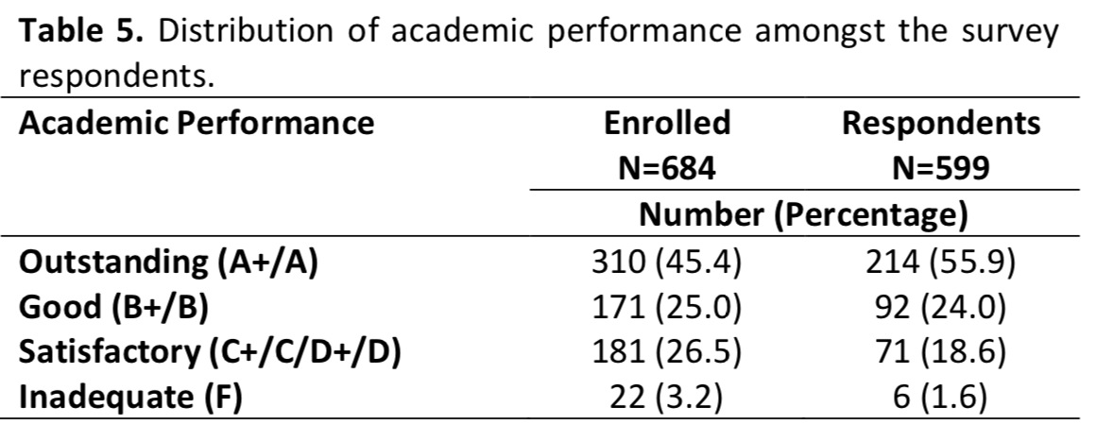
The sampled population is representative to different levels of academic achievement, although a little shifted to the right (high achievement)

Slide 24
Case study and clickers are identified as the least effective components of the flipped classroom
Expected to be Spoon fed
Learning attitude could be very different from the global learners of the MOOC

Slide 25
In the coming September
Usage of ANA101x MOOC will be further extended:
Replacing 2 lectures (out of the 13) as self-learning components
Develop 4x F2F flipped sessions (= 4 tutorial hrs) which will be graded (40% of the subject assessment using challenging questions)
Remaining tutorial sessions either self-practice with 3D anatomical visualizer or consultation with assigned tutors
Those 40% will not repeatedly assessed in the final exam (60%)

Slide 27
Further development…
The challenging questions being used in the flipped classroom will also be later-on shared and incorporate as part of the ANA101x discussion forums.
Our on-campus students will be recruited to exchange their ideas learnt in the classroom and extend their discussion with global learners.
Data being generated in these activities will be analyzed, in order to form the basis for preparing the collaborative teaching and virtual tutorials in the future.

Slide 28
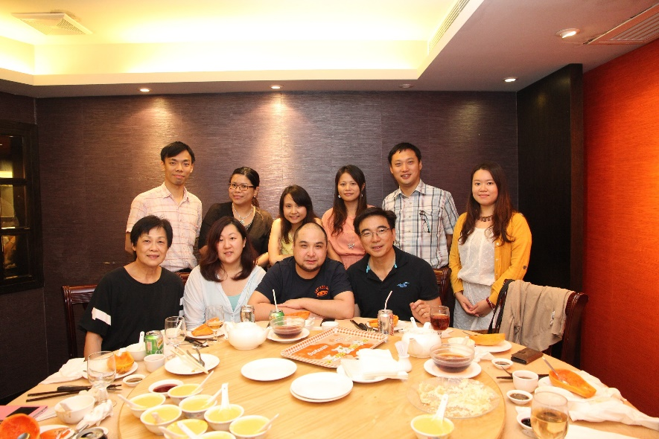
Thank you… Q&A

