Slide 1
Effects of cultural background on sediments' learning performances and perceptions in different learning contexts
PhD Student,Aciang Iku-Silan
Graduate Institute of Applied Science & Technology, NTUST, Taipei, Taiwan
Chair Professor, Gwo-Jen Hwang
Graduate Institute of Digital Learning and Education, NTUST, Taipei, Taiwan

Slide 2
Introduction
People from each culture has it’s own way of identifying and solving problems.
Despite the versatility of Eastern and Western sciences, there are some differences of learning methods existed in different cultures as yet.
Especially in the fields of humanities and social sciences, learners are often influenced by their own culture when they are learning, and it’s not easy to obtain objective and fair results.

Slide 3
Literature Review-Situational learning 1
There are four main preconditions for classroom learning in context-based learning (Anderson, Reder, & Simon 1996; Wilson 1993).Learning is built on actions in everyday situations：
Knowledge is taken from the situation and then transformed into other similar situational learning is a social process that involves thinking, understanding, problem solving, and interaction with narrative and procedural knowledge.
Except for complexity, durability, and social environment that existed from roles, behaviors, and situations, learning is learned from the reflection of context and applied in the context of everyday life..

Slide 4
Literature Review-Situational learning 2
Barab and Duffy (2000) believe that curriculum design based on “ Situational Learning ” should grasp two key points:
To meet specific learning needs, Authentic Learners’ activities should be integrated into learning environment, creating situations that enable them to think and solve practical problems (Senge, 1994).
The teaching design ethic context stories should focus more on anthropological perspectives (Lave, 1996), and enter culture through story and socialization (Malinowski, 1979).
According to James (1890), individuals contribute to the integration of situations through the motives and goals of self-contribution, as well as the community's approval and incentives. They also see peers watching various videos or developing contextual products. experience (Comello & MLG, 2009).

Slide 5
Literature Review-Situational learning 3
When the learning environment is created, it make learning easier, the natural learning environment enable learners return to reality and informal issues and the dialogue contributed by the participants, to construct solutions to solve problem with collaborative learning(Courtney and Maben-Crouch, 1996).
Young (1993) suggested that teachers designing “situational learning” in the classroom should guiding learners involved in a complex, practical, and problem-centered behaviors to obtain knowledge.
The environment encourages the learners to understand and increase empathy so that they can better understand the context and clues of learning (Ottosson, 1997).

Slide 6
Literature Review-Learning by doing 1
The United States put forward the "American Competitiveness Initiative" in its State of the Union address and believes that the key to maintaining the future national science and technology competitiveness is to cultivate talents with STEM literacy (Bush, 2006).
STEM is a fusion of practice and interactive teaching strategies in Science, Technology, Engineering, and Mathematics to develop students' abilities to obtain knowledge and innovation in science and technology (Wendell & Rogers, 2013; Kristen & Chris, 2013; McDonald, 2012; Guzey , Roehrig, Tank, Moore, & Wang, 2014; Petit, Ganesh, & Kheddar, 2015),

Slide 7
Literature Review-Learning by doing 2
Lin, Deng, Chai, & Tsai (2013) finds the relationship between learner's science learning of self-efficacy and scientific knowledge and belief the concept and method of scientific learning (Chiou, Liang, & Tsai, 2012)
Lin and Tsai (2012) divided the scientific learning self-efficacy into five aspects in order to understand learners’ self-efficacy in scientific learning. The following sub-items are as follows：

Slide 8
Literature Review-Learning by doing 3
Conceptual understanding：the understanding and application of cognitive skills in scientific knowledge.
higher-order cognitive skills：Higher-order Cognitive skill
Practical Work：the cognitive or psychological level to complete the scientific experiment.
Everyday Application：the application of scientific knowledge in life.
Social Communication：the ability to discuss scientific knowledge with colleagues or friends.

Slide 9
Literature Review-Learning by doing 4
The robot possesses the characteristics of diverse knowledge. Natalia and Friederike (2015) have demonstrated that the application of robots in education has a significant correlation with science, technology, engineering, and mathematics.
Xu and Tsai (2014) found that teaching through robot programs is helpful to increase the learning achievement of students with low motivation.

Slide 10
Research Background & Motive 1
To avoid learning bias caused by cultural differences.
If there is no cultural homogeneity between learners and teachers, it is easy to make the learning effect bias because of cultural differences. For example, in a cooperative study in which mothers adjusted and trained their children's behavior, the findings of Japanese and American researchers showed great differences (Kim, 2001), and similar situations occurred in the educational curriculum of the indigenous people in Taiwan.
A researcher must be correct under the conditions of the research situation so as not to violate the learning results of cultural differences.

Slide 11
Research Background & Motive 2
For instance, in the past, some scholars studied the mathematics abilities of “Kpelle” tribal students (Cole, 1996). Many people responded the difficulties of local children in learning mathematics, classifying graphics, and jigsaw puzzles.
Scholars later learned it from the bargaining performance of the tribal people's daily life and found that the local people are actually very smart, and thus come to the conclusion that "regardless of the cultural differences related to mathematics, what is the expression, but the overall lack of measurement and skills must not be included. "Inside" conclusion.

Slide 12
Research Background & Motive 3
In addition to cultural differences, what are the problems with the Indigenous people’s multicultural education?
Scholars (Reys, Reys, Lapan, Holliday, & Wasman, 2003) have clearly stated that their learning goals are in the K-12 school curriculum. Many students cannot establish concepts and skills from the process. According to studies, unless all The small “parts” are presented to facilitate students’ memory. Otherwise, they will stop seeing “the whole” and become new thinking that only has a little memory and cannot create a big pattern.
This situation is exactly like an Indigenous student who would like to rashly focus on a small part of his memory without first having a broad perspective on his own culture. This would be impossible to truly understand when the learner is unable to understand for a long time. , it will lose its learning attitude and motivation.

Slide 13
Research Background & Motive 4
Cultural sensitivity
The most important feature of “cultural sensitivity” is to understand and respect different cultures. The meaning refers to the similarities and differences among people who are conscious of their different cultures and exist in people’s subjective consciousness.
This feeling is generally not given a specific value. Positive, negative, no matter it’s right or wrong, means only that those people you are aware of are quite different (Hammer, Bennett, & Wiseman, 2003).

Slide 14
Research Purpose & Problems
Are there any significant differences existed in the academic performance of learners with different background ?
Are there any significant differences existed in the academic performance of learners with different background adopt different learning approach with same learning mode ?
How to examines learning performance of learners with different cultural backgrounds through “situational learning” and “learning by doing” contexts ? and their differences in learning achievement and effectiveness in different contexts ?

Slide 15
Research Design
In this study, a quasi-experiment was conducted on the sustainable 4 weeks unit, the objective included 2 learning approaches with 4 courses.
The study lasted 4 weeks; each week involved 45 minutes of classes. Each class included a lecture and two group activities.
It was to compare the effectiveness and measure whether the culture difference existed between the Indigenous students and the Han students with ANCOVA analysis.
The covariance were the prior-test and questionnaire, while the dependent variables included learning achievement, learning attitude, learning motivation, and technology acceptance in science.

Slide 16
Introduction of 2 learning systems 1
Situational learning course
Cultural film of medicine plants at 1st week.

Slide 17
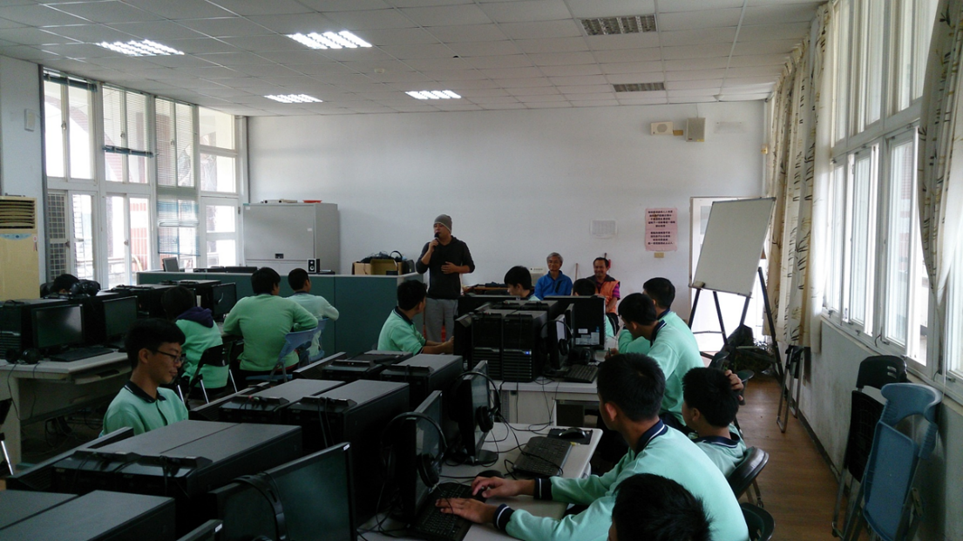
Introduction of 2 learning systems 2
Situational learning course
The protagonist of the film on-site teaching at 2nd week.

Slide 18
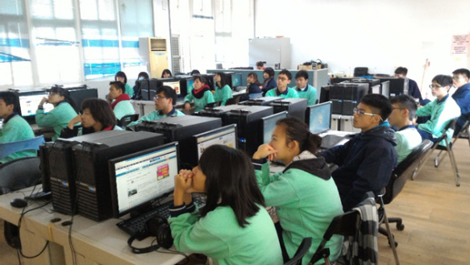
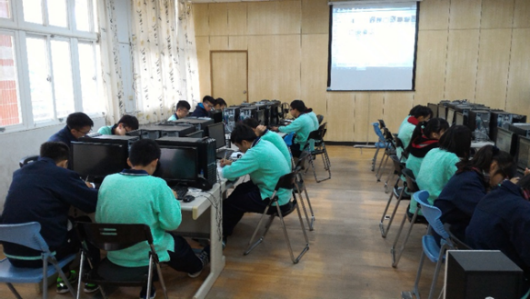
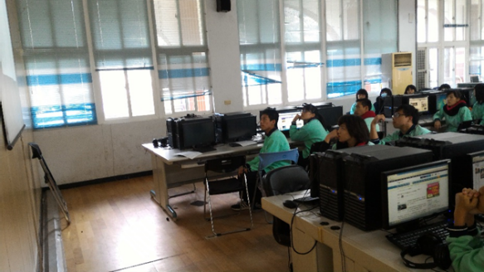
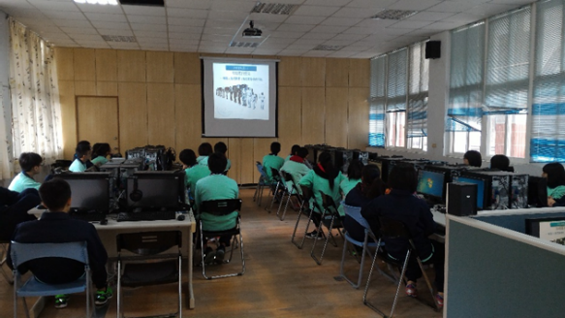
Introduction of 2 learning systems 3
Learning by doing course
The introduction film of Flipped robot at 3rd week.

Slide 19
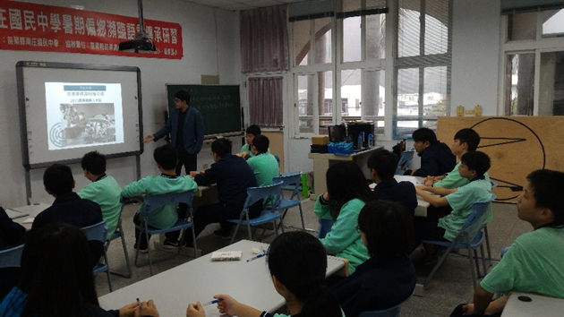
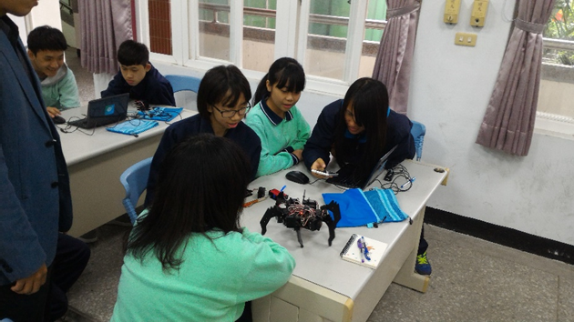
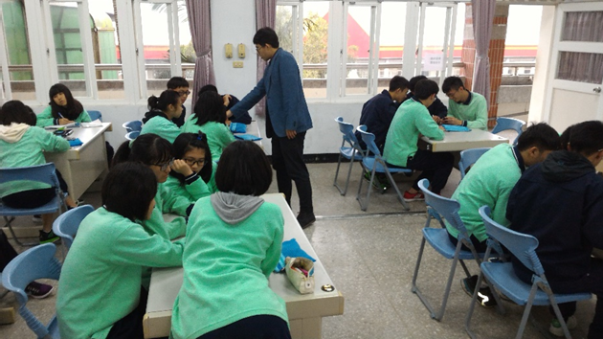
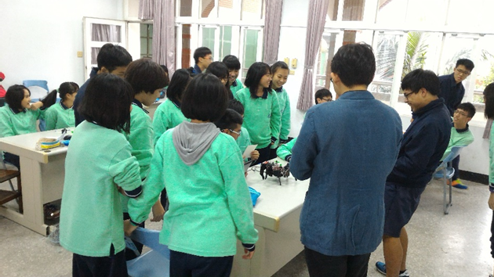
Introduction of 2 learning systems 4
Learning by doing course
Flipped Robot on-site learning at 4th week.

Slide 20
Participants
The subject included 3 classes of 3rd graders from an junior high school in northern Taiwan.
At 1st and 2nd week, a total of 67 students participated in this study; At 3rd and 4th week, a total of 71students participated in this study , the average age of the subjects was 15.
Three classes were assigned to be the Indigenous group and the Han group, all of the students were taught by the same instructor who had taught natural science course for more than 10 years.

Slide 21
Instruments 1
The test sheets were developed by 2 experienced teachers.
The pre-test aimed to evaluate the students’ prior knowledge of learning the course unit “cultural film of medicine plants” and “the introduction film of Flipped robot ” , it consists of 20 yes-or-no items, 20 multiple-choice items, with a total scores of 100.
The post-test aimed to evaluate the learning achievements of the students’ in the learning activity. It consists of 20 yes-or-no items, 20 multiple-choice items and 5 fill-in-the-blank items for assessing the students’ learning achievement addressed in the learning content of the selected course unit. The total scores of post-test was 100.

Slide 22
Instruments 2
The learning attitude scale, including a total of 7 items, was compiled by Hwang, Yang, & Wang(2013) and is also measured with 5-points Likert scale. The Cronbach’s is .93, showing high reliability of the scale.
The learning motivation scale, including a total of 34 items, was compiled by Tuan et al.(2005) and is also measured with 5-points Likert scale. The Cronbach’s is .93, showing high reliability of the scale.
The technology acceptance questionnaire originated from the questionnaire developed by Hwang et al. (2012b) . It consists of 19 items with a seven-points Likert rating scheme, including 6 items for “perceived usefulness”, 7 items for “perceived ease of use” and 6 items “learning satisfaction “, the Cronbach’s alpha values of the 3 dimensions are .94, .94 and .93, respectively.

Slide 23
Instruments 3
The open-ended questionnaire was conducted by asking the following questions：
What are the advantage of the learning approach in comparison with other approach you have experienced ? Why ?
What are the disadvantage of the learning approach in comparison with other approach you have experienced ? Why ?
Would you prefer to learn this approach for other course in the future ? Why or why not ?
Do you any suggestion that might improve the learning approach ?

Slide 24
Experimental Procedure
電腦
教室
Effects of cultural background on sediments' learning performances and perceptions in different learning contexts
30分鐘
1st week：45分鐘
2rd week：45分鐘
40 分鐘
3rd week：45分鐘
4th week：45分鐘
40 分鐘
60分鐘
The Indigenous student group (25 students)
The Han student group (42 students)
Prior-test questionnaire、Learning attitude, motivation, self-efficacy
Culture film of Medicine plants
the protagonist of the film on-site teaching
Post-test questionnaire、Learning attitude, motivation, self-efficacy, Technology acceptance
The Indigenous student group (33 students)
The Han student group (38 students)
The introduction film of Flipped robot
Flipped robot on-site learning
Post-test questionnaire、Learning attitude, motivation, self-efficacy, Technology acceptance
10 students/ group, Open-ended questionnaire

Slide 25
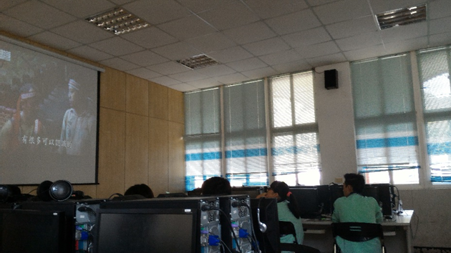
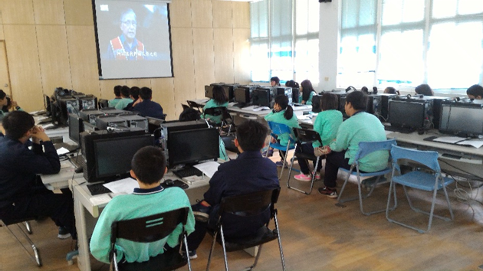
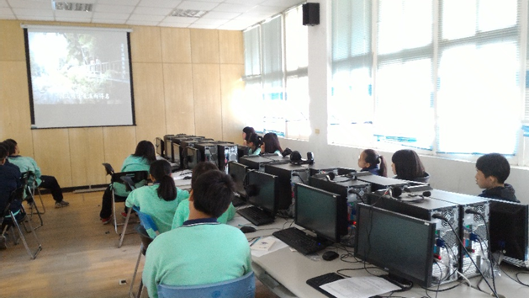
The“cultural film of medicine plants” learning at 1st week

Slide 26
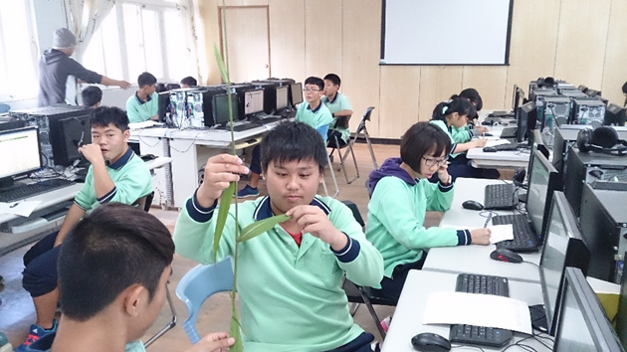
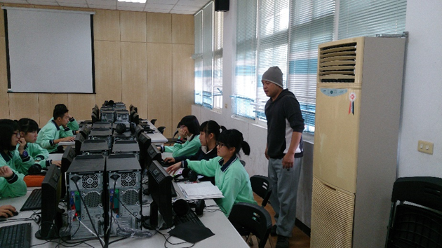
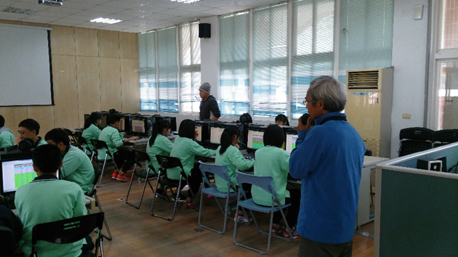
the protagonist of the film on-site learning at 2nd week

Slide 27
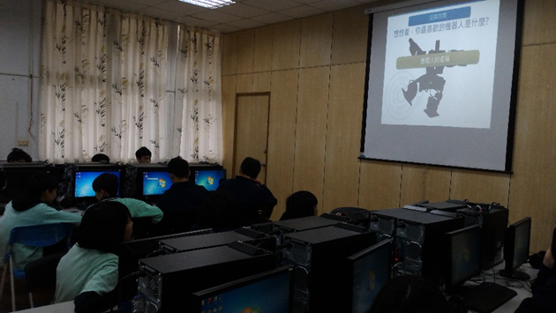
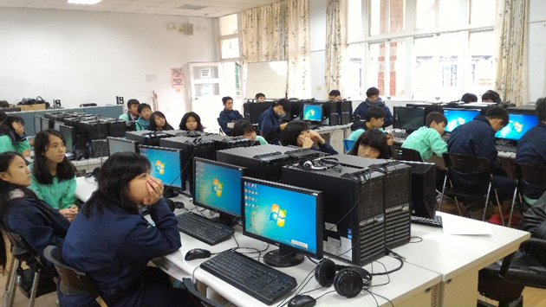
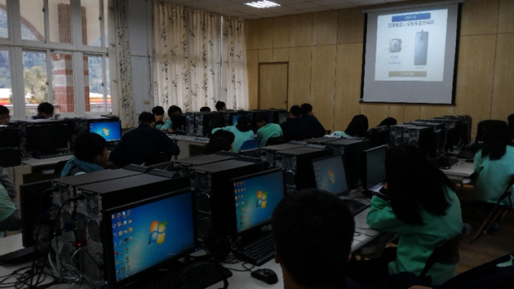
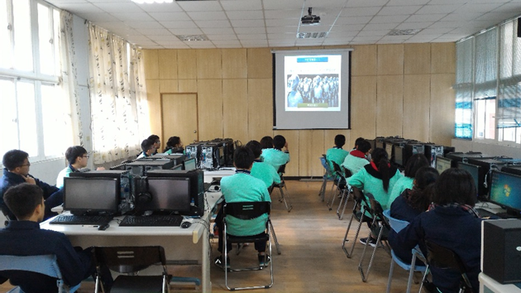
The introduction film of Flipped robot at 3rd week

Slide 28
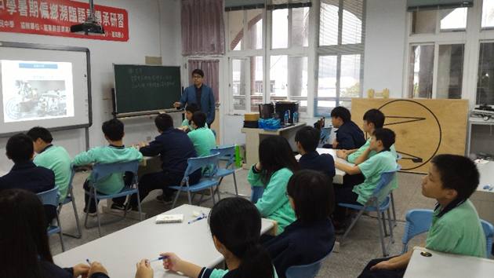
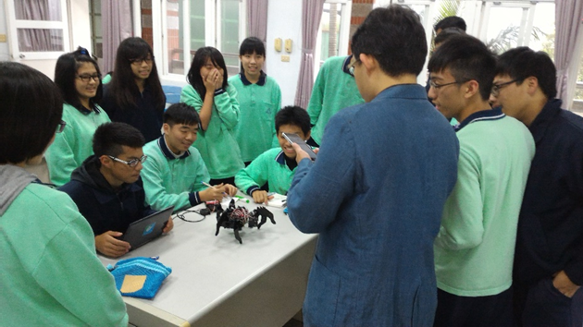
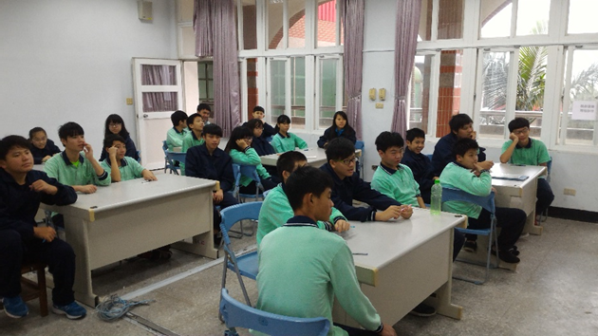
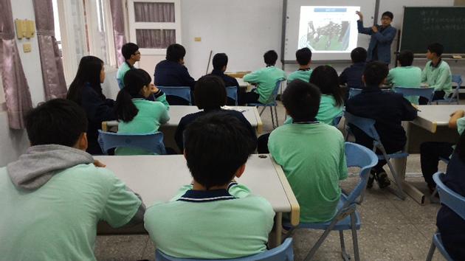
Six-claw robots on-site learning at 4th week

Slide 29
Results 1： “situational learning”
As the Table 1 shows, the means of the ratings on “learning achievement”, “learning attitude”, “learning motivation”, “perceived usefulness” and “perceived ease of use” for the Indigenous group were 85, 4.44, 4.24, 4.36 and 4.30; and the standard deviations were 7.91, 0.53, 0.52, 0.47 and 0.65 respectively.
It’s found that the post-questionnaire rating of the 2 groups were significantly different, as the adjusted mean of the Indigenous group were 85.01(F=9.629, p<.01), 4.44(F=8.098, p<.01), 4.26(F=15.573, p<.001), 4.35(F=9.453, p<.01) and 4.27(F=7.775, p<.01), and were significantly higher than the Han group (79.63, 4.00, 3.63, 3.89 and 3.84) , which means the “situational learning” had significant impact on improving the student’s “learning achievement”, “learning attitude”, “learning motive”, “perceived usefulness” an “perceived ease of use” in the “cultural film” and “the protagonist of the film on-site teaching” 2 steps course.

Slide 30
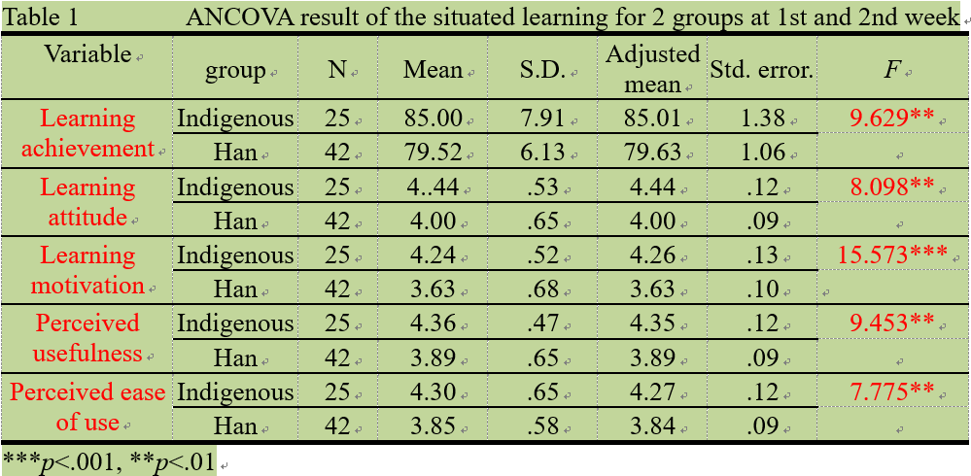
ANCOVA result of the 1st and 2nd week

Slide 31
Results 2：“learning by doing”
On the other hand, the means of the ratings on “ learning achievement ”, “learning attitude”, “ learning motive ”, “ perceived usefulness ” an “ perceived ease of use ” for the Indigenous group were 87.58, 3.88, 3.86, 4.36 and 4.29; and the standard deviations were 6.97, 0.57, 0.59, 0.44 and 0.48 respectively.
It’s found that the post-questionnaire rating of the 2 groups were significantly different, as the adjusted mean of the Indigenous group were 87.57(F=1.991, p=.163), 3.86(F=1.845, p=.179), 3.86(F=.341, p=.561), 4.36(F=4.108, p<.05) and 4.28(F=15.568, p<.001), and were significantly higher than the Han group (84.99, 4.04, 3.63, 3.95, 4.09 and 3.77) only on “ perceived usefulness ” and “ perceived ease of use ” , which means the “learning by doing ” had significant on improving the student’s “perceived usefulness” and “perceived ease of use” in the “Flipped Robot film” and “ Flipped Robot on-site learning” as Table 2 shows.

Slide 32
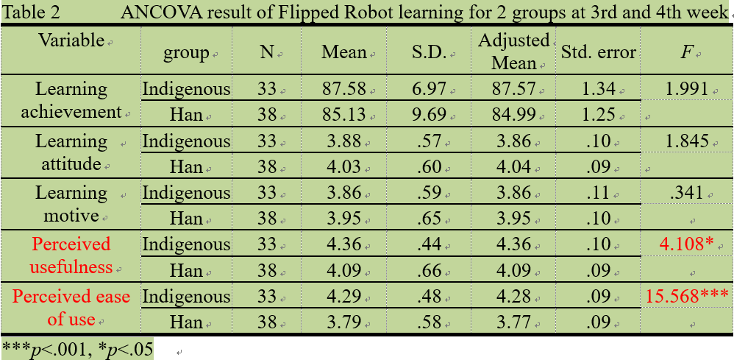
ANCOVA result of the 3rd and 4th week

Slide 33
Results 3： Open-ended interview
According to the qualitative interview results on ten members of each group, there’re 10 members of the Indigenous group all expressed their preference for using their own ethnic cultural film as learning tool for “Situated-learning”, among them, six members confirmed that robot teaching can effectively enhance learning efficiency.
On the contrary, there are five members of the Han group complained that they did not have enough time to continue learning robots, and another three had disregarded the opinion of Indigenous cultural films as learning tool

Slide 34
Discussion and conclusions
Students’ cultural background would not affect their learning performances or perceptions in the “ learning by doing ” context, which is mainly mission-oriented and is not related to culture comparison.
On the contrary, in the “ Situated-learning ” context, students with different cultural backgrounds might have different learning performances or perceptions.
Accordingly, this study suggests that researchers need to consider the effects of cultural backgrounds in “ situated learning ” activities.

Slide 35
Suggestions
This study suggests future researchers, when discussing cultural differences, should consider the effectiveness of “ learning” exist in “ a context in which learners apply in the cognitive process” rather than “ whether a culture has a cognitive process ”.

Slide 36
The end
Dear Lords,
Thanks for your kindly listening,

