Slide 1
Technology-facilitated gamification in school classrooms
Bernardo Yuk-Wang WONG, Ivy Ming LU, and Paul LAM
Centre for Learning Enhancement And Research
The Chinese University of Hong Kong

Slide 2
Introduction
The whole project
  Three-Year Research: December 2015 – December 2018
  Participants: Fourteen schools selected by Education Bureau of Hong Kong (including eight primary, four secondary, and two special schools)
  Research Methods: Interviews, Class observations, Surveys, Case studies on test marks in control groups
The part on gamification
  Period: February 2017 to March 2018
  Data Source: Class observations and interviews

Slide 3
Literature review
‘Gamification’ is the practice of turning everyday tasks into game-like activities for the sake of enhancing motivation and engagement (Kapp, 2012).
Gamification is using game-based mechanics, aesthetics and game thinking to engage people, motivate action, promote learning, and solving problem (Kapp, 2012).

Slide 4
Gamification is using game-based mechanics, aesthetics and game thinking to engage people, motivate action, promote learning, and solving problem (Kapp, 2012).

Slide 5
Game-based
  A game is a system in which players engage in an abstract challenge, defined by rules, interactivity, and feedback, that results in a quantifiable outcome often eliciting an emotional reaction(Koster, 2005).
  A game is a set of activities involving one or more players. It has goals, constraints, payoffs, and consequences. A game is rule-guided and artificial in some respects. Finally, a game involves some aspect of competition, even if that competition is with oneself (Dempsey et al, 2002).

Slide 6
Mechanics
  The mechanics of playing a game include levels, earning badges, point systems, scores, and time constraints.
Aesthetics
  Engaging graphics or well-designed experienced.
Game thinking
  It is the idea of thinking about everyday experience and converting it into an activity that has elements of competition, cooperation, exploration and storytelling (Kim, 2011).

Slide 7
Methodology
Interviews
  The teachers and students whose classes were observed on the days of school visits were interviewed so that ePedagogy in the key learning areas in the teaching processes could be examined with more scrutiny.
Class observations
  The research assistants applied an observation protocol. Each class was observed by two research team members and a timesheet was marked separately. For an example, the members marked the timesheet when they observed students learned by playing games happily.

Slide 8
Findings
Teachers turned the everyday tasks, such as exercises, presentations and group collaboration, into game-like activities.
Students were highly motivated and engaged when they were playing games.
Kahoot!, Quizlet and Minecraft are examples of games and platforms that allow the students to achieve their learning objectives.
  The games have goals, constraints, and some of them involve an element of competition.

Slide 9

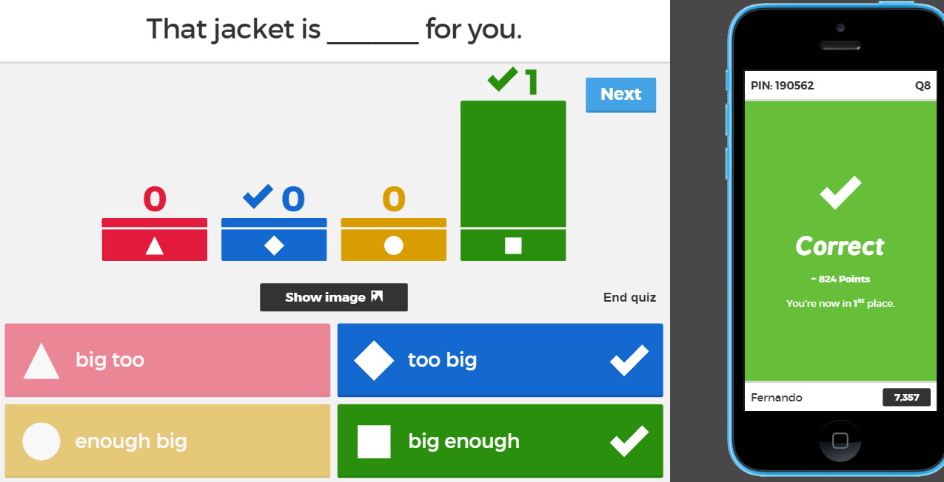
Case I
Kahoot! is a free game-based learning platform for teachers and students.
Procedures
  The teacher first creates a learning game which consists a series of multiple-choice questions.
  Then the students answer the questions on their own devices, while the games are displayed on a shared screen.
Kahoot! involves an element of competition and enhances
students motivation.
Picture source: http://www.elteaching.com/?page_id=278

Slide 10
Class: Primary 5
Subject: Mathematics
Topic: Pictograms
The teacher asked students to join a Kahoot! game that was created by him earlier.
Students simply entered the session number in Kahoot! webpage to join the game.

Slide 11
The game was consisted of multiple-choice questions on Pictograms.
Students had to answer quickly and accurately in order to win.

Slide 12
Students were concentrated and waiting for Kahoot! to reveal the correct answer on the screen.
They were very excited when they had answered the question correctly.

Slide 13
Alongside the correct answer, Kahoot! also showed the number of responses of each choice.
The teacher then analyzed the questions with the whole class to consolidate their knowledge of Pictograms.

Slide 14


Case II
Minecraft is a game-based learning platform that some educators use to engage students.
Players are able to build whatever they can imagine with the resources in an open-ended world in Minecraft.
Picture source: Minecraft.net

Slide 15
Class: Junior Secondary (Special Education)
Subject: Chinese
Topic: Types of glass
The teaching objectives of this lesson were to let the students read and understand a passage about multiple types of glass.
Students first read the passage. Then, they formed into groups and completed different activities.

Slide 16
In one of the activities, several students were assigned to create a virtual building in Minecraft to demonstrate the types of glass that they have learned.
For example, they built a museum with anti-theft glass to demonstrate how to prevent burglary.

Slide 17
The students then presented the building to the rest of the class.

Slide 18

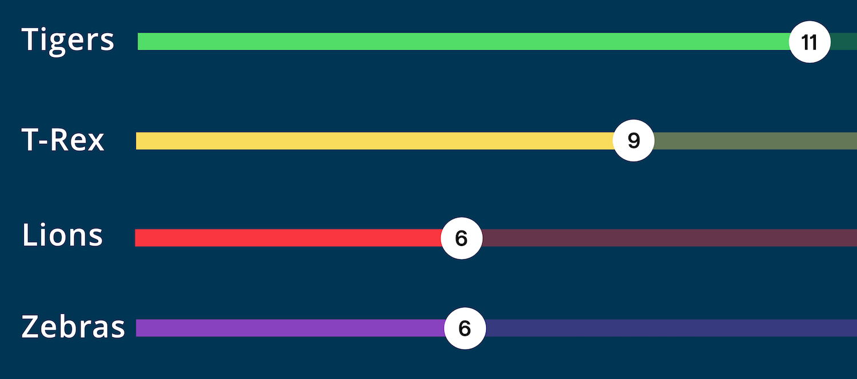
Case III
Quizlet is a mobile and web-based study application.
It provides engaging and customisable games for students.
One of the games it provides is that students could form into groups and compete on some tasks.
Picture source: http://digitalmobilelanguagelearning.org/
Notes:
In this case, the teacher used Quizlet to practice students’ collaboration skills.
Quizlet is a mobile and web-based study application. It provides engaging games for the students. One of the games is that the students have to collaborate and compete on some tasks.
It engages students and practices students’ collaboration skills.

Slide 19
Class: Primary 6
Subject: Mathematics
Topic: Percentage and fractions
The teacher first gave the class a lecture on percentage and fractions.
Then, students formed into groups and played games in Quizlet together.

Slide 20
In each group, students had to answer some mathematical questions in turns on their own iPads.
Students were working together to get as many correct answers as they could in the shortest time so they could win the game.

Slide 21
The progress of the student groups were shown on the screen.
The teacher knew the performances of the students immediately and offered help to the group which was having difficulties.

Slide 22
Students were engaged during the game and they felt cheerful when their group won.
Encouragements and leadership were also observed in this class.

Slide 23
Discussions
More convenient and user-friendly games are readily available.
Teachers are able to take the opportunity to transform traditional classroom activities into more engaging activities with gaming elements.
Such practice will become more and more popular when more teachers are aware of what the technology can offer.
Characteristics of gamification in these cases
  The tools are free and easy to use.
  It is applied to achieve the teaching and learning objectives.
  There were follow-up evaluation or consolidation after the games.

Slide 24
References
Dempsey, J. V., Haynes, L. L., Lucassen, B. A. & Casey, M. S. (2002). Forty simple computer games and what they could mean to educators. Simulation & Gaming, 33(2), 157–68.
Kapp, K. M. (2012). The gamification of learning and instruction. San Francisco: Wiley.
Kim, AJ. (2011, March 32). Gamification 101: Designing the player journey. Google Tech Talk.
Koster, R. (2005). A theory of fun for game design. Scottsdale, AZ: Paralyph. Press, p. 34

Slide 25
Thank you!

