Slide 1
Student Learning Pattern & Page Views Data
eLearning Forum Asia 2018
Sze Kiu YEUNG
24 May 2018

Slide 2
Student Learning Pattern & Page Views Data
Introduction
Learning Management System (LMS) switched from Blackboard to Canvas in 2015
July 2016 semester, all Level 1 courses started to use Canvas LMS
Canvas Data, a data service, became available in 2016
This presentation discuss the use of Canvas Data on students’ learning pattern.

Slide 3
Student Learning Pattern & Page Views Data
Canvas Data
A data warehouse provided by Instructure (the company that runs Canvas LMS)
Data is available for [1] Download OR [2] stored on the Cloud via Amazon Redshift data warehouse
SUSS uses the Download option
Based on the Dimensional Modelling structure, the tables are downloaded as FACT (measurements) and DIMENSION (categories)
Data is compressed as TEXT files

Slide 4
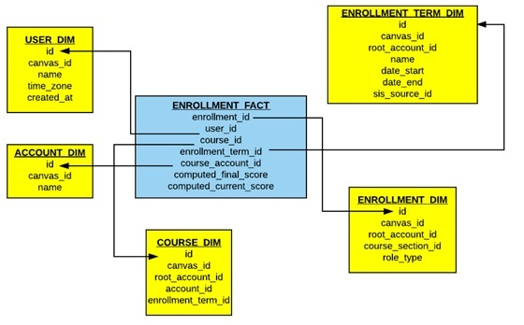
Student Learning Pattern & Page Views Data
Canvas Data
Adheres to the Star Schema convention in that
a FACT table is merged by a series of DIMENSIONAL tables
Example
Star Schema for Enrollment

Slide 5
Student Learning Pattern & Page Views Data
Canvas Data
Provides data in the following categories:
Accounts, Courses, Users
Enrollments
Logins, Pseudonyms
Assignment Submission
Quiz Submission
Discussions, Conversations
Page Views
Big Data (e.g. 150GB;
Extract [4GB] has
32millions records)

Slide 6
Student Learning Pattern & Page Views Data
Research Questions
1. What is students’ learning patterns on Canvas LMS for the SSC109 Introduction to Social Sciences course in the July 2016 semester?
2. Do students who performed well in SSC109 use the Canvas LMS more often compared to students who performed poorly?

Slide 7
Student Learning Pattern & Page Views Data
Literature Review
Siemens (2011) defined learning analytics as the “measurement, collection, analysis and reporting of data about learners .....”
However, Macfadyen and Dawson (2010) pointed out that extracting LMS data was slow and cumbersome because the Blackboard LMS offered limited data interrogation and reporting
In Australian a Loop system is available that provides learning analytics data for visualisation (Corrin, Kennedy, Barba, Bakharia, Lockyer, Gasevic, Williams, Dawson & Copeland, 2015)

Slide 8
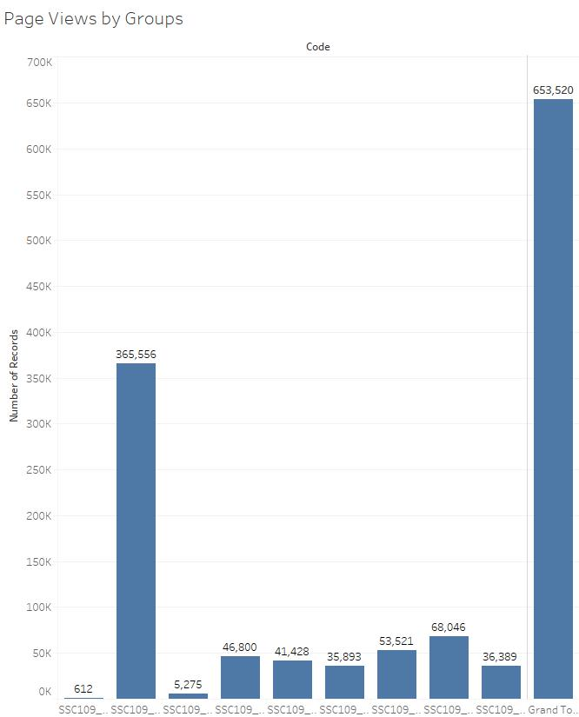
Student Learning Pattern & Page Views Data
Results & Discussion
Page Views for
SSC109 Introductory
to Social Sciences
(July 2016 semester)
by Groups
Resit L01 T01 T02 T03 T04 T05 T06 T07

Slide 9
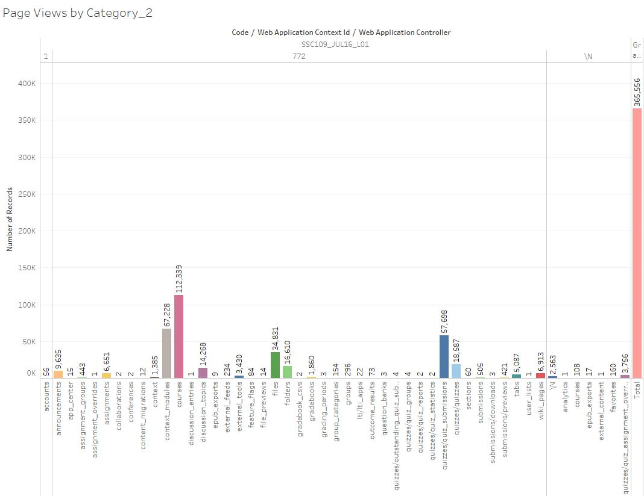
Student Learning Pattern & Page Views Data
Results & Discussion
Page Views for all
students in L01
Context_Modules
&
External_Tools
provide details of
Student Learning Pattern

Slide 10
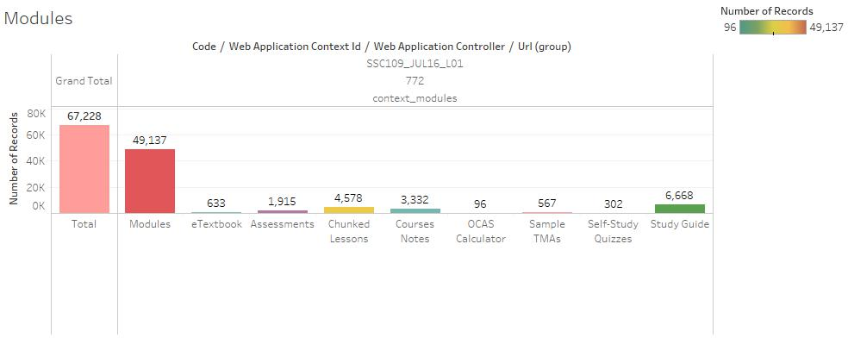
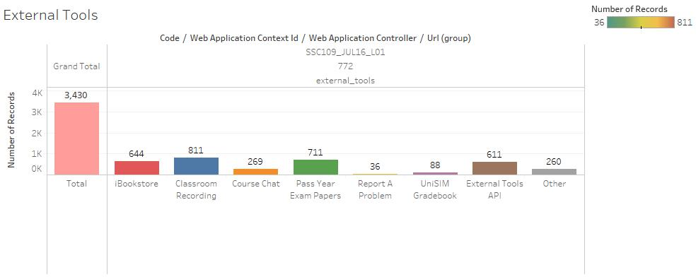
Student Learning Pattern & Page Views Data
Results & Discussion
Breaking down
Context_Modules
&
External_Tools
we observe the
Elements
(i.e. Modules,
Classroom
Recording, etc)
available that all
students in L01
accessed in Canvas LMS

Slide 11
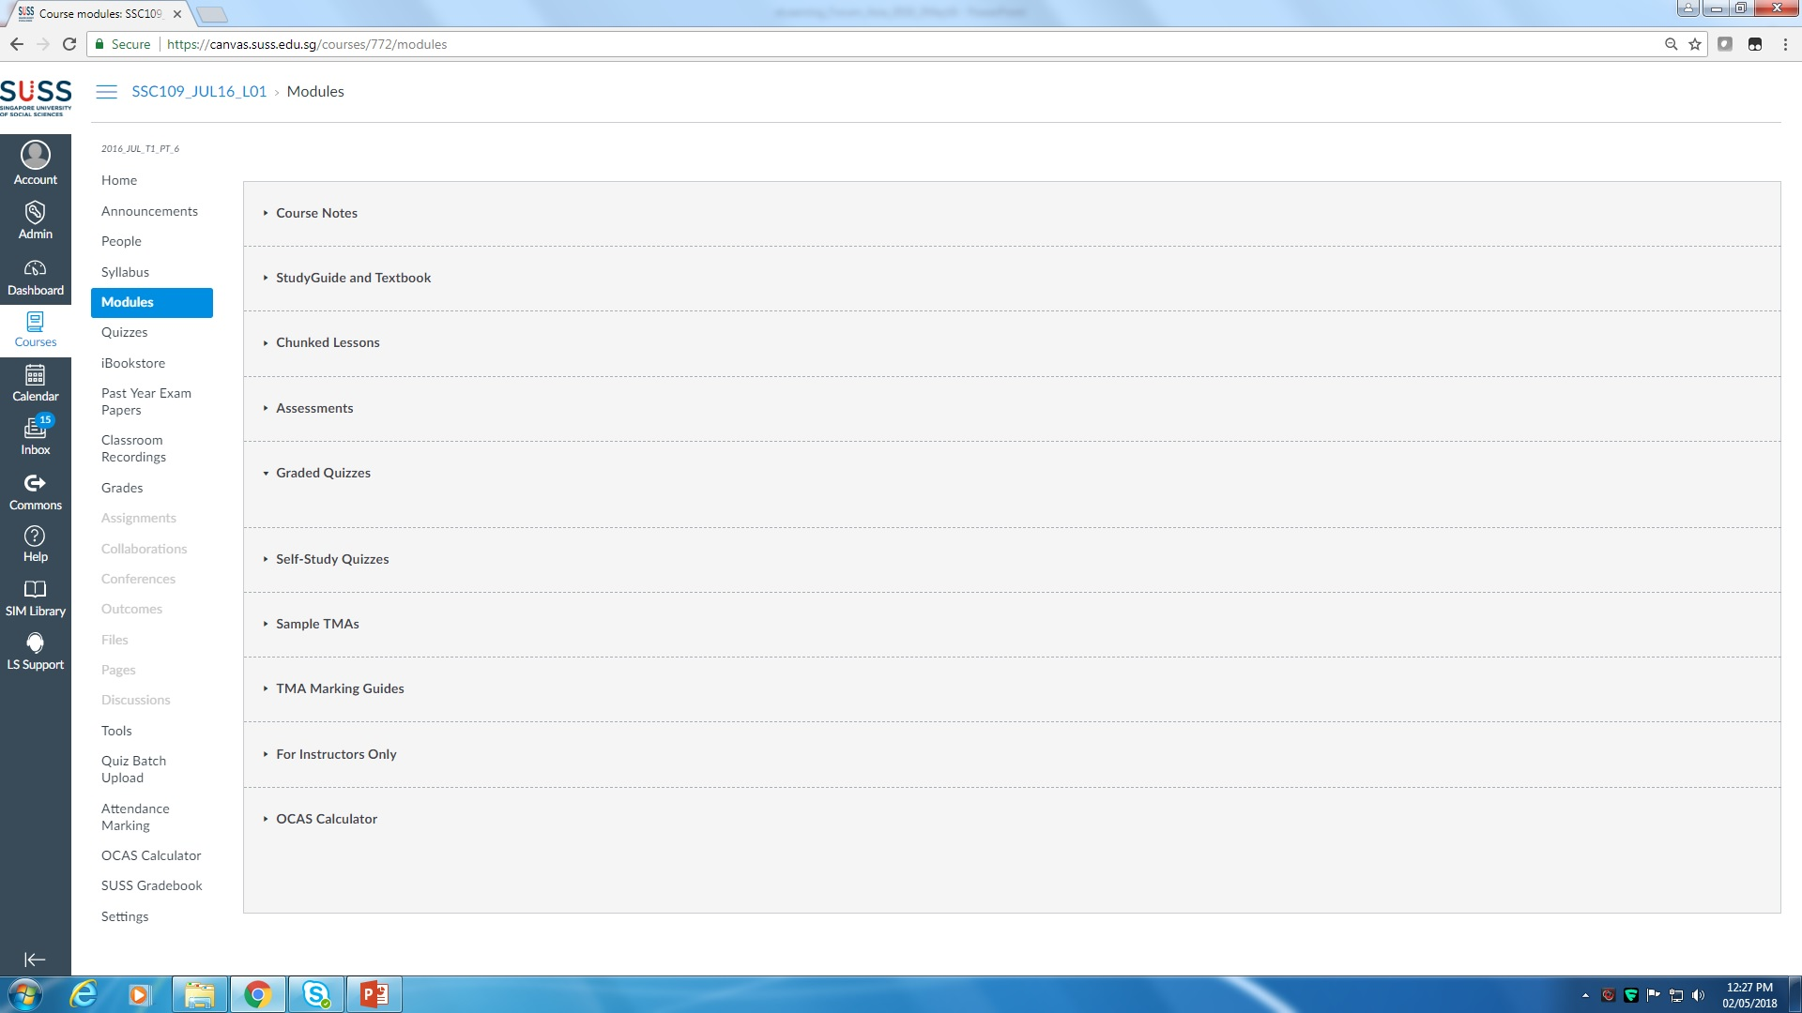
Student Learning Pattern & Page Views Data
Results & Discussion
Elements in Canvas LMS captured by Context_Module & External_Tools

Slide 12
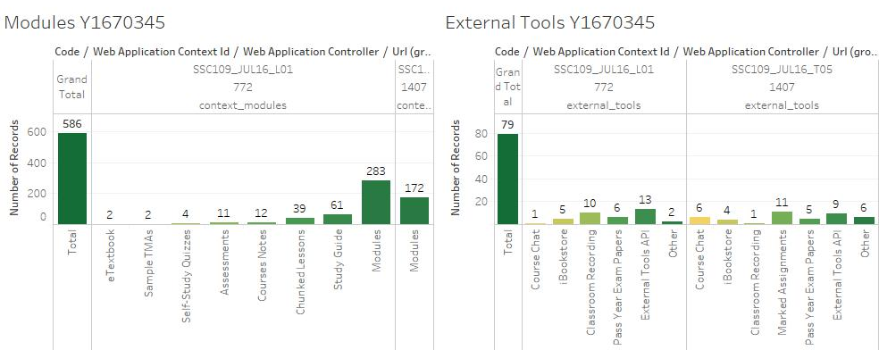
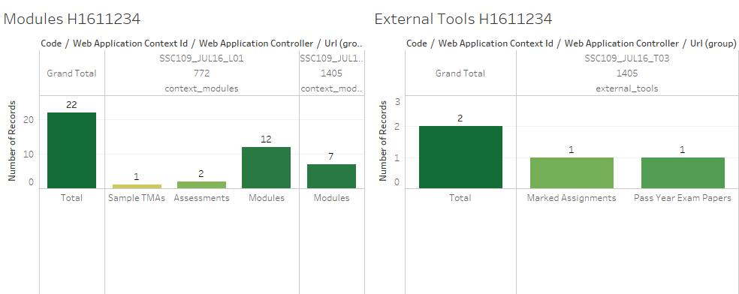
Student Learning Pattern & Page Views Data
Results & Discussion
When 2 students’
Learning Pattern are
identified we see that
Y1670345
accessed LMS 665 times
(OCAS 76.6%)
and
H1611234
accessed LMS 24 times
(OCAS 29.6%)
with the Elements that
they accessed.

Slide 13
Student Learning Pattern & Page Views Data
Conclusion
Clearly, the above data visualisation shows that to be successful in learning/e-learning it is necessary to use the LMS at timely
intervals during the semester (Research Question 2)
Elements that are accessed most include
Modules, Study Guide, Chunked Lessons, Course Notes, Classroom Recordings & Pass Year Exam Papers
(Research Question 1)
While this study looks at 1 course, Canvas Data
provides data for every course/school/level for further analysis
Page Views data, while not easy to extract, is provided to
SUSS’ Institutional Research & Analytics Unit for their use also
This is presentation showed data that can be extracted for learning analytics purposes

