Slide 1
Session D2
A Framework for Evaluating Critical Thinking Apps
New Detective Tool to Tell What Students Are Thinking in Class
Use of Social Media to Motivate Academic Inquiry and Discussion for Developing of Critical Thinking
AR Marker-Based Assessment as Learning for an Analytical Thinking
Social Media as Digital Companionship: Scaffolding in the E-Learning Context

Slide 2
A Framework for Evaluating Critical Thinking Apps
Teresa Chen, Ph.D.
California State University, Long Beach
eLearning Forum Asia
Taipei, Taiwan
May, 2018

Slide 3
Overview
Introduction
Literature Review
Method
Results and Discussion
Conclusion

Slide 4
Introduction
Significance of the research
Current practices
Research questions
Audience who may benefit from the study

Slide 5
Significance
Importance of critical thinking
Apps for cultivating critical thinking
Challenges
  Misalignment between the conceptualization of critical thinking and the content of the so-called CT Apps
  Anecdotal recommendations in the “best Apps” lists and reviews
Notes:
Me: Educators at all levels have recognized the importance of critical thinking. The common core state standards emphasize the development of critical thinking skills (Anderson, 2015; Duesbery & Justice, 2015). The Association of American Colleges and Universities (2011) also includes critical thinking as one of the essential learning outcomes.
Me: mobile software applications (Apps) have emerged to become promising and have prompted the educational community to examine the affordance, design and effects of the relatively recent innovation (e.g., Lopuch, 2013; Stevenson, Hedberg, Highfield, & Diao, 2015).
2016-Haynes: “Various constituent groups in our society are in widespread agreement about the importance of critical thinking. For instance, the Higher Education Research Institute (HERI) found that over 99% of faculty across the United States felt that teaching critical thinking is “essential” or “very important” (DeAngelo et al., 2009). Similarly, Derek Bok, president emeritus of Harvard University, notes national studies have found that more than 90% of faculty members in the United States consider critical thinking the most important goal of an undergraduate education (Bok, 2006). Employers also recognize the importance of critical thinking and problem solving skills. A recent survey by the American Association of Colleges and Universities (AACU) found that 75% of employers want colleges to place more emphasis on critical thinking, real world problem solving, communication, and creativity, and 93% of these employers felt that these skills were more important than major (AACU, 2013). Similarly, a recent national survey released by Northeastern University (2013) found that both the general public and employers thought colleges should focus more efforts on improving critical/creative thinking skills and communication. The need for critical thinking skills is not limited to the United States. In a 2012 survey conducted by the American Management Association of international managers and executives, critical thinking skills were ranked as the most important skills related to growth (AMA, 2012). These sam”

Slide 6
Research Questions
What can be considered a critical thinking App?
What are the design principles that are essential in the development of a critical thinking App?

Slide 7
Intended Audience
Apps users, including instructors (and students)
Apps designers and developers

Slide 8
Literature Review
Critical thinking skills, dispositions, and the strategies that support students’ development of CT
Software (with an emphasis on Apps) design principles that can be applied to the design of CT Apps
Research-based tools (e.g., rubrics and checklists) for Apps evaluation

Slide 9
Method: Research Synthesis
Formulate a research problem
Conduct a literature search
Evaluate search results
Analyze results
Interprete findings
Use the findings to create and validate an evaluation framework

Slide 10
Three Lines of Research
Critical Thinking
Definitions
Pedagogical approaches
Design Principles
User interface design
User experience design
Apps Evaluation
Research-based criteria
Evaluation tools
Instructional design

Slide 11
Definitions of Critical Thinking
Cognitive skills and affective dispositions from the landmark “Delphi Report” (Facione, 1990)
“Critical thinking is a habit of mind characterized by the comprehensive exploration of issues, ideas, artifacts, and events before accepting or formulating an opinion or conclusion” (AACU, 2009)
Operational definition (Liu, et al., 2014)
  Five dimensions, including analytical and synthetic dimensions
  Argument analysis & development; causation & explanation
Critical-thinking assessment test (Haynes, et al., 2016)
  “Classic” and broadened definitions
Notes:
“…critical thinking is reflective thinking focused on deciding what to believe or do…” (Ennis, 1997, p. 2)
Five dimensions: “two analytical dimensions (i.e., evaluating evidence and its use; analyzing arguments); two synthetic dimensions, which assess students’ abilities to understand implications and consequences and to produce their own arguments; and one dimension relevant to all of the analytical and synthetic dimensions – understanding causation and explanation.” (Liu, et al., 2014, p. 14) -- ETS

Slide 12
Definitions
Formal Reasoning
Skills & Dispositions
Problem-Solving & Creativity
Definitions of Critical Thinking

Slide 13
Pedagogy
Mixed approach (Ennis, 1989; 1997)
  teaching critical thinking as a subject itself
  infusing it in the other subject matter
Strategies: e.g., Argument mapping, case studies, computer-assisted reasoning, logic modeling (Mathias, 2015; Niu, Behar-Horenstein, & Garvan, 2013)
Explicit instruction of reasoning principles and ample opportunities for practice: Essential to students’ development of critical thinking skills (Heijltyes, van Gog, Leppink, & Pass, 2014)

Slide 14
Design Principles
Instructional design models (Brown & Green, 2015; Luterbach, 2018)
Eight golden rules of interface design (Shneiderman, et al., 2016)
Fundamental principles of interaction (Norman, 2013)
Notes:
https://www.interaction-design.org/literature/article/shneiderman-s-eight-golden-rules-will-help-you-design-better-interfaces
https://www.interaction-design.org/literature/topics/ux-design
https://www.nngroup.com/articles/author/don-norman/

Slide 15
Apps Evaluation
Tools: Frameworks, rubrics and checklists (e.g., Cherner, Lee, Fegely, & Santaniello, 2016; Israelson, 2015; Lee & Cherner, 2015; Ok, Kim, Kang, & Bryant, 2016)
Evaluation criteria
  Subject/ content/ educational value
  Design (including instructional design/ technology design/ user experience design)
  Engagement/ motivation

Slide 16
Three Lines of Research
Critical Thinking
Apps Evaluation
Design Principles
Evaluation Framework

Slide 17
Framework: Categories
Content
Pedagogy
  Critical thinking in particular
  Instructional design in general
User-centered design principles
  Interface design
  User experience design
Notes:
https://www.usertesting.com/blog/2016/04/27/ui-vs-ux/
https://www.webdesignerdepot.com/2012/06/ui-vs-ux-whats-the-difference/

Slide 18
A. Content
Enables users to
Evaluate evidence and its use
Analyze and evaluate arguments
Understand implications and consequences
Develop sound and valid arguments
Understand causation and explanation
Broadened definitions:
Problem-solve and develop creativity
Notes:
https://www.usertesting.com/blog/2016/04/27/ui-vs-ux/
https://www.webdesignerdepot.com/2012/06/ui-vs-ux-whats-the-difference/

Slide 19
B. Pedagogy
Specifically
  Explicit instruction of reasoning principles
  Ample opportunities for practice
  Instructional strategies
In general
  learning objectives, instructional strategies and assessment as well as alignment among them
  Bloom’s taxonomy
Notes:
http://www.celt.iastate.edu/teaching/effective-teaching-practices/revised-blooms-taxonomy

Slide 20
C1. Design: User Interface
Strive for consistency
Enable frequent users to use shortcuts
Offer informative feedback
Design dialog to yield closure
Offer simple error handling
Permit easy reversal of actions
Support internal locus of control
Reduce short-term memory load
Eight Golden Rules (Schneiderman, et al., 2016)

Slide 21
C2. Design: User Experience
Affordances
Signifiers
Constraints
Mappings
Feedback
Conceptual model
Fundamental Principles (Norman, 2013)

Slide 22
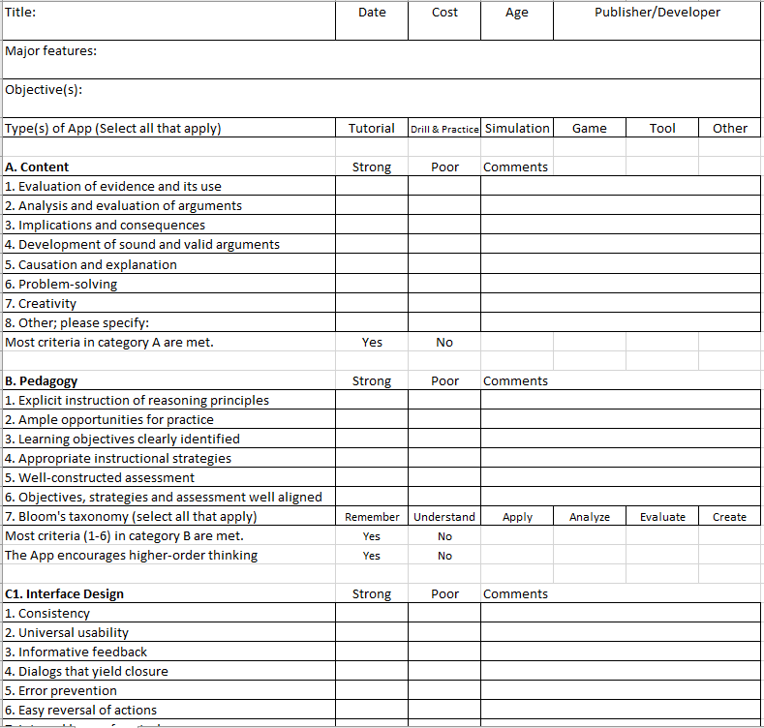
Evaluation Instrument

Slide 23
Validation: Pilot Test
Two evaluators’ independent review of ten CT Apps
  80% in agreement with category A, 60% with category B, 90% with C1, and 80 with C2.
Correlation with the evaluation rubric, for assessing instructional Apps in general, developed by Lee and Cherner (2015)
  Overall recommendation: 80% in agreement

Slide 24
Conclusion
Implications for practice
  Guidelines for the development of CT Apps
  Teaching and learning with CT Apps
Implications for research
  Design and quality of CT Apps
  Effectiveness of CT Apps (learning outcomes)

