Slide 1






Development of Location-based Driven Application for Innovative and Technology-assisted Teaching and Learning Practices

Slide 2








Team structure
Dr. Charles WONG (LSGI)
Project Leader
Mr. Roy KAM (EDC)
Educational Developer
Dr. Kimberly SHEEN
Project Manager
Ms. Ariel MAK
Project Associate
Ms. Zoe KWAN
Project Associate
Ms. Joyce HO
Project Assistant
Mr. Guanjing XIONG
Technical Assistant
Mr. Kelvin LU
Technical Assistant

Slide 3

Smart Cities
(Source:in.nec.com)
Notes:
Smart City:
-Modern day buzz word
-Many facets to Smart City
-Strategy of urban development using modern technological solutions for efficient & effective management of the city
-Installing IoT sensors for data collection to enable effective decision-making

Slide 4
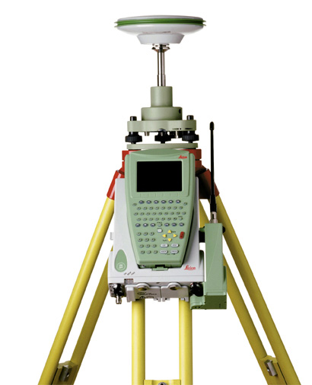
Hong Kong and Neighboring Cities
Singapore
“Smart Nation”
Korea “U-City scheme”
Smart City
Hong Kong
“Energizing Kowloon East”
China “Wuhan 2020 scheme”

Slide 5

Smart Campus in South Korea
Search bus location
Commute shuttle ticketing/reservation
Automatic attendance check through Beacon
Electronic Roll Book & Attendance Re- authentication
All 3 domestic mobile service providers NFC & mobile barcode
Screen LOCK service
Search for academic information
Support various smart devices
Anti-plagiarism System
Sign up for Y-CES/Mobile
Academic Information
Shuttle Bus
Reservation
Electronic
Attendance
Mobile
Student ID
Comprehensive
Academic
Search
Smart
Register
Yonsei
Gong-Gam
School
Cafeteria
Library Seats/
Checkout/
Return
Cyber
lecture
Safety/
Security
Academic, cultural, art contents on campus
Access/share information through smart devices
Alerts through mobile calendar
Information on number of people at the cafeteria
Provide information on the menu
Korea’s first global MOOC registration
Flipped learning system
Automatic lecture recording system
Y-Care Safety Call
Campus Entry Control
Mobile library seat search & reservation
Book checkout reader & kiosk services
Late fee alert & payment

Slide 6
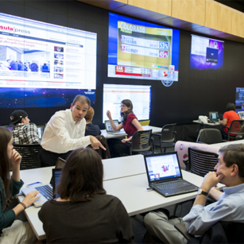
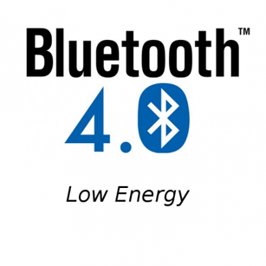
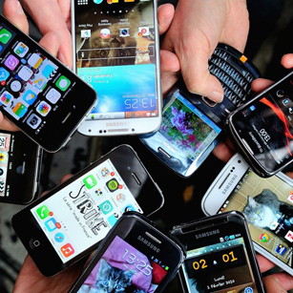
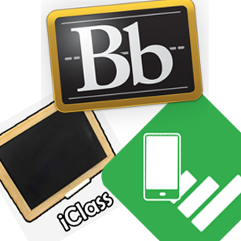
iBeacon Technology
Multimedia Teaching
& BYOD
LBS & BLE
Low power consumption
Wireless technology
Widely applied in
iOS 7+, Android 4.3+,
WP 10+
Class attention
A high visual orientation
A better learning outcomes
Current
Educational APP
96.7%
from age 15 to 54 have smartphone
Lack of in-class interaction
No location-based learning
Indoor study
80% of time
GPS
Fail to receive signals in indoor
High power consumption
Notes:
iBeacon installed within a specific area e.g. within classroom setting
Students bring their own device with installed app
iBeacon act as transmitter, when student approach will prompt for information available from beacon
iBeacon is location aware, user device can detect location using Bluetooth signals
Dependent on type of beacon, long or short range, a single beacon can have a coverage ranging from 70m to 200m with an average battery life of 3yrs.
Installation does not require additional power supply

Slide 7


Motivation
Assisted teaching and learning
Smart campus

Slide 8
Project Objectives
Developing a multi-platform application system for teaching and learning using BLE technology based on LBS to make the campus more “Smart”
Promote BYOD in the class
Implement classroom attendance checking system
Implement classroom response system
Encourage and support on the implementation of scenario-based learning
Better tracking on the performance of the students
Notes:
This is what we are going to do:
Investigate classroom ecology and behavior
Identify differences between coherts, years, and disciplines
Identify how information gathered can be utalized in learning space design

Slide 9
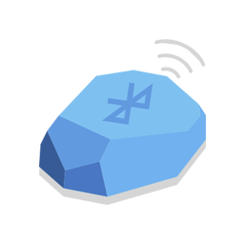
System Design
A single BLE Tag (iBeacon) has an effective range up to tens of meters and it has a long battery life for years.
Identifiers of iBeacons
MAC
(Unique)
Field | Size | Description
MAC | 6 bytes | Media Access Control Address (MAC address) Unique identifier of network devices which is often referred to hardware or physical address Format XX:XX:XX:YY:YY:YY (using hexadecimal text)
UUID | 16 bytes | Universally Unique Identifier Format: XXXXXXXX-XXXX-XXXX-XXXXXXXXXXXX (using hexadecimal text)
Major | 2 bytes | Format: XXXX (using decimal text) Further specify iBeacon under UUID
Minor | 2 bytes | Format: XXXX (using decimal text) Further specify iBeacon under Major
UUID
Major
Major
Minor
Minor
Minor
Minor

Slide 10




System Design
Each iBeacon is a Bluetooth® Low Energy transmitter. It broadcasts radio signals uniquely and location-specific data
Browser accessible
Multiplatform support

Slide 11


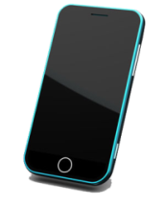



System Data Flow
Bluetooth® Low Energy transmitter. It broadcasts radio signals uniquely and location-specific data
Estimote
iBeacons
LBS
Send
Operate
Communicate
Network
Show
Get
Student
Smart
Device
Send
Get
Send
Operate
Teacher
Show
Get
Browser
Server
Administrator
Notes:
After the previous slide, then demonstrate our iClass Poly U app to audience. Introduce by Kevin

Slide 12
System Design
System Console
Sign Up
Log In
Location-based Service Management
Indoor Positioning
Location Proximity Service
Education Management
Hands Up
Check Attendance
Class Discussion
Group Discussion
In-class Test
Class Materials
Class Activities
Educational Exhibition
Database Management
Update function

Slide 13
System Design
Proximity
-triggered
Interaction
Indoor
Positioning
Class
Identification
Received Signal Strength Indicator (RSSI)
Identifiers
Identifiers

Slide 14




Indoor Positioning Implementation
Trilateration Principle
In GPS
We’re somewhere on this sphere
Two measurements tell us somewhere in this area
Three measurements tell us one of two points
Ideally, three ranges are enough for solving the position, because one of these two points is a ridiculous answer (either too far from Earth or moving at an impossible velocity) and can be rejected without a measurement.

Slide 15
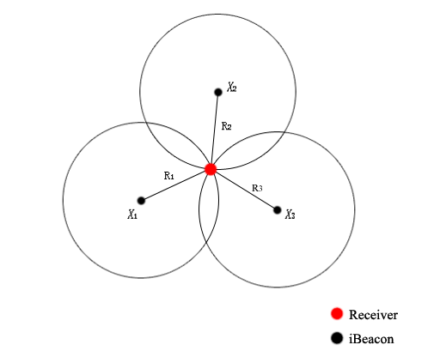

Indoor Positioning Implementation
Trilateration Principle
In iBeacons
$$\sqrt{{(X_{i}−x)}^{2}+{(Y_{i}−y)}^{2}}=R_{i}$$
where i = 1, 2, 3, …, (X_{i}, Y_{i}) are the coordinates of iBeacons and (x, y) are the coordinates of the receiver.

Slide 16
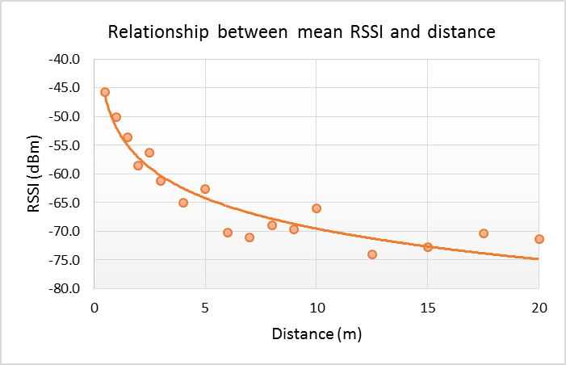

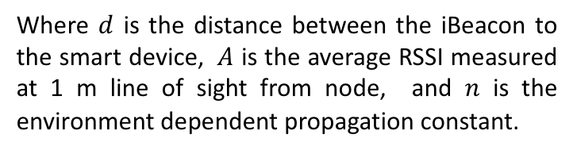

Indoor Positioning Implementation
Single Distance
$$RSSI=−(10×n\log_{10}d+A)$$
$$d= {10}^{\frac{A−RSSI}{10×n}}$$
Where $d$ is the distance between the iBeacon to the smart device, $A$ is the average RSSI measured at 1 m line of sight from node, and $n$ is the environment dependent propagation constant.

Slide 17
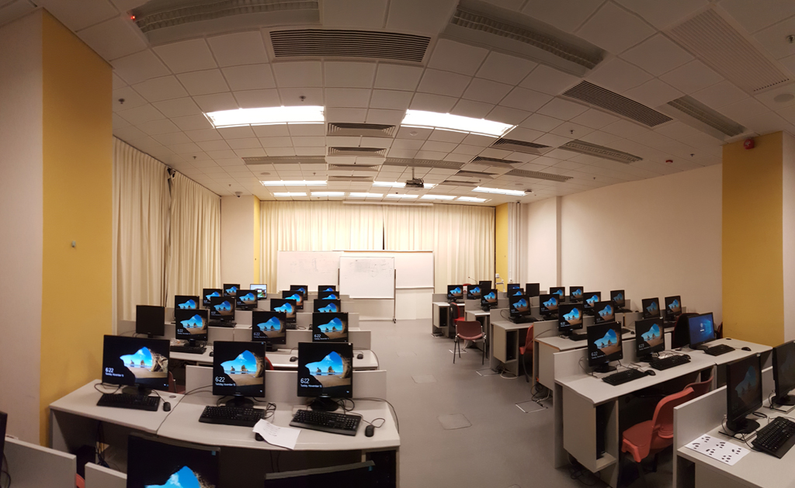
Indoor Positioning Implementation
Trilateration Method
8m
0
7m
Four iBeacons were put on the wall of the four corners of ZS1001, PolyU
iBeacons

Slide 18
Indoor Positioning Implementation
Fingerprint Method
Collect Signal Data
Store Data in Server
Match the Data
Find the Optimized Location
Preparation Stage
Positioning Stage

Slide 19

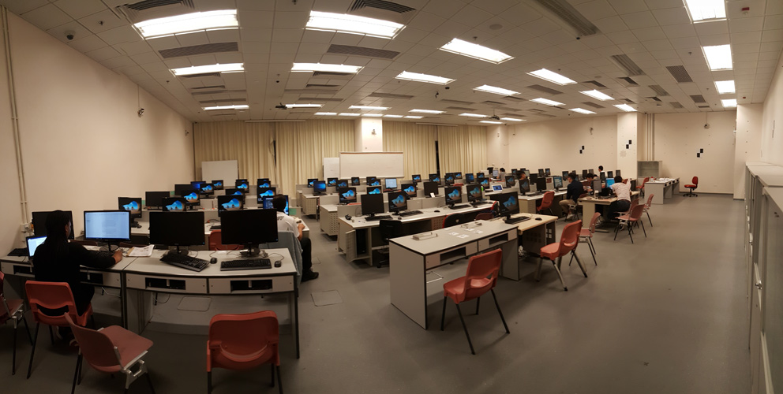
Indoor Positioning Implementation
Fingerprint Method
14
12
10
8
6
4
Six iBeacons were put on the ceiling of ZS1010, PolyU
2
0 m
2
4
6
8
10
12
14
16
iBeacons
Data Collecting Location

Slide 20
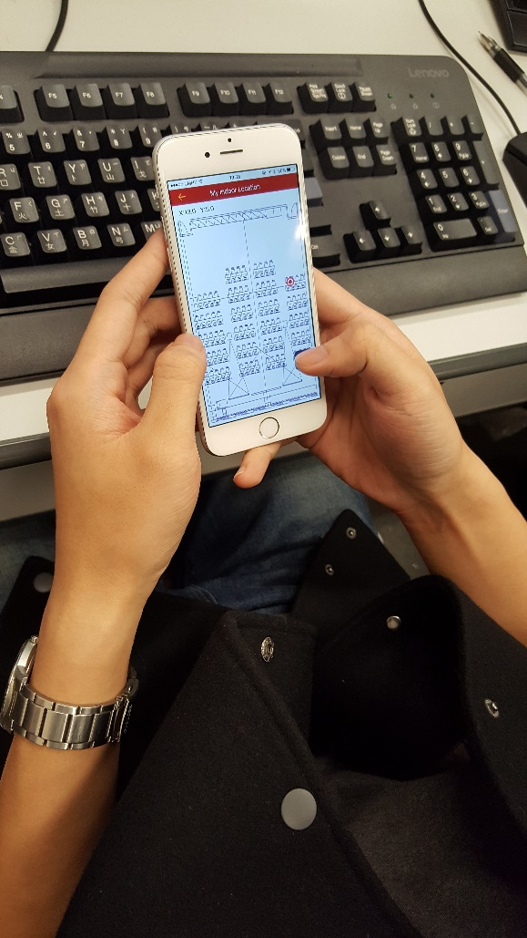
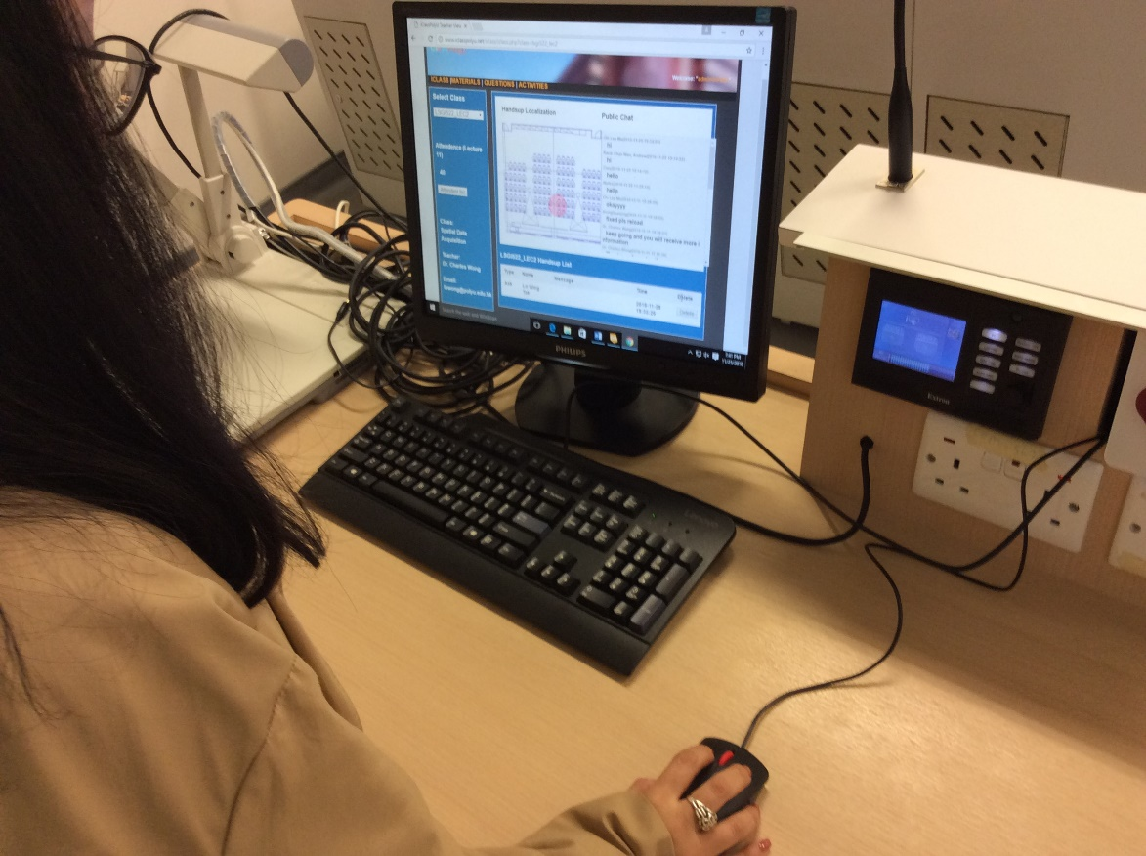
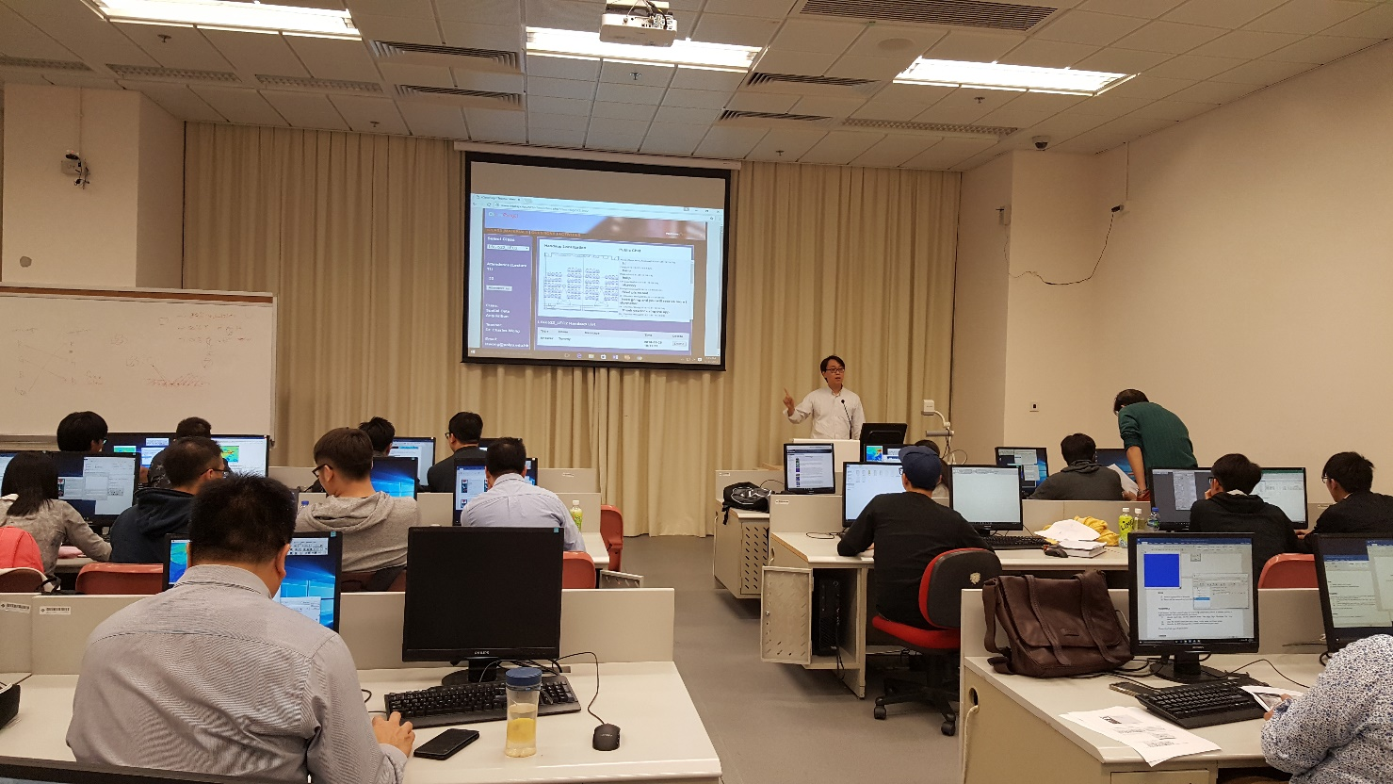
Pilot work

Slide 21
Indoor Positioning Accuracy Analysis
Indoor Positioning Test Cases
Trilateration method
20Point
Randomly
Fingerprint method
55 students
Every 60 seconds
1778 set of data were recorded

Slide 22
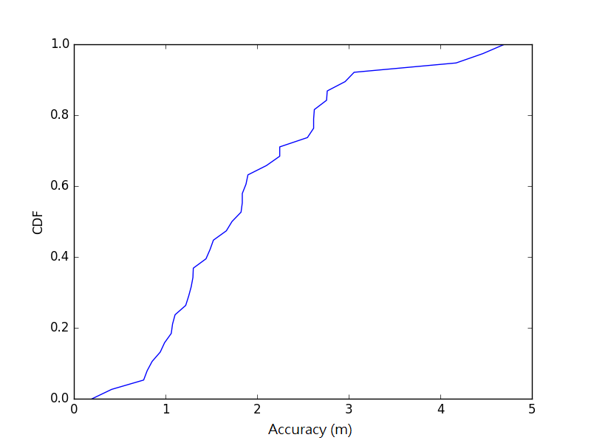
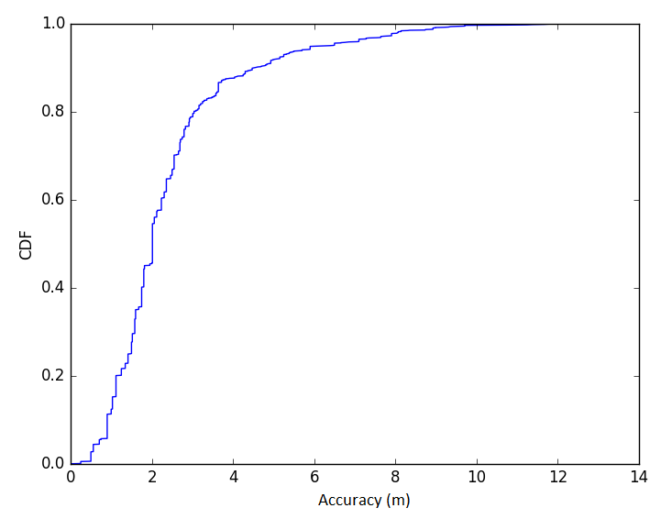
Indoor Positioning Accuracy Analysis
Accuracy
Trilateration method
Fingerprint method
Average accuracy is 1.8 meters
Average accuracy is 2.4 meters

Slide 23
Indoor Positioning Accuracy Analysis
Comparison/ Evaluation
 | Trilateration | Fingerprint
Average accuracy | 1.8 m | 2.4 m
Error Rate with respect to diagonal dimension of the room | 18.5% | 11.2%
Cumulative distribution function in 3 m | >80% | >80%
Recommended application | Small room | Large room

Slide 24
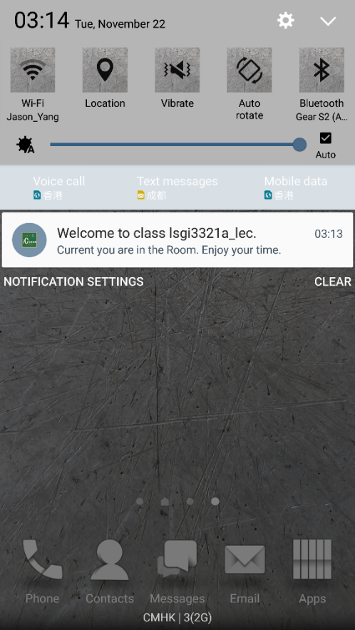
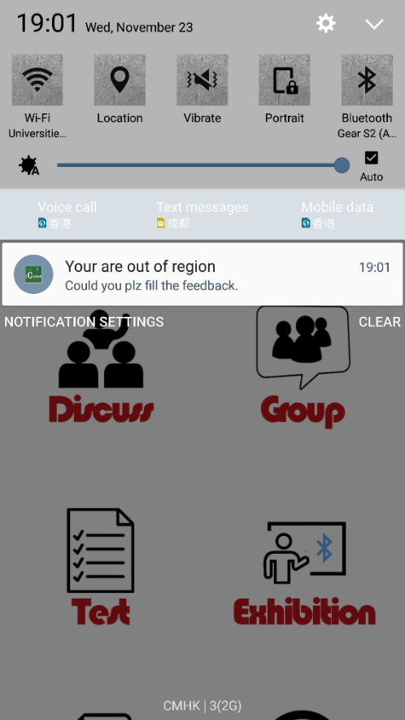
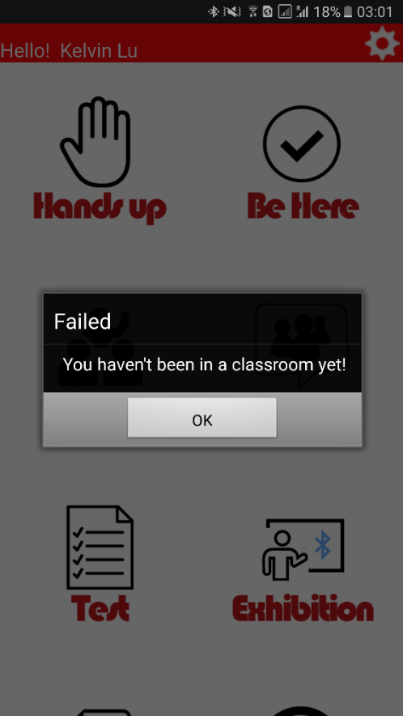
LBS Functions
Classroom Detection
Inside Classroom
Out of Classroom
Not in Classroom

Slide 25
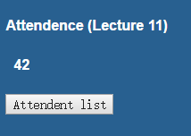
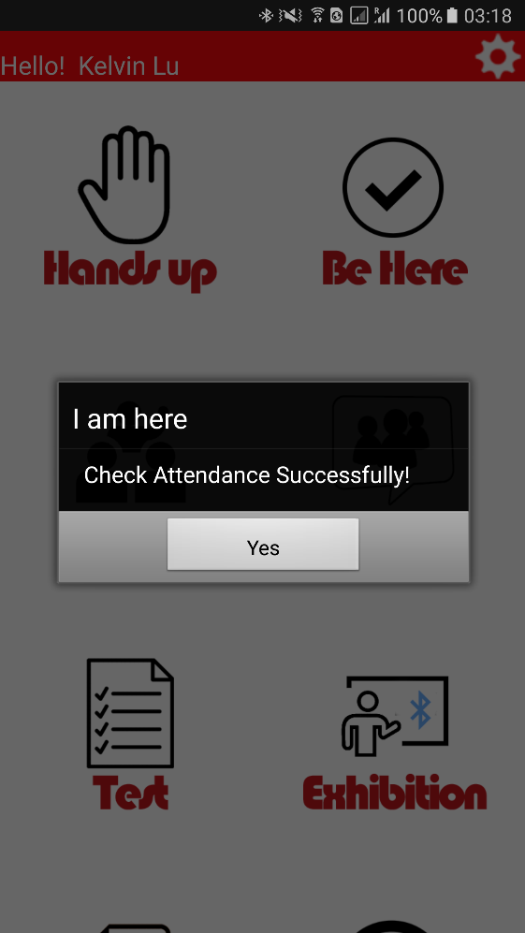
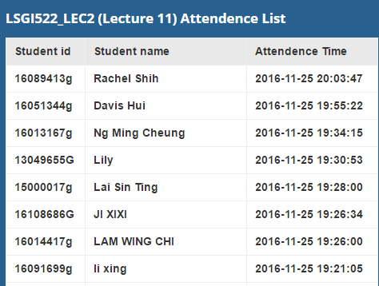
LBS Functions
Check Attendance
Web Console
(Teacher Side)
Phone Client
(Student Side)

Slide 26
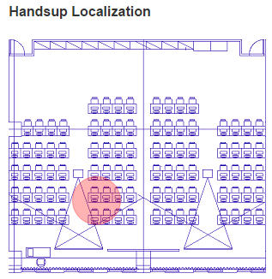
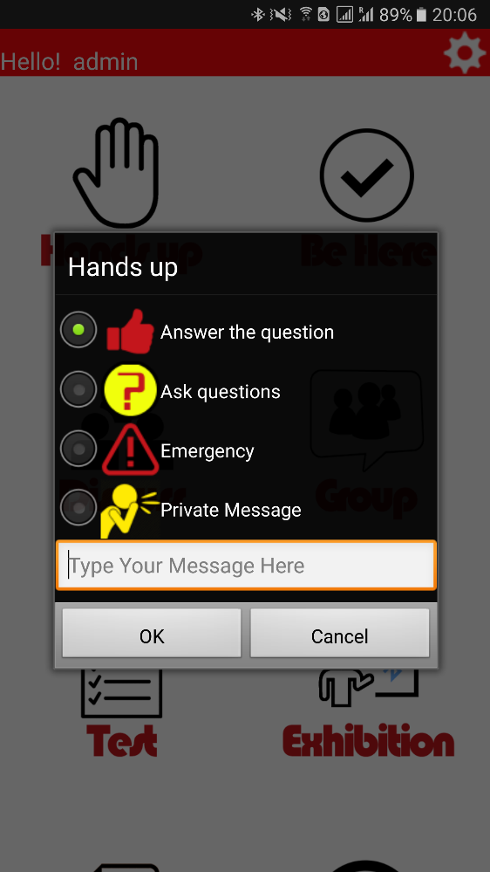
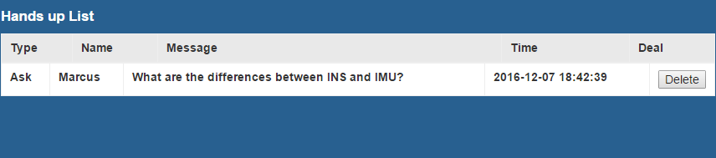
LBS Functions
Hands up
Web Console
(Teacher Side)
Phone Client
(Student Side)

Slide 27
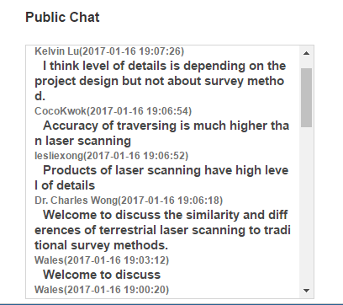
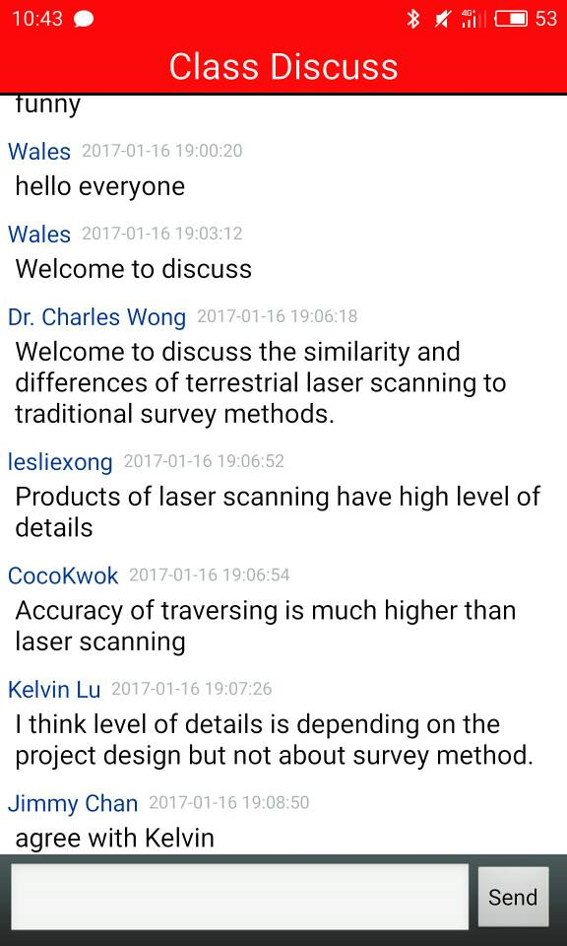
LBS Functions
Discuss
Phone Client
(Student Side)
Web Console
(Teacher Side)

Slide 28
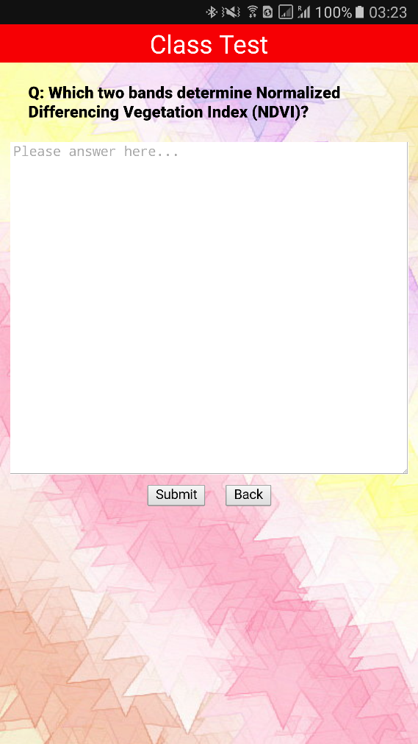
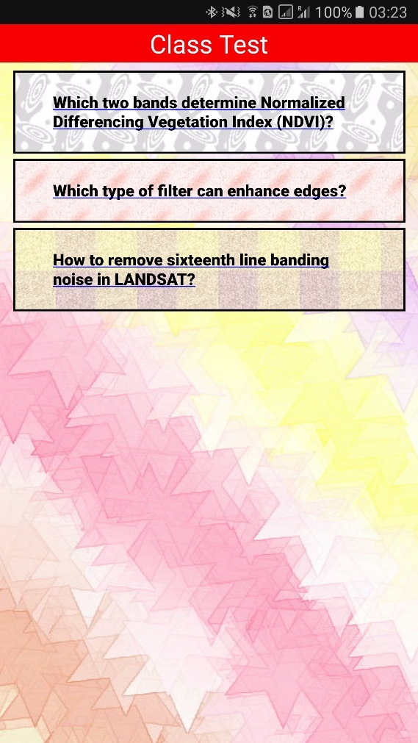
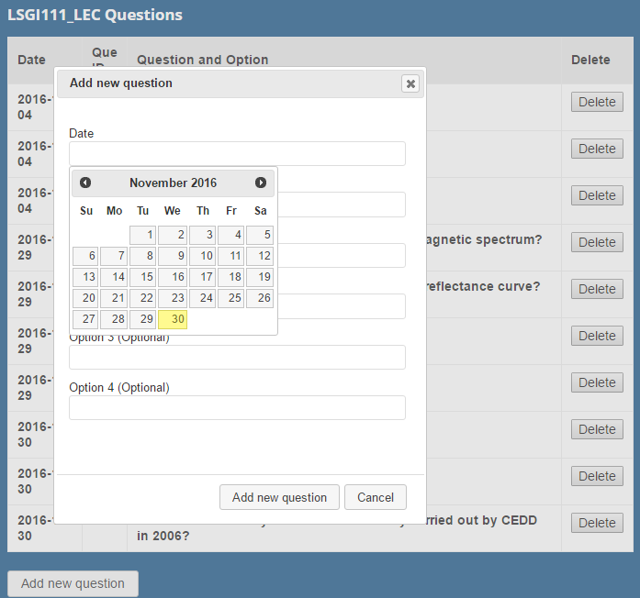

LBS Functions
Web Console
(Teacher Side)
Test management system
In-class Test
Phone Client
(Student Side)

Slide 29
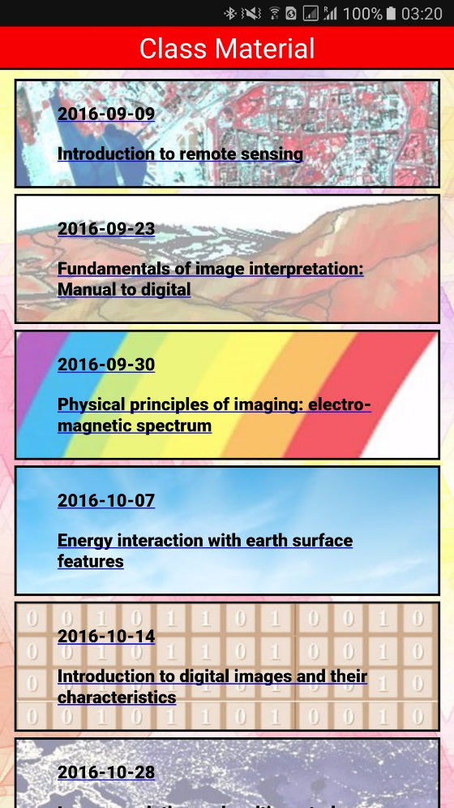
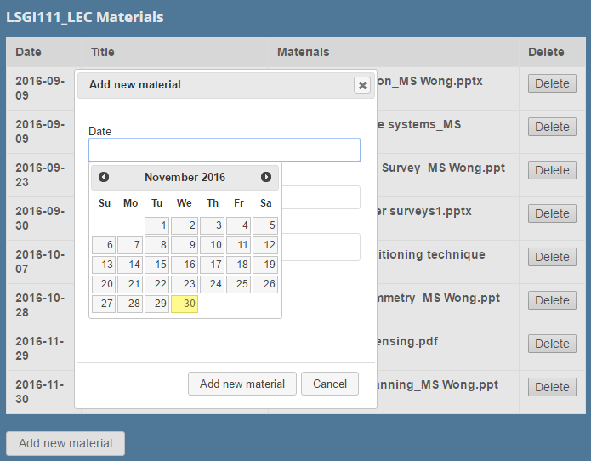
LBS Functions
Phone Client
(Student Side)
Web Console
(Teacher Side)
Materials management system
Class Material

Slide 30
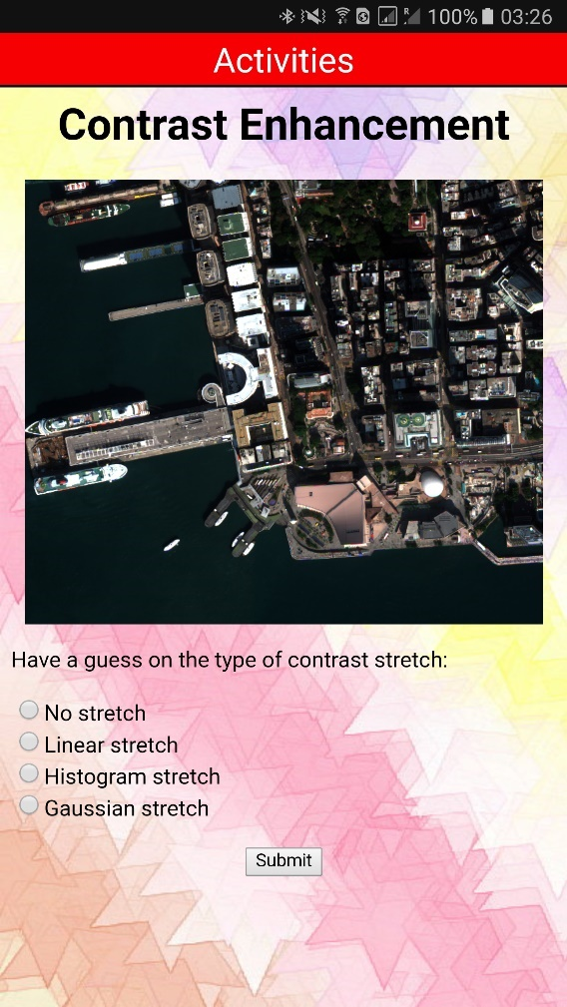
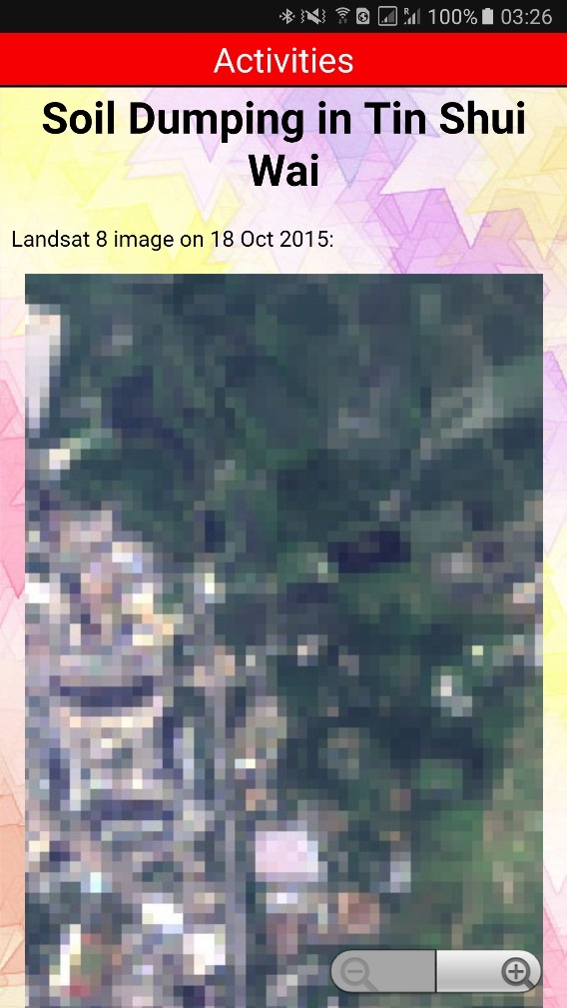

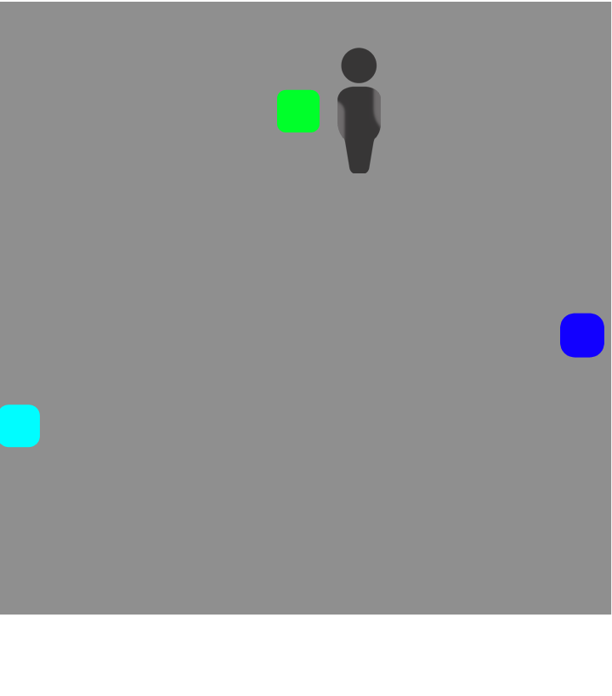
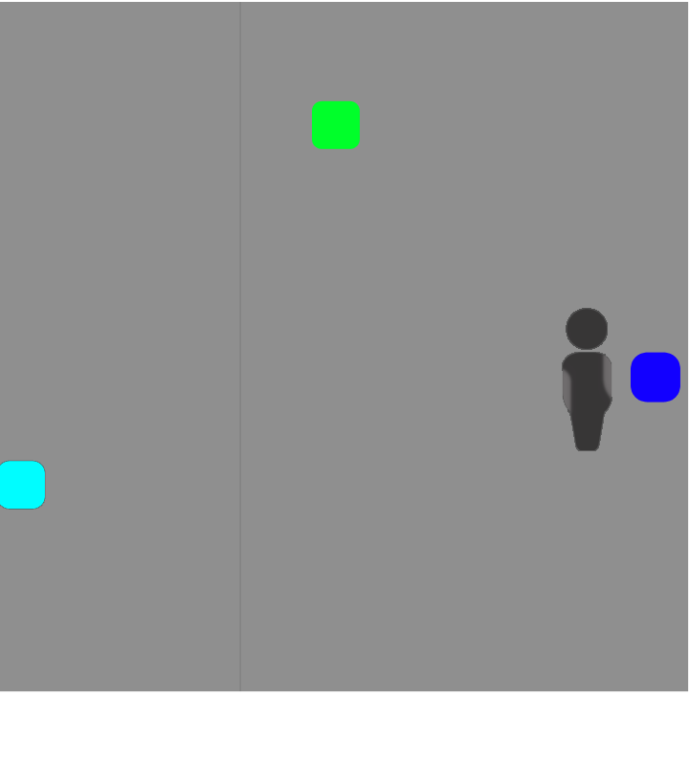
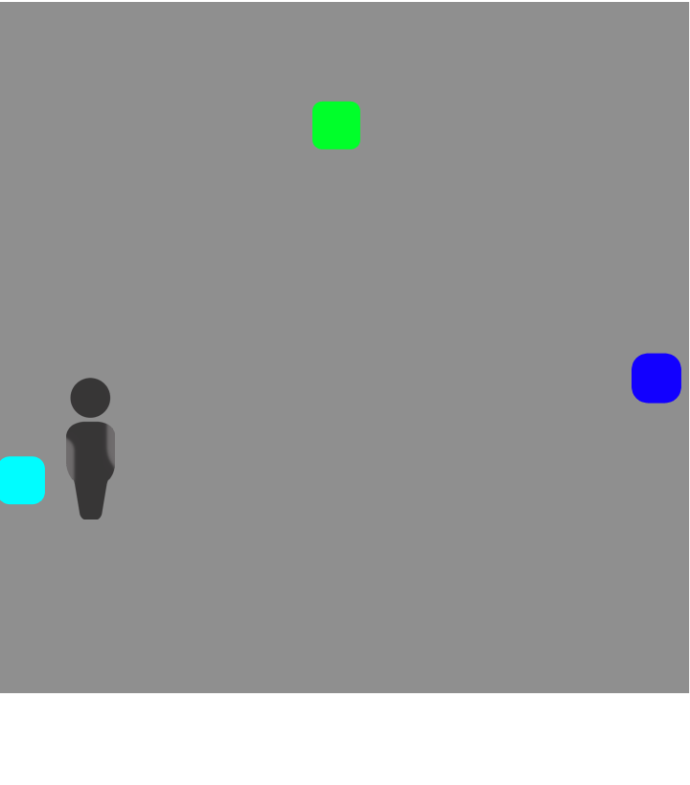
LBS Functions
Location-based Activities
User Location

Slide 31
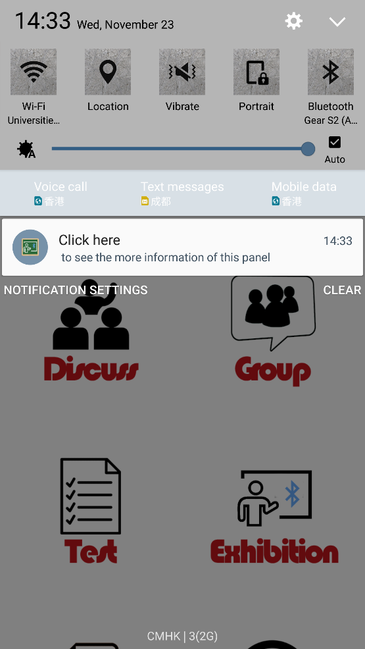
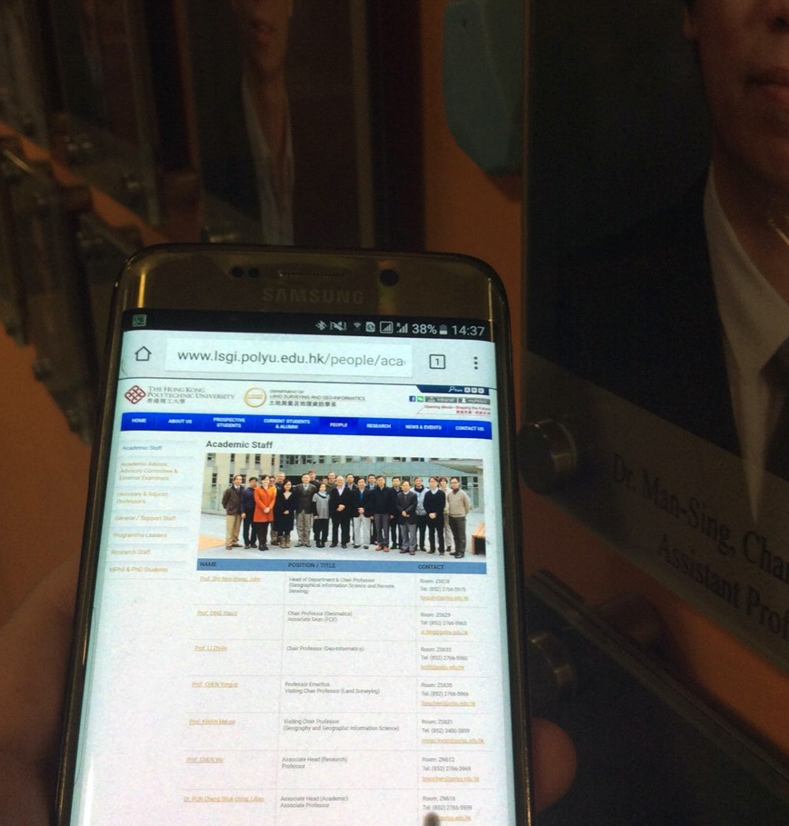
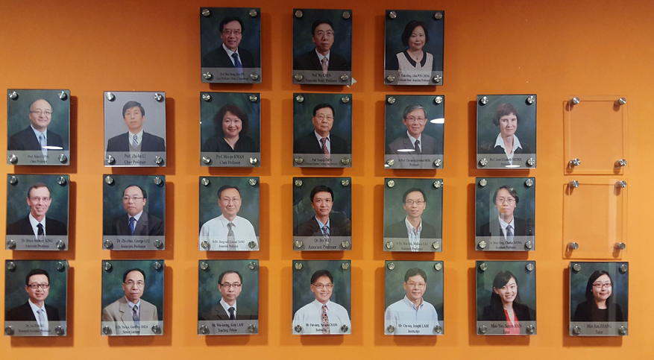

LBS Functions
Proximity Exhibition

Slide 32
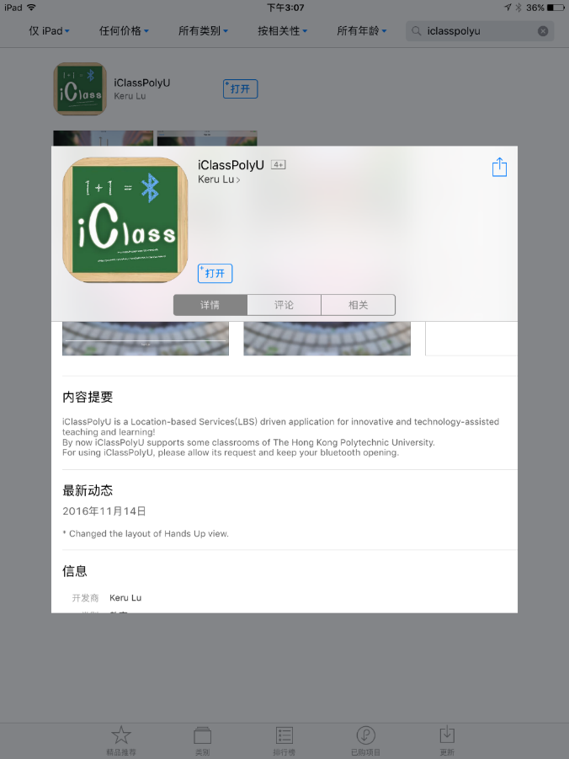
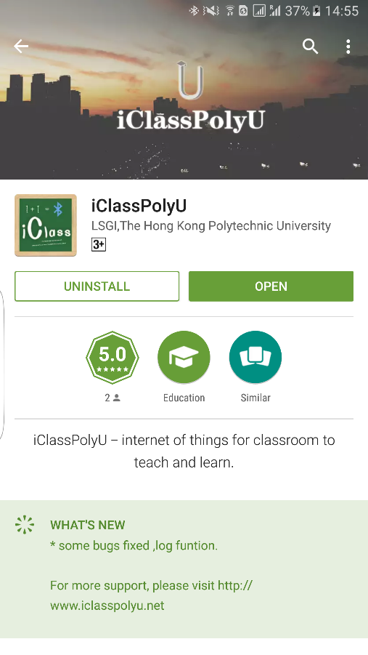
Conclusion
An integrated multi-platform teaching and learning system
Associated with Location-based Service (LBS) using iBeacon technology

Slide 33
Potential Applications
Location-based Driven Application for Innovative and Technology-assisted Teaching and Learning Practices
Smart Campus
Retail
Shops
Exhibitions
Indoor Navigation
Public Place

Slide 34

For more information on Geo-informatics, please join our free MOOC: Introduction to Urban Geo-Informatics
34
Notes:
If you would like more information on aspects of Geo-Informatics like Smart Cities and sensing technology, please join our introduction to urban geo-informatics online course through edx.

Slide 35
Thank You!
Notes:
Next step

Slide 36
References
  Zou, H., Jiang, H., Luo, Y., Zhu, J., Lu, X., & Xie, L. (2016). Bluedetect: An ibeacon-enabled scheme for accurate and energy-efficient indoor-outdoor detection and seamless location-based service.
  Sensors, 16(2), 268.
  Barapatre, A., Shelake, V., Pawar, G., & D.R., A. (2017). Smart College System using IoT BLE Beacons.
  Ijarcce, 6(4), 438-442. doi:10.17148/ijarcce.2017.6485
  Dirk, V. M., Galyna, T., Kostiantyn, P., Goncharov Y. (2015). Smart Campus based on iBeacon Technology.

