Slide 1
Implementing Open Source Educational Technologies At Xi’an Jiaotong-Liverpool University
eLearning Forum Asia 2018
Wednesday, May 23rd

Slide 2
Witamy
Benvenuto
Hoan nghênh
歡迎
Welkom
Suswagatam
Bem-vindos
أهلا وسهلا
Selamat datang
Fáilte
Καλώς ορίσατε
Добро пожаловать
Aloha
Welcome!
Karibuni
ยินดีต้อนรับ
환영합니다
Bienvenido
Bienvenue
Shushagatom
Velkommen
欢迎
Кош келиңиз
Тавтай морилогтун
Shalom
Hoşgeldiniz
ようこそ
Willkommen

Slide 3
About me:
Roland Sherwood
Manager, Educational Technologies
Institute of Leadership & Education Advanced Development (ILEAD)
Xi’an Jiaotong-Liverpool University
roland.sherwood@xjtlu.edu.cn

Slide 4
About us:
Founded in 2006
Largest joint-venture university in China; partnership between Xi’an Jiaotong University (China) and University of Liverpool (UK)
14,000 students; 1000 members of academic staff
English as a medium of instruction
Strong focus on the use of educational technologies to enhance learning, teaching and research activities

Slide 5
Open source educational technologies at XJTLU:
‘Open source software is software with source code that anyone can inspect, modify, and enhance.’
- opensource.com

Slide 7
Open source educational technologies at XJTLU:
‘Open source software is software with source code that anyone can inspect, modify, and enhance.’
- opensource.com

Slide 8
Open source educational technologies at XJTLU:
Flexibility
Cost
Data
privacy
Community

Slide 9
Flexibility:

Slide 10
Flexibility:
Customisation (functionality, look and feel, language, bug fixes, etc.)

Slide 11
Notes:
Replace hardware e.g. clickers, attendance

Slide 12
Flexibility:
Customisation (functionality, look and feel, language, bug fixes, etc.)
Integrations
Hosting freedom
Vendor support

Slide 13
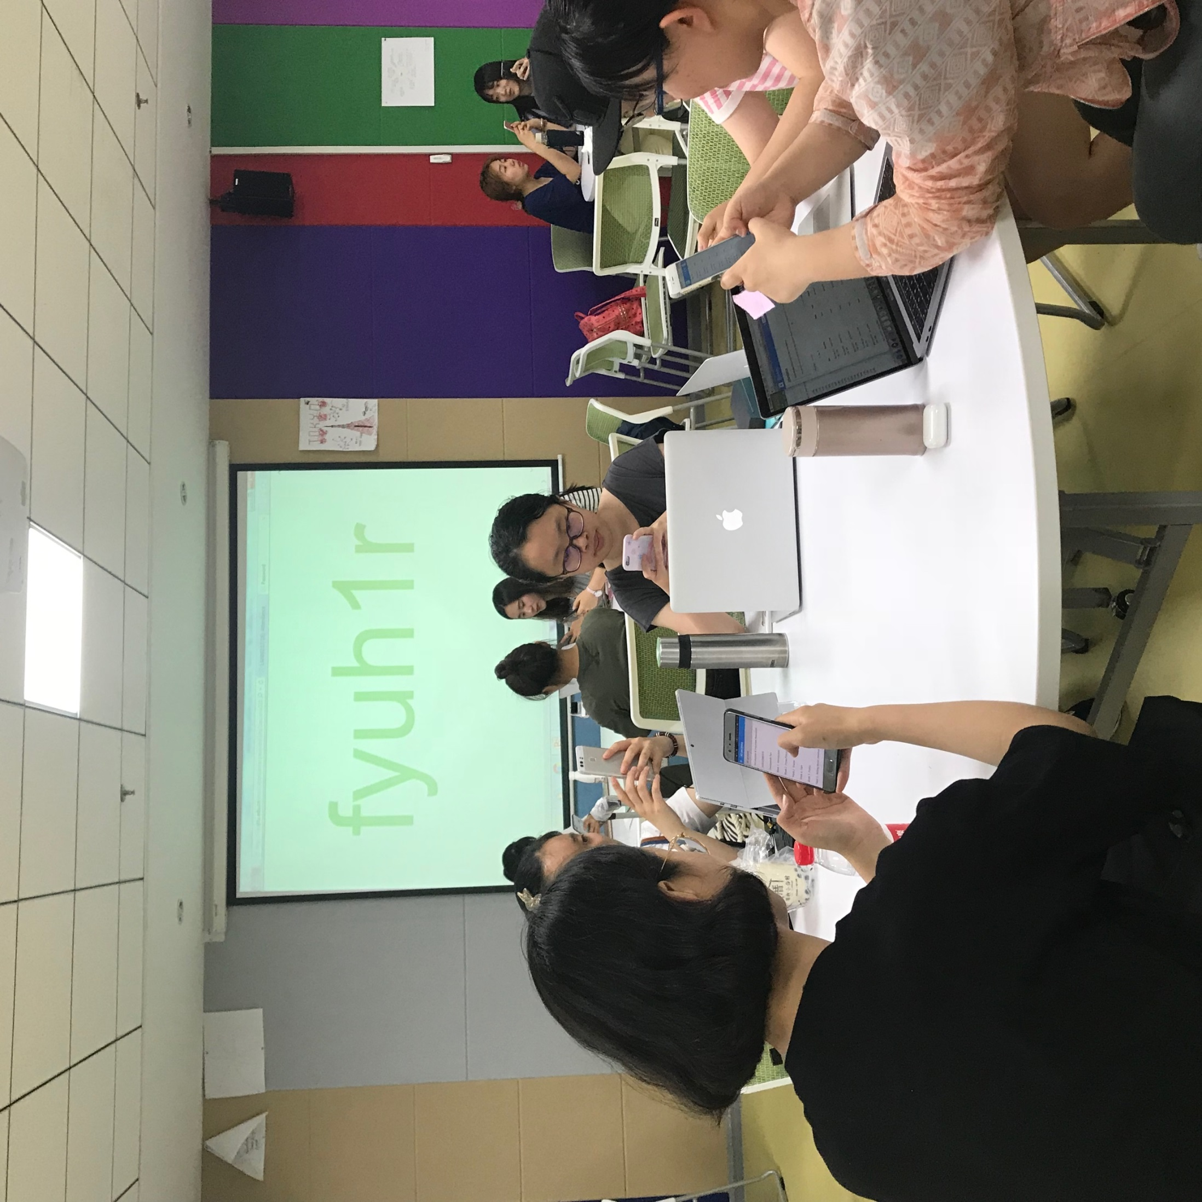
Notes:
Replace hardware e.g. clickers, attendance

Slide 14
Cost:
Open source software not “free”

Slide 15
Cost:
Open source software not “free”
$$$
$$$
$$$
$$$
$$$
License
Installation
Maintenance
Upgrades
Add ons
$$$
Total

Slide 16
Cost:
Open source software not “free”
+

Slide 17
Cost:
Open source software not “free”
Complex balance between variety of factors
Sometimes commercial solution is better option

Slide 19
Community:

Slide 20
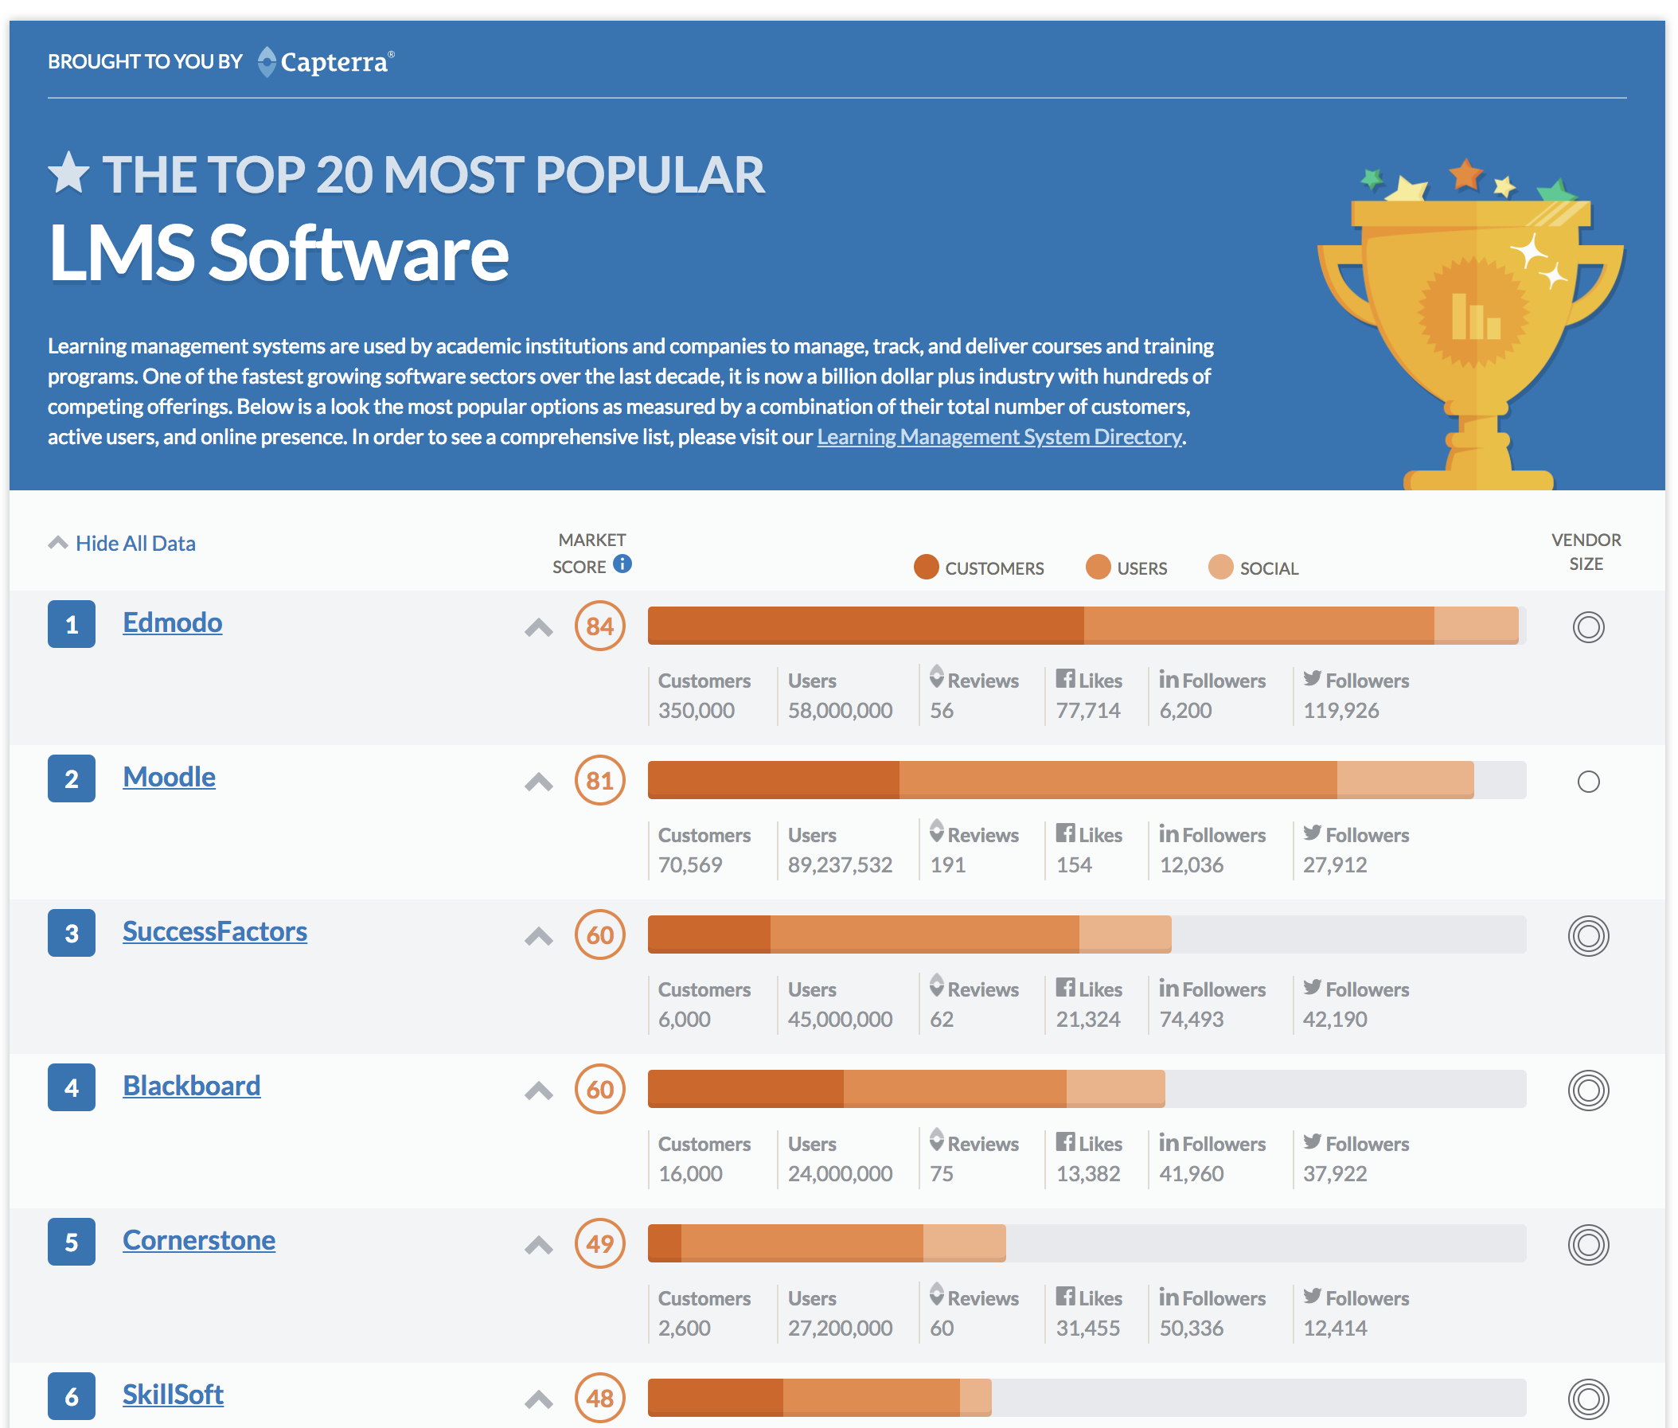
Source: Capterra – Nov. 2017
http://www.capterra.com/learning-management-system-software/#infographic

Slide 21
Community:
Support and sharing of knowledge (online and offline)
Contribute back as well as help shape the technology

Slide 22
Data privacy:

Slide 23
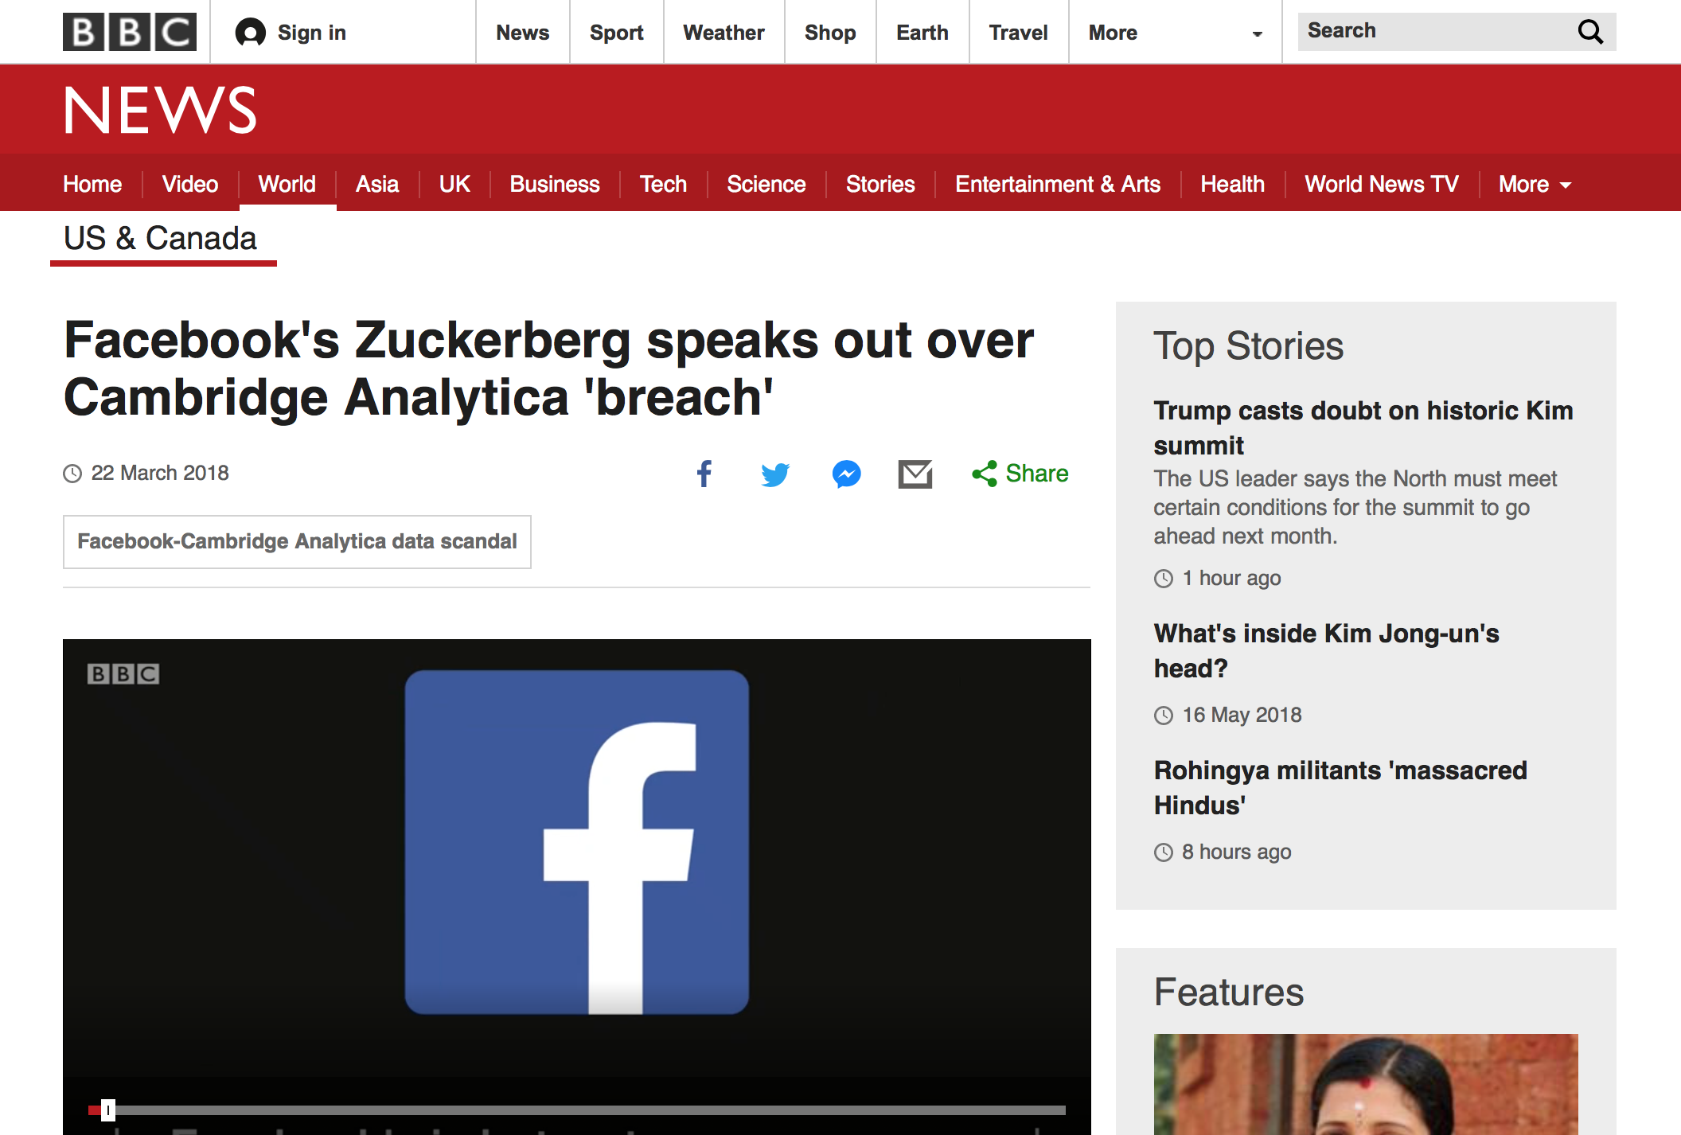

Slide 24
Data privacy:
Greater insight into what data is captured
Control over how data is stored and shared
Implications for learning analytics, distance learning

Slide 26
Open source educational technologies at XJTLU:
Moodle
Safe Exam Browser
BigBlueButton
Etherpad
Mahara
LimeSurvey
WebPA
Discourse

Slide 27
Q&A:
?

Slide 28
Go raibh maith agaibh
Teşekkür ederim
감사합니다
Dzięki
Danke
Toda
Ευχαριστώ
Tak
Asante
謝謝
Баярлалаа
Thank you!
Gracias
ขอบคุณ
どうも
Obrigado
Kia ora
唔該
Mahalo
Спасибо
Grazie
Dank u
ممنونم
مہربانی
Terima kasih
Рахмат
Merci
Cảm ơn ông

